Slide 1
A Case for the Existence of God for Jewish Secularists

Slide 2
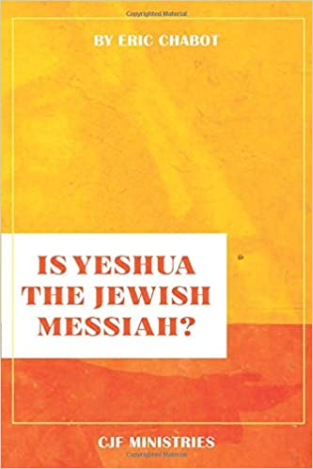
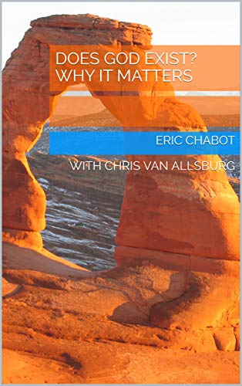
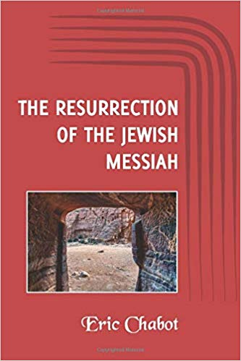
Resources
1. Thinkapologetics.com
2. Eric Chabot You Tube Channel: Has teachings from meetings on campus
3. Books

Slide 3
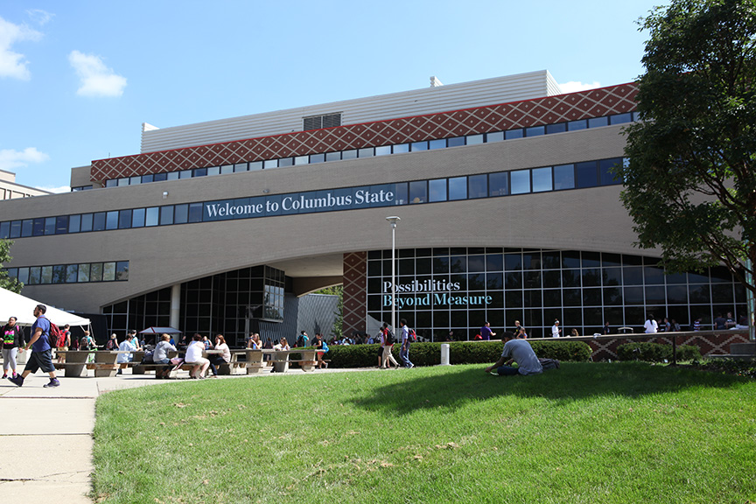
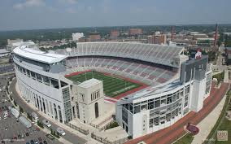
Evangelizing, Equipping, and Educating at The Ohio State University and Columbus State Community College
Columbus State Community College, 30,000 Students
The Ohio State University, 64,000 students

Slide 4
Biblical faith is trust or confidence in God/the Messiah that is based on knowledge or good reasons.
Think about every commitment you have made? Who you married, where to live, what job to take, what to eat, what repair shop to use, where to vacation, how to invest your money, where you go to church.
Do you have good reasons or any reasons for committing to these things?

Slide 5
Yes, the apostles gave reasons for their beliefs
Paul wrote of ‘defending and confirming the gospel’ (Philippians 1:7)
Paul ‘reasoned . . . explaining and proving from the Scriptures the Messiah had to suffer and rise again from the dead’ (Acts 17:2–3)
‘Every Sabbath [Paul] reasoned in the synagogue, trying to persuade Jews and Greeks’ . . . (Acts 18:4).
Peter commands us to ‘always be prepared to give an answer to everyone who asks you to give the reason for the hope that you have . . . with gentleness and respect’ (1 Peter 3:15)

Slide 6
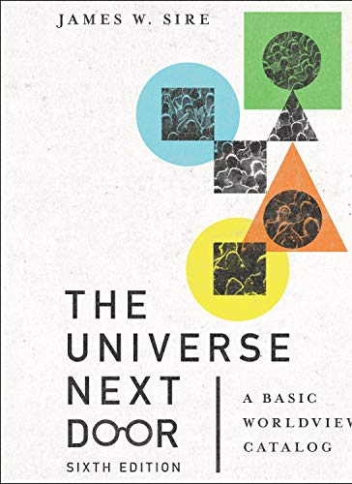
1. Your faith needs to be more than just a personal relationship with the Messiah!
2. James Sire says our worldview is our “set of presuppositions about the basic makeup of our world.”
.”

Slide 8
Secularism:
An atheistic and materialistic worldview that advocates for a public society free from the influence of religion.
Secularists’ concern is for the current age (as opposed
to eternity) and human beings (as opposed to God).
Secularists seem to believe that all public considerations—education and government, primarily—must be based on materialism, the idea that only the physical world exist.

Slide 9
Secularism
Atheism: a philosophical or religious position characterized by disbelief in the existence of a god or any gods.
Materialism: a theory that all being and processes and phenomena can be explained as manifestations or results of matter.
Naturalism: a theory denying that an event or object has a supernatural significance.

Slide 12
Pew Research Center: Jewish Americans in 2020
“Overall, about a quarter of U.S. Jewish adults (27%) do not identify with the Jewish religion: They consider themselves to be Jewish ethnically, culturally or by family background and have a Jewish parent or were raised Jewish, but they answer a question about their current religion by describing themselves as atheist, agnostic or “nothing in particular” rather than as Jewish. Among Jewish adults under 30, four-in-ten describe themselves this way.”

Slide 13
Prolific Jewish Atheists

Slide 14
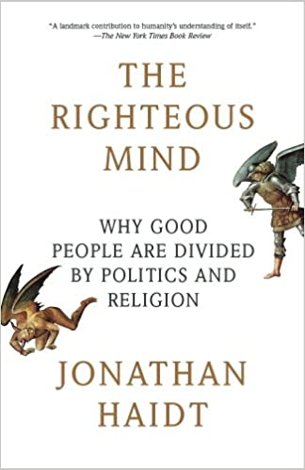
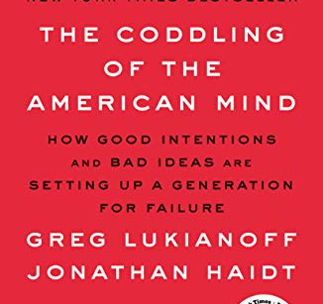
A professor of ethical leadership at NYU’s Stern School of Business, Haidt calls himself a “Jewish atheist.”

Slide 15
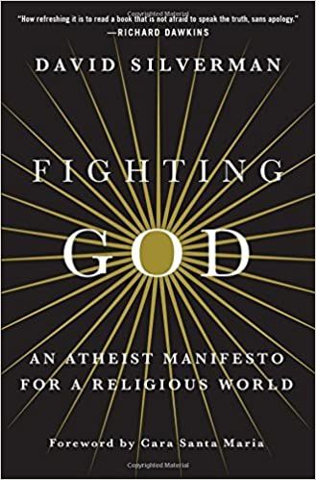
David Silverman
1. Born in a middle-class Reform Jewish family in Marblehead, Massachusetts.
2. Went to Hebrew school and had his bar mitzvah at age 13.
3. Was president of American Atheists from 2010 to 2018.

Slide 16
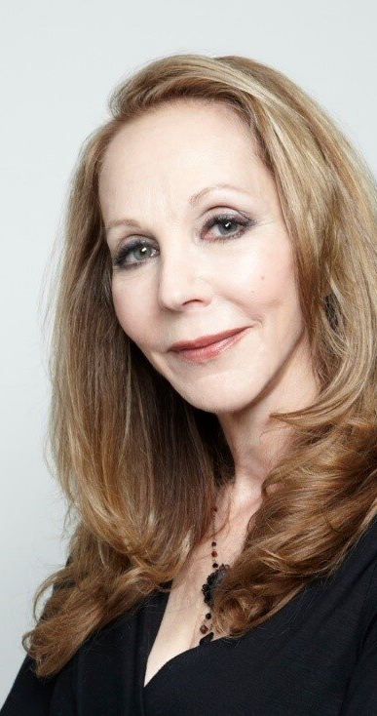
Rebecca Goldstein
American philosopher, novelist, and public intellectual.
Raised Orthodox. Became an atheist at end of undergraduate work.

Slide 17
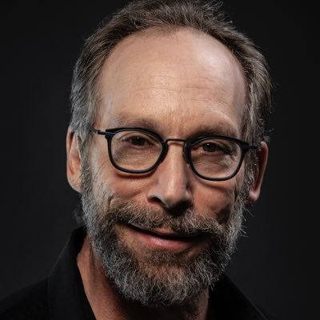
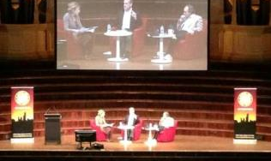
Author of A Universe from Nothing: Why There is Something Rather than Nothing
Debated William Lane Craig in April, 2013.
Lawrence Krauss is an American theoretical physicist and cosmologist.

Slide 18
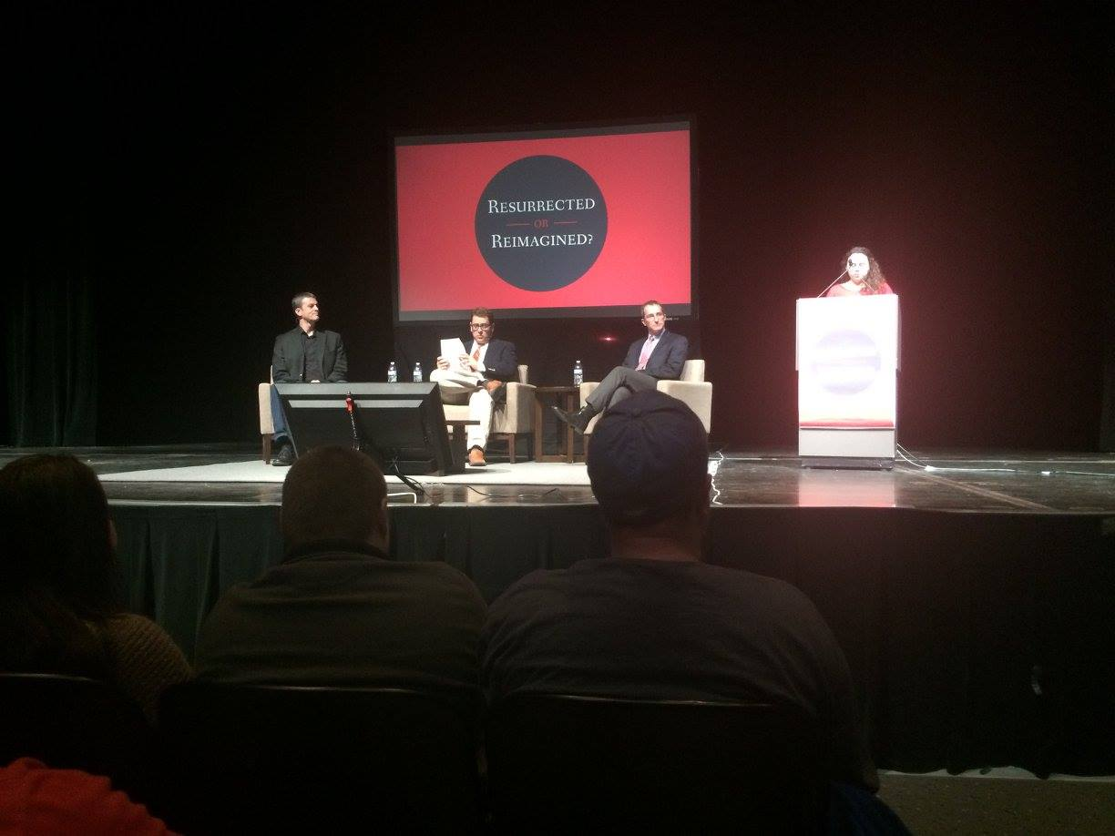
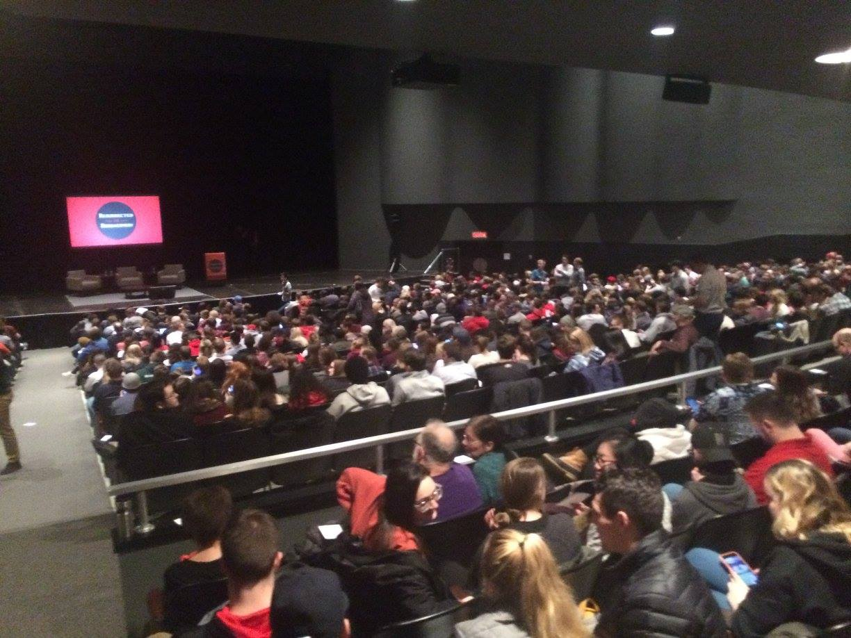

Slide 19
What’s your truth language?

Slide 20
But many Jewish people are post modern and we live in a post truth culture?

Slide 21
We want true bank statements
We want true prescriptions from our doctors
We want our teachers/professors to give us true instructions
We want our friends and family members to tell us the truth
We want our politicians to tell the truth
We want the true instructions on how to use something we purchase

Slide 22
And we all know:
1. Everyone seems to care about getting truthful and factual information about Covid!

Slide 23
God’s Existence Impacts:
1. The way we view reality
2. How we define and attain knowledge
3. Morality/Ethical choices
4. Origins: Where do we come from?
5. Destiny: Where are we going? 6. How we explain the human condition 7. Why is there suffering/evil in the world?

Slide 24
Truth Language: Dealing with the Scientific/Empirically Minded Jewish person

Slide 25
Alex Rosenberg says
“ The methods of science are the only reliable ways to secure knowledge of anything” – as the only rational ideology one could possibly hold in the face of what science tells us about the way the world is.”

Slide 26
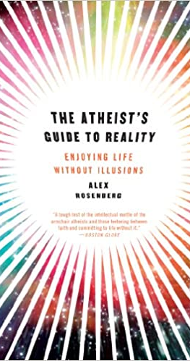
1. Is there a God? No.
2. What is the nature of reality? What physics says it is.
3. What is the purpose of the universe? There is none.
4. What is the meaning of life? Ditto.
5. Why am I here? Just dumb luck . . .
6. Why should I be moral? Because it makes you feel better than being immoral.

Slide 27
Rosenberg says
“ The methods of science are the only reliable ways to secure knowledge of anything” – as the only rational ideology one could possibly hold in the face of what science tells us about the way the world is.”

Slide 28
Science is restricted to only look for material/physical explanations to reality.
Science doesn’t deal with the big metaphysical questions.
We need other tools such as philosophy and theology.

Slide 29
1. If metal detectors discover only coins and other metallic objects, than reality only consists of things that are metal?

Slide 30
WHAT SCIENCE CAN'T PROVE: Dr. William Lane Craig explains to Dr. Peter Atkins
https://www.youtube.com/watch?v=BQL2YDY_LiM

Slide 31
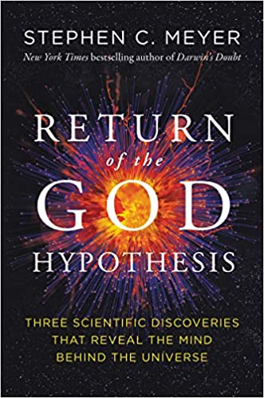
1. The beginning of the universe
2. The design/fine tuning of the universe
3. The origin of the information in
DNA needed to build the first living cell
4. Meyer’s arguments point to theism (a personal God), not deism, pantheism, or materialism.

Slide 33
NO WAY!
1. The universe was produced by mindless, undirected, nonconscious, nonmoral processes.
2. Human beings were produced by an undirected, valueless process.
3. Life somehow emerged from nonliving matter.
4. All the cosmic constants just happened to be right; given enough time and/or many possible worlds, a finely tuned world eventually emerged.

Slide 34
The Jewish Agnostic
“I just don’t think we can know if a personal God exists”
“How can we know?”

Slide 35
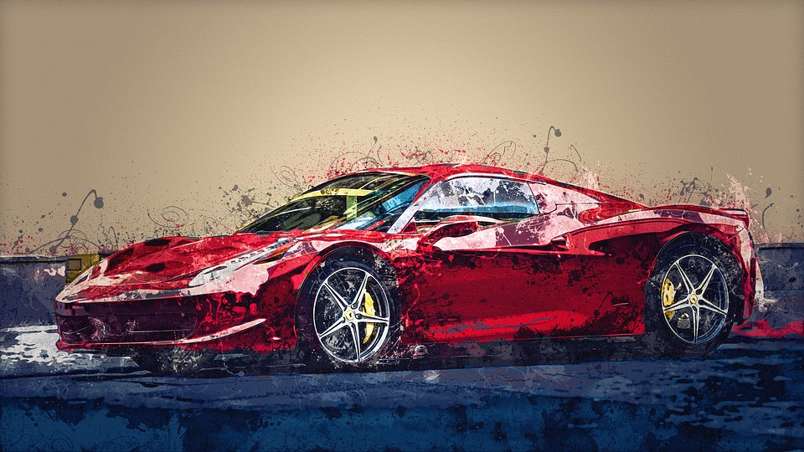

Slide 36
REMEMBER:
None of these things are directly visible to us. 1) Electrons
2) Protons
3) Neutrons
4) Individual atoms
5) Electric Fields
6) Magnetic Fields
7) Gravitational fields
8 ) Justice
9) Consciousness of other human beings
10) The wind.

Slide 37
Correct!
“We similarly infer the existence of God from his effects in the world which are all around us.”

Slide 38
“For the wrath of God is revealed from heaven against all ungodliness and unrighteousness of men, who by their unrighteousness suppress the truth. For what can be known about God is plain to them, because God has shown it to them. For his invisible attributes, namely, his eternal power and divine nature, have been clearly perceived, ever since the creation of the world, in the things that have been made. So, they are without excuse.” – Romans 1: 18-20.
.

Slide 39
Truth Language The Jewish Atheist Who’s Concerned About Justice, Equality and Rights

Slide 40
Jewish Values
1. Tikkun Olam: In Jewish teachings, any activity that improves the world, bringing it closer to the harmonious state for which it was created.
2. Pursue justice, equality, rights for people.

Slide 41
“I WANT A WORLD OF JUSTICE, FAIRNESS, AND EQUALITY!”
This assumes the person knows how things ought to be because there is a standard of goodness (a corruption or absence of goodness), by which we judge something.

Slide 42
1. I want to work towards a better world
(Who gets to define better?)
2. I want to help people and work for equality, rights for humans!
(Why do people matter?)

Slide 43
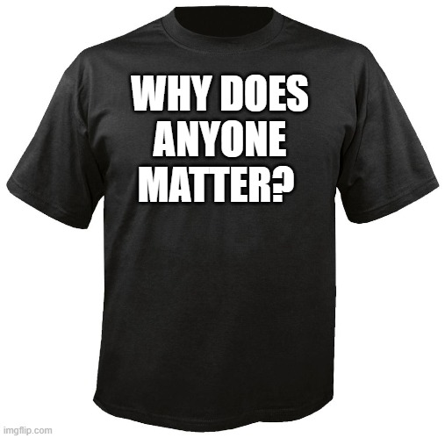

Slide 44
Do we have intrinsic value, dignity, and rights because we bear the image of a personal God?
Is man an accident of nature, and ultimately only a higher form of an animal, and the highest authority we have access to is each other, that the only source for truth we have is science!

Slide 45
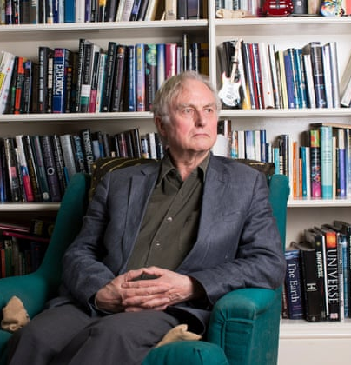
“In a universe of blind physical forces and genetic replication, some people are going to get hurt, other people are going to get lucky, and you won’t find any rhyme or reason to it, nor any justice. The universe we observe has precisely the properties we should expect if there is at bottom, no design, no purpose, no evil, and no good. Nothing but blind pitiless indifference, DNA neither knows or cares. DNA just is. And we dance to its music.”
- Richard Dawkins, River Out of Eden: A Darwinian View of Life (New York City: Basis Books, 1992), 133.

Slide 46
As a secularist, I think :
3. I am morally obligated to help the world become a better place, and I am morally obligated to fight for equality, justice, and rights. Why?

Slide 47
1. “That’s not fair”
2. “That’s not
right”
PEOPLE WILL SAY:
3. “I want justice”
4. “That’s morally wrong”
5. “That’s evil”
6. “What the heck is wrong with people?”

Slide 48
The complaints assume people know:
1. The difference between what is fair and unfair.
2. The difference between what is just and unjust.
3. The difference between what is morally right and morally wrong.
4. The difference between what is evil and good.

Slide 49
People seem to appeal to a moral standard that is being violated?
1. A Standard – provides a measure of good/bad, right/wrong.​ -But where does the standard come from?
-Is there an authority – someone/thing that has the right to impose the standard and enforce adherence?

Slide 50
I have my own set of moral values and moral duties!
I determine why and what people group has value, dignity, and rights!
The Individual
(Subjective)
.
I have my own standard for what the world should look like!
I determine what happiness is!
Notes:
MAIN POINT:
Take the time to go through Simon Greenleaf’s background and The Rules of Evidence Administered in the Courts of Justice. Emphasize the fact that he has been considered one the most outstanding professors responsible for helping Harvard Law School gain an eminent standing among the legal schools in the United States and that his work A Treatise on the Law of Evidence is still considered the greatest single authority on evidence in the entire literature of legal procedure.
You may want to assign a student to summarize this section.

Slide 51
Why humans have moral values and moral duties
Why all people have equality, dignity, value , and rights
God/Transcendent Source
(Objective)
.
The standard for what the world should look like
Determines what real happiness is
Notes:
MAIN POINT:
Take the time to go through Simon Greenleaf’s background and The Rules of Evidence Administered in the Courts of Justice. Emphasize the fact that he has been considered one the most outstanding professors responsible for helping Harvard Law School gain an eminent standing among the legal schools in the United States and that his work A Treatise on the Law of Evidence is still considered the greatest single authority on evidence in the entire literature of legal procedure.
You may want to assign a student to summarize this section.

Slide 52
Truth Language
Identity can be related to these questions:
1. What are my loves? 2. With what or whom am I intimate? 3. What are my loyalties? 4. What causes me to commit my time and energy? 5. Toward what am I aiming my life? What is success?

Slide 53
What others think of me (external factors, can’t be controlled)
What society says about me, (external factors, can’t be controlled)
My Core Identity is defined by:
.
Job/possessions (external factors, can’t always be controlled)
Relationships (external factors, can’t be controlled)
Notes:
MAIN POINT:
Take the time to go through Simon Greenleaf’s background and The Rules of Evidence Administered in the Courts of Justice. Emphasize the fact that he has been considered one the most outstanding professors responsible for helping Harvard Law School gain an eminent standing among the legal schools in the United States and that his work A Treatise on the Law of Evidence is still considered the greatest single authority on evidence in the entire literature of legal procedure.
You may want to assign a student to summarize this section.

