Slide 1
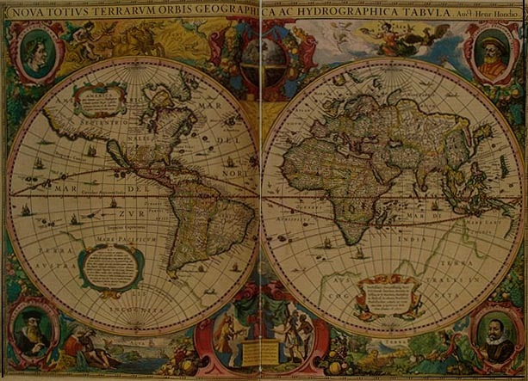
Mapping Contemporary Views on Israel-Palestine

Slide 2
Part I: The Mainstream Jewish Community

Slide 3
The American Jewish Community
The pew foundation:
A portrait of jewish americans

Slide 4
A Portrait of Jewish Americans

Slide 5
A Portrait of Jewish Americans
61%

Slide 6
American Jews: Divided
“To AIPAC, J Street is beyond the pale of ‘pro-Israel,’ more critical of Israel’s actions than those of its enemies. To J Street, AIPAC represents an old American perception of pro-Israel, ignorant of the beliefs and sentiments of both the younger generation of American Jews and of the majority of Israelis.”
—Charles Kopel, Moment Magazine, 2012

Slide 7
American Jews: Divided
“In these different perspectives lies the flaw of each lobby group’s repertoire: a deep transgression of omission. AIPAC presents what Israel is on paper, and what the concept of Israel looked like in 1948 (with, of course, a great deal of accolades for the small nation’s start-up miracles and high-tech achievements), but says nothing of the real status of Arabs in Israeli society, of the women who are made to ride in the back of buses in Haredi communities.”
—Charles Kopel, Moment Magazine, 2012

Slide 8
American Jews: Divided
“J Street presents what is supposedly a liberal Zionist ideal, and a genuine effort to save the soul of Israel. Its narrative seems, however, to include no room to blame anyone but the Likud-led coalition for Israel’s misfortune. No recognition of rocket fire from Gaza on Israeli civilians.”
—Charles Kopel, Moment Magazine, 2012

Slide 9
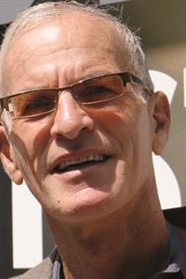
Anti-Zionist Jewish Intellectuals
Norman finkelstein
Noam chomsky

Slide 10
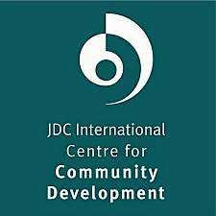
The European Jewish Community
JDC International Centre for Community Development

Slide 11
European Jews
“As regards subgroup differences, Eastern Europeans see the main future threats as the alienation of Jews from the Jewish community life and the lack of effective assistance from Jewish organizations abroad. Western Europeans, on the other hand, are more likely to consider anti-Semitism as a threat than are Eastern European (30% vs. 14%).”

Slide 12
European Jews: Strong Agreement?

Slide 13
Israeli Jewish Community

Slide 14
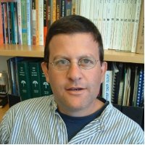
Israeli Jewish Community
“What’s striking is that the Israeli public seems to have lost interest with the Palestinian question — the general feeling is that it’s like the weather, nothing you can do about it.”
— Guy Ben-Porat, Dept. of Public Policy and Administration, Ben Gurion University

Slide 15
Israeli Jewish Community
Oxford Research Group Study, 2006–2009
“The proposals that the group developed were not so much linked to the problems of Gaza and the West Bank, but were more related to what the future state would look like, and the distinction between Jewishness (cultural Jewish identity), Zionism (national Jewish identity) and Judaism (religious Jewish identity). The social fragmentation of Jewish Israeli society became the main concern of the discussion.”

Slide 16
Part II: The Mainstream Palestinian Community

Slide 17
Mainstream Palestinian Views
Oxford research group
Palestinian Center for Policy
and Survey Research
The washington institute

Slide 18
Oxford Research Group (Palestine Strategy Group section)
“The starting point for this report is the near-consensus in the PSG that the option of ending the conflict with Israel through bilateral negotiations — which the Palestinian leadership has pursued for 20 years — is not available given the intransigence of the present Israeli government. . . . “

Slide 19
Oxford Research Group (Palestine Strategy Group section)
Scenarios acceptable to many or most Palestinians are:
Sovereign Palestinian state, 1967 borders, Jerusalem as its capital
Single bi-national state
Single democratic state
Jordan-Palestinian state confederation

Slide 20
Oxford Research Group (Palestine Strategy Group section)
Scenarios not acceptable to many or most Palestinians are:
Status quo
Palestinian state controlled by Israel
Unilateral separation by Israel, Palestinians still controlled
Egypt absorbs Gaza and/or Jordan absorbs West Bank

Slide 21
Palestinian Center for Policy and Survey Research

Slide 22
Palestinian Center for Policy and Survey Research

Slide 23
Palestinian Center for Policy and Survey Research

Slide 24
The Washington Institute: If the Palestinian leadership negotiates a two-state solution with Israel, do you think that will be . . .

Slide 25
Part III: The Christian Community

Slide 26
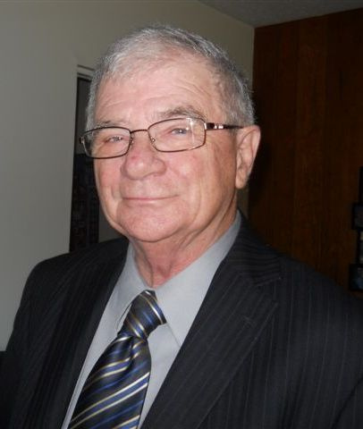
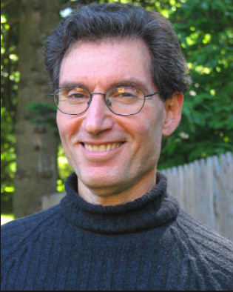
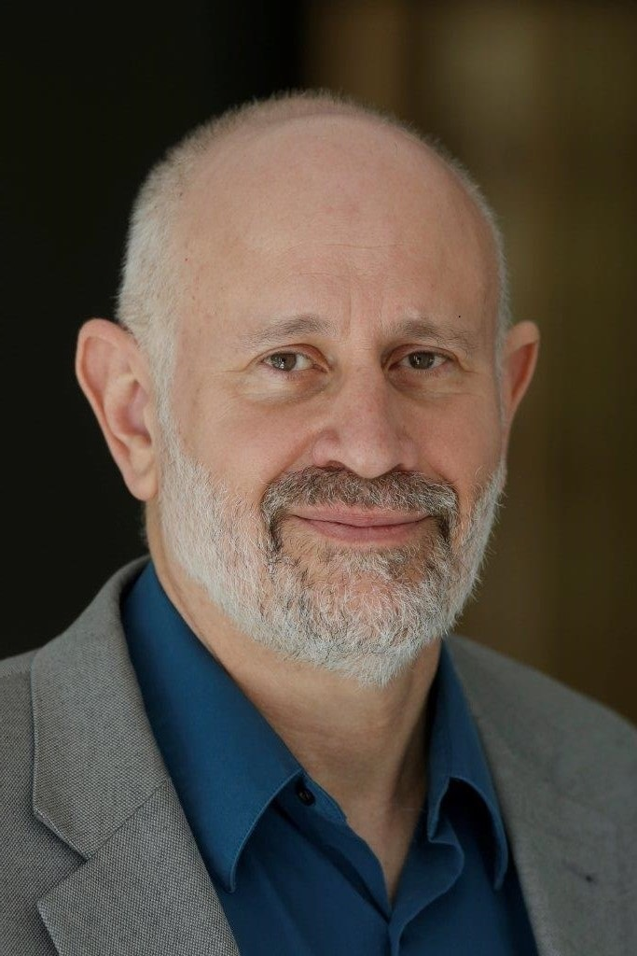
The Christian Community
STEPHEN SPECTOR
PAUL MERKLEY
YAAKOV ARIEL

Slide 27
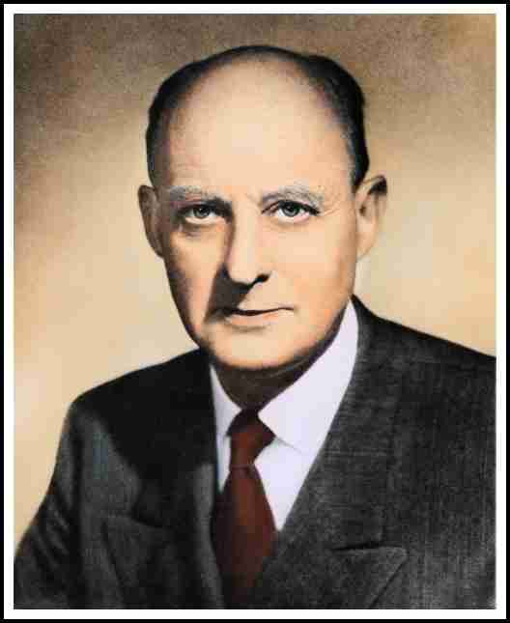
Key Christian Supporter After 1948: Reinhold Niebuhr

Slide 28
Paul Merkley
In 1947–48, that part of the Church in the West that is today called “fundamentalist” or “evangelical” was overwhelmingly supportive of the Zionist solution to the Jewish problem. The rest of the Protestant church (what is generally spoken of today as “the mainstream”) was mostly well disposed, but with many dissenters. The Roman Catholic church had powerful objections but did not feel able, in the light of the general humanitarian advantage that the Jewish cause briefly held in the immediate wake of the war, to compel nations with Roman Catholic populations to oppose.

Slide 29
Paul Merkley
Yet almost immediately after the initial decisions were taken, these latter two constituencies (mainstream Protestants and Roman Catholic) shifted into the ranks of those denouncing the new state — and eventually became overwhelmingly hostile. Had the voting on the partition of the Palestine Mandate taken place five or ten years later, the Jewish state would not have come into existence.

Slide 30
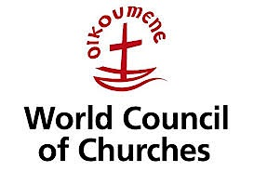
Paul Merkley

Slide 31
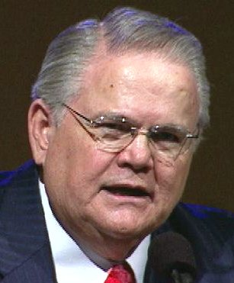
Paul Merkley
John Hagee

Slide 32
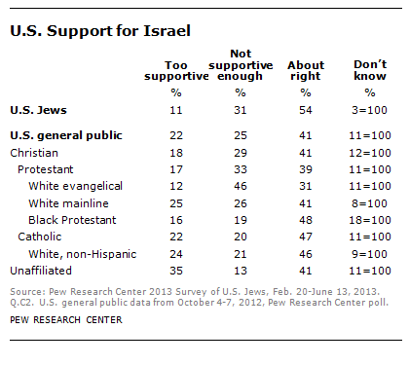
Survey Results: Christian Views of Israel

Slide 33
Survey Results: Christian Views of Israel

Slide 34
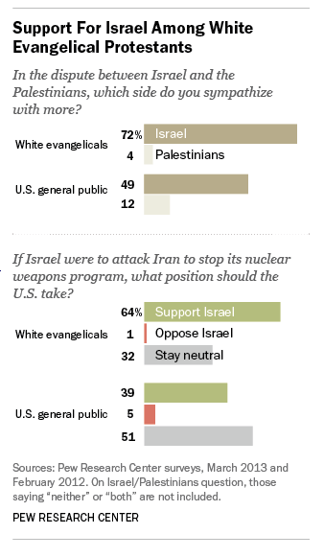
Survey Results: Christian Views of Israel

Slide 35
Survey Results: Christian Leaders’ Views of Israel
39%
34%

Slide 36
Survey Results: Christian Leaders’ Views of Israel
49%

Slide 37
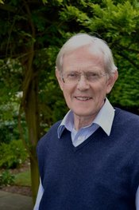
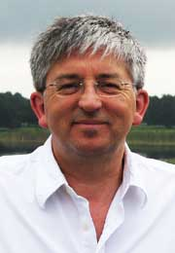
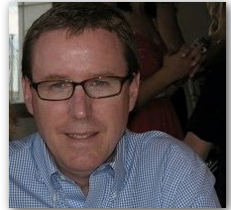
Some anti-(Christian) Zionism evangelical voices
Gary burge
Colin chapman
Stephen sizer

Slide 38
The Boycott, Divestment, and Sanctions Movement (BDS)

Slide 39
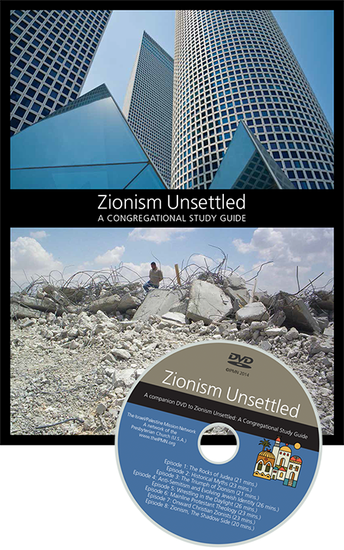
The Boycott, Divestment, and Sanctions Movement (BDS)

Slide 40
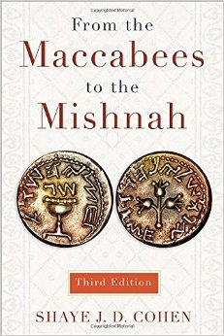
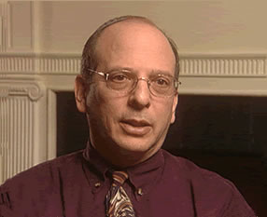
The Boycott, Divestment, and Sanctions Movement (BDS)

Slide 41
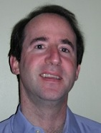
The Boycott, Divestment, and Sanctions Movement (BDS)
Jon HaBER

Slide 42
The Boycott, Divestment, and Sanctions Movement (BDS)

Slide 43
The Boycott, Divestment, and Sanctions Movement (BDS)
United methodist church
Evangelical lutheran church in canada
United church of canada

Slide 44
Part IV: Messianic Jewish Views

Slide 45
Israeli Messianic Jews
Poll of 80 Israeli messianic leaders

Slide 46
Israeli Messianic Leaders: Possibility of Peace

Slide 47
Israeli Messianic Leaders: Best Solution

Slide 48
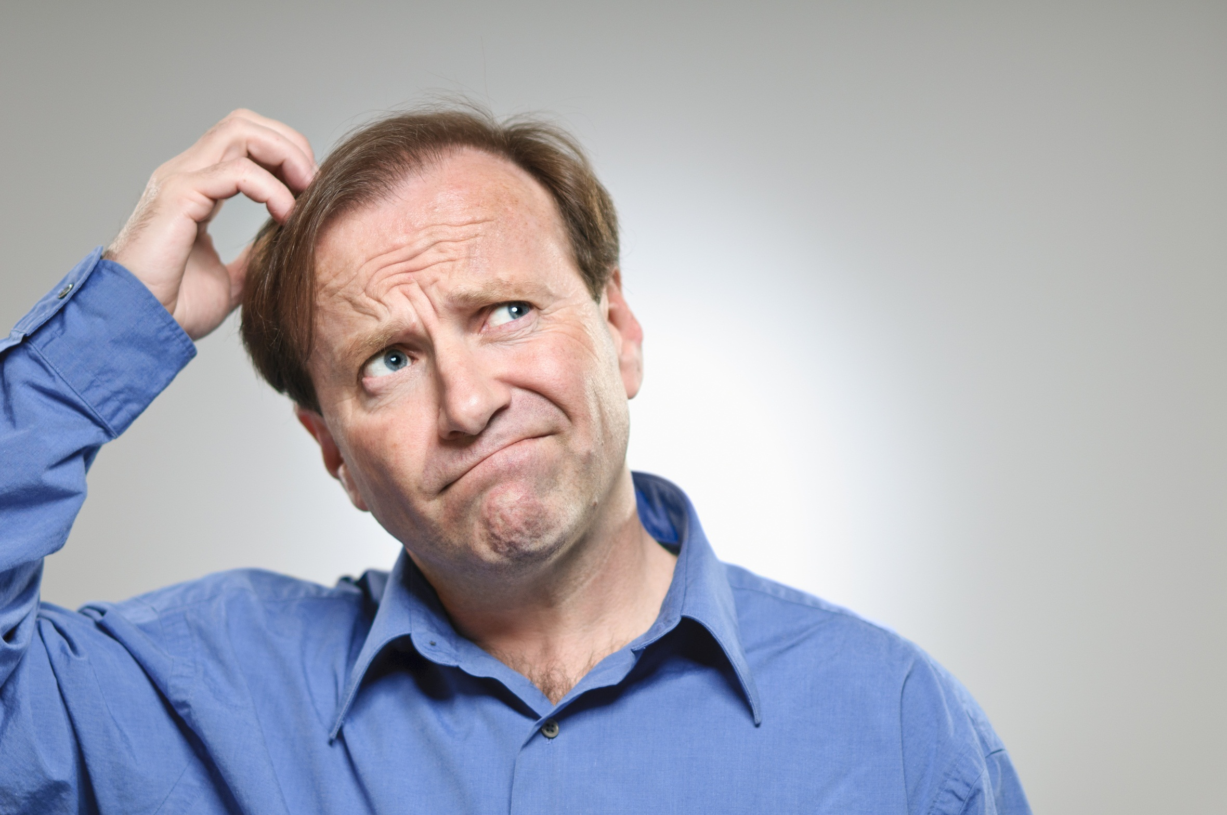
North American Messianic Jews

Slide 49
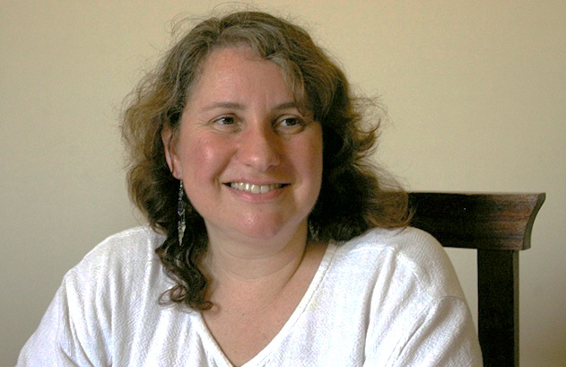
A Messianic Jewish Voice About the Palestinians
JUDITH MENDELSOHN ROOD, “A Reflection Upon our Witness in the Muslim World,” Mishkan (2008)

Slide 50
Judith Rood
On “the determination of Arab Christians to remain committed to Arab and Palestinian nationalism in the face of radical Islam”:
“It gives one pause to read that Christian Arabs have joined the “Islamic” al-Aqsa Brigade in response to the failure of the Oslo Peace Process to end the occupation of the future Palestinian state. By weakening Palestinian Christians, the policies of both Israel and the Palestinian Authority have drive them away in search of safety and a future — and radicalized those who stay.”

Slide 51
Judith Rood
“Christian Arabism and Christian Zionism thus divide the body and inflame the political conflict . . . In defending the failings of Israel and Palestine, we do no one any favors. It is critically important that we bring these issues to the forefront, so that with prayer and intercession we can find effective ways to fight the rabid anti-Semitic images and rhetoric disseminated throughout the world by the Islamist media, and seek justice for both Palestinians and Israelis.”

Slide 52
Part V: Arab Christian Views

Slide 53
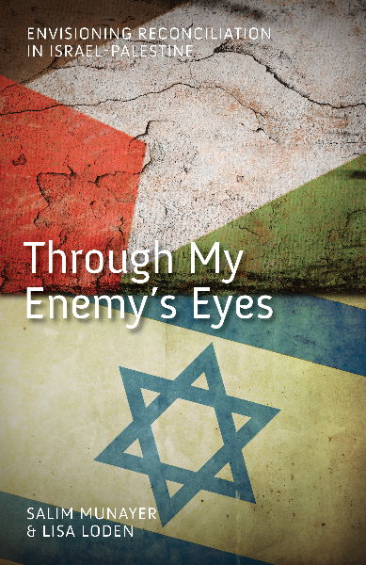
Voices of Dialogue, Balance and Reconciliation
An Arab christian and a
messianic jewish viewpoint
Salim munayer & lisa loden

Slide 54
Salim Munayer: Through My Enemy’s Eyes
Significant challenges face this [Palestinian Christian] community. First, Palestinian Christians need to find a way of dealing with the Jewish people and the state of Israel in a way that does not invalidate the historical and religious attachment the Jewish people have to the Holy Land but that also confidently asserts Palestinians’ legitimate attachment.

Slide 55
Salim Munayer: Through My Enemy’s Eyes
Second, Palestinian Christians need to learn to relate to Islam in a way that addresses the differences between Christianity and Islam frankly, but that also avoids ‘Islamophobia’ and hatred of Muslims.

Slide 56
Salim Munayer: Through My Enemy’s Eyes
Third, Palestinian Christians need to address the hermeneutical threat posed by the Christian Zionist and some Messianic Jewish approaches to the Bible that claim exclusive, ethnically Jewish ownership of the land.

Slide 57
Salim Munayer: Through My Enemy’s Eyes
Finally, Palestinian Christians need to re-evaluate their communal identity, especially in light of the growing numbers of Muslim-background believers and the increasing ethnic diversity of the Christian population in the Holy Land, due to the influx of immigrants from Russia and Ethiopia, along with other foreign national workers.

Slide 58
Lisa Loden: Through My Enemy’s Eyes
Given the ongoing Israeli–Palestinian conflict, it is understandable that the Messianic community should choose to identify itself as a part of the nation of Israel. The difficulty is that national identity can become confused with the principal spiritual identity of being members of the trans-national, trans-ethnic, trans-cultural body of Messiah of which there are also members from the ‘enemy’ community.

Slide 59
Lisa Loden: Through My Enemy’s Eyes
In the main, the Israeli Messianic community is apathetic regarding issues of injustice that are the daily fare of their Palestinian brothers and sisters. Messianic Jews’ preoccupation with their own community and its issues tends to overshadow active engagement with the volatile issues of justice, human rights and peace that are vital for their Palestinian brothers and sisters. . . The predominant eschatological understandings of the Israeli Messianic Jew (referred to earlier) can preclude any realistic grappling with difficult issues . . .

Slide 60
An Influential Voice
Naim ateek and the sabeel ecumenical liberation theology center

Slide 61
An Important Document

Slide 62
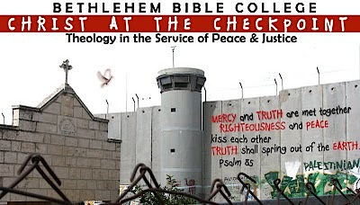
Christ at the Checkpoint

Slide 63
Other Conferences
Impact: holy land
Lausanne Initiative for
Reconciliation in Israel/Palestine
Borough park symposium

Slide 64
Impact: Holy Land

Slide 65
Lausanne Initiative for Reconciliation in Israel/Palestine

Slide 66
Borough Park Symposium

Slide 67
Part VI: The (Mostly) Secular World

Slide 68
The (Mostly) Secular World
FUTURE AMERICAN LEADERS:
SURVEYED BY THE ISRAEL PROJECT
THE GERMAN PUBLIC:
SURVEYED BY THE
BERTELSMANN FOUNDATION

Slide 69
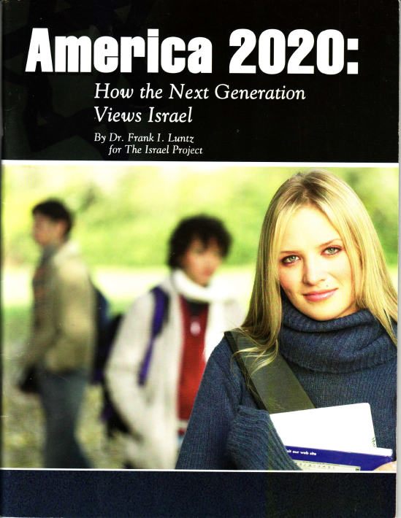
Future American Leaders: The Israel Project
Frank I. Luntz, America 2020: How the Next Generation Views Israel, The Israel project (2005)

Slide 70
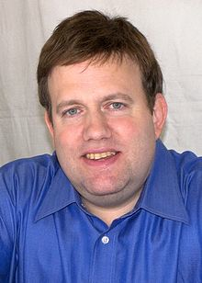
The Israel Project: America 2020
“Support for Israel was described as a vestige of one’s upbringing, a sense of allegiance that used to exist widely in American culture.”
“First and foremost, they know nothing about the history of the Middle East. Nothing. . . . The “facts” they do “know” are often wrong and work against Israel.”
Frank I. Luntz

Slide 71
The Israel Project: America 2020
“Support for Israel is intellectual, while support for the Palestinians is emotional. . . . In the end, the Palestinians are winning hearts and minds because they have humanized the conflict.”
“There is growing support among elite graduate students for a ‘one-state solution’ to the Israeli-Palestinian dispute.”

Slide 72
The Israel Project: America 2020
“Israeli spokespeople need to sympathize with the Palestinian people when condemning their leaders. How? Hold them accountable for the lack of freedom, democracy, openness and justice.”

Slide 73
The German Public: The Bertelsmann Foundation

Slide 74
The German Public: The Bertelsmann Foundation

Slide 75
The German Public: The Bertelsmann Foundation

