Slide 1
Nazi Ideology and ‘Jewish Chosenness’
JIM MELNICK
LCJE NORTH AMERICA 38TH ANNUAL CONFERENCE
Dallas, Texas - 7 JUNE 2021
Conference Theme: “Restoring the Jewishness of the Gospel”

Slide 2
The Doctrine of ‘Jewish Chosenness’
Is central to our faith and to the whole Bible
There is a spectrum of Jewish views on the doctrine

Slide 3
Arthur Hertzberg (1921-2006) Renowned Jewish scholar and Conservative rabbi
The Doctrine of Jewish Chosenness
“The essence of Judaism is the affirmation that the Jews are the chosen people: all else is commentary.”
HERTZBERG (1966)

Slide 4
Two competing notions: ‘Particularism’ versus ‘Universality’
Understanding Jewish Identity
The level and degree of interaction between these two notions - both in individuals and within communities - define at any one time in time what it means to ‘be Jewish’

Slide 5
JOEL S. KAMINSKY (SMITH COLLEGE)
A LEADING JEWISH SCHOLAR TODAY on the DOCTRINE of ‘JEWISH CHOSENNESS’

Slide 6
Two competing ideas of Jewish identity: ‘Particularism’ versus ‘Universality’
Kaminsky writes of “the widespread tendency to favor the universal over the particular, and the wrongheaded notion that Israel’s understanding of God’s universal nature ultimately conflicted with her election theology, necessitating a rejection of the particularistic dimensions of biblical theology.”
JOEL S. KAMINSKY, “Election Theology and the Problem of Universalism,” Horizons in Biblical Theology 33 (2011): 43.

Slide 7
Understanding this dichotomy is critical to how we approach Jewish missions!
Two competing ideas of Jewish identity: ‘Particularism’ versus ‘Universality’

Slide 8
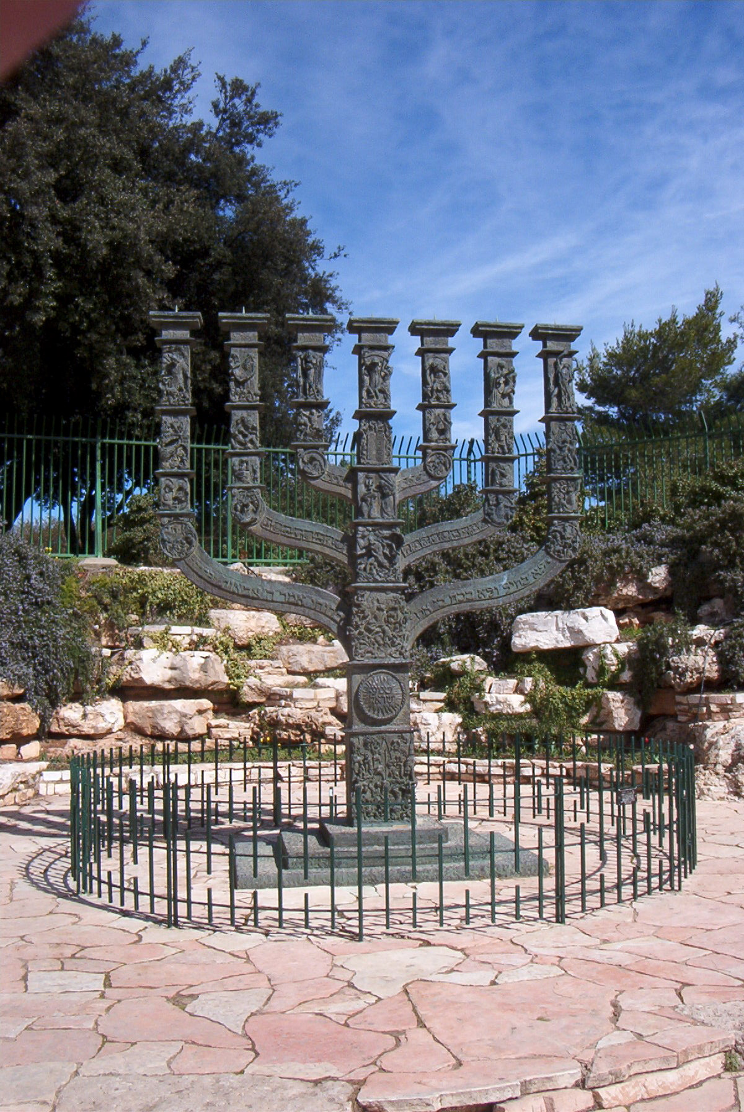
Nazi Ideology vs. ‘Jewish Chosenness’

Slide 9
“Is history merely a series of events whose sum is meaningless?... No people has ever insisted more firmly than the Jews that history has a purpose and humanity a destiny.”
Paul Johnson
A History of the Jews (1987)

Slide 10
“Implicit in the doctrine of chosenness is the belief that what has happened to the Jews, and what continues to happen to them, is at the center of human history.”
Jocelyn L. Hellig, “The Myth of Jewish Chosenness in the Modern World,” Dialogue & Alliance, Vol. 3, No. 3 (Fall 1989), 5.
THIS VIEW WAS THE COMPLETE ANTITHESIS OF NAZI IDEOLOGY, which sought to eradicate all aspects of this worldview by destroying the Jewish people

Slide 11
“Implicit in the doctrine of chosenness is the belief that what has happened to the Jews, and what continues to happen to them, is at the center of human history.”
Jocelyn L. Hellig, “The Myth of Jewish Chosenness
in the Modern World,” Dialogue & Alliance, Vol. 3,
No. 3 (Fall 1989), 5.

Slide 12
One Reason for Antisemitism
The course of history is providential, with the Jewish people at the very center of that history
Anti-semites cannot abide that
NAZISM; COMMUNISM; even SECULAR JUDAISM – all want to build a new society that has freed itself from the inexorable truth that the story of mankind is already wrapped up in the books of the HEBREW PROPHETS – in other words:
THE HISTORY OF THE WORLD IS JEWISH HISTORY!!!

Slide 13
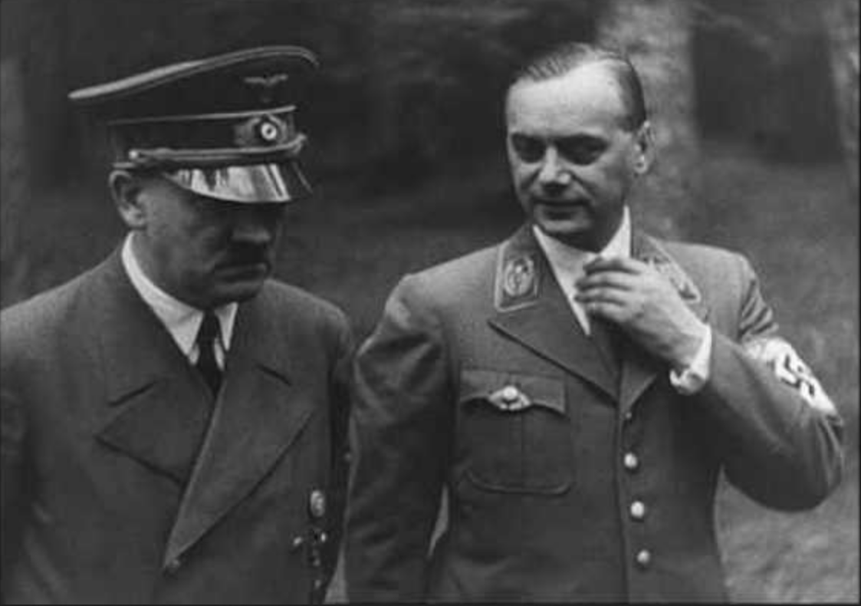
Hitler and Rosenberg

Slide 14
ROSENBERG was Nazism’s Chief Ideologist
Hitler considered Rosenberg to be “the deepest thinker
in the [Nazi] Party.”
Robert K. Wittman and David Kinney, The Devil’s Diary (2016): 191.

Slide 15
Hitler created the “German National Prize for Art and Science” (in part a reaction to the Nobel Prizes), and Rosenberg was its first recipient.
Robert K. Wittman and David Kinney, The Devil’s Diary (2016): 212-214.

Slide 16
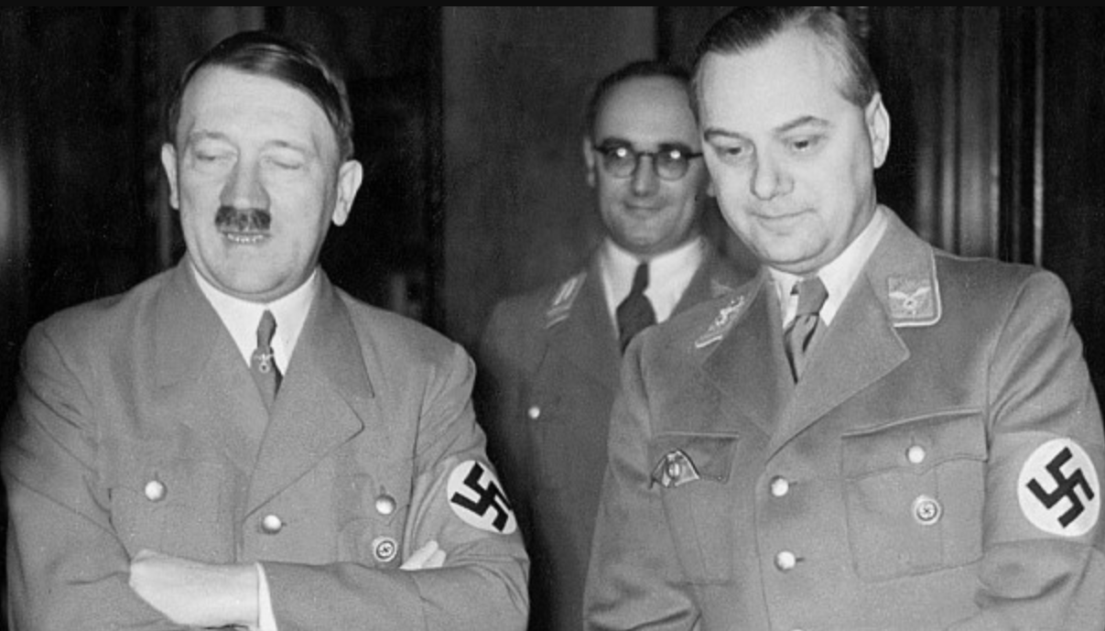
“Hitler himself fought back tears when he broke the news [of the prize to Rosenberg] before hand.’”
Robert K. Wittman and David Kinney, The Devil’s Diary (2016): 212-214.
“’Only you can receive the first prize of the Reich. You are
the man, after all…” (Adolf Hitler to Rosenberg)

Slide 17
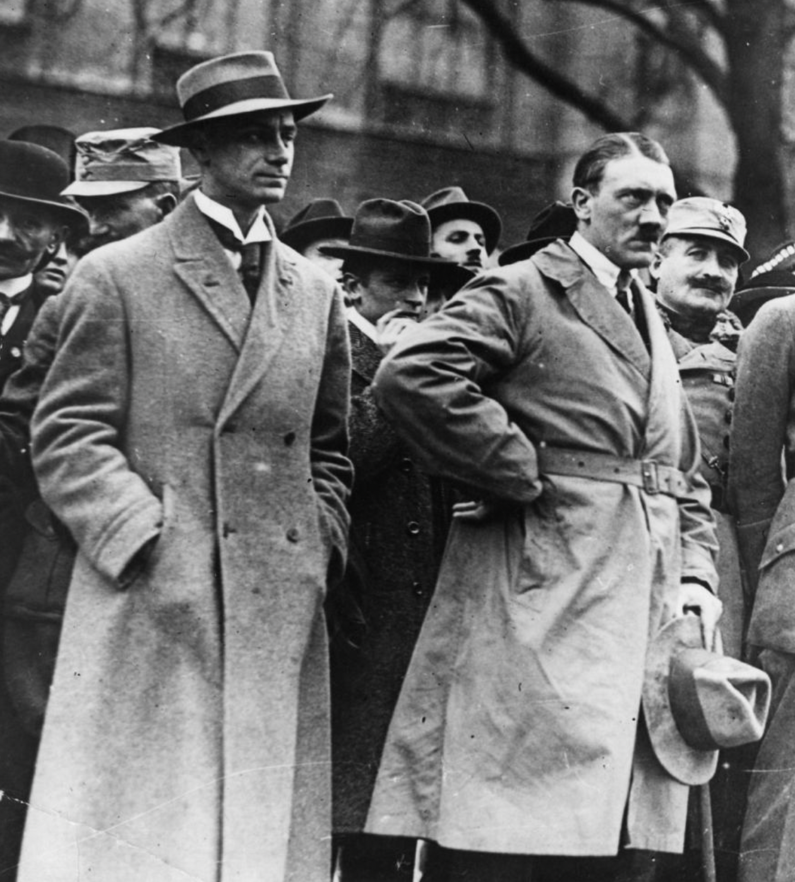
THE ROSENBERG DIARY – 2012 >>> 2016

Slide 18
One of his primary goals in the 1920s and ‘30s was to mock, minimize or destroy philo-Semitic German Christian support for the Jewish people
NAZI THEORIST
ALFRED ROSENBERG
Rosenberg despised Christianity, but he was very familiar with many Scriptures, including ROMANS 11!

Slide 19
Planck’s constant
MAX PLANCK
Famous German physicist and scientific leader in Germany

Slide 20
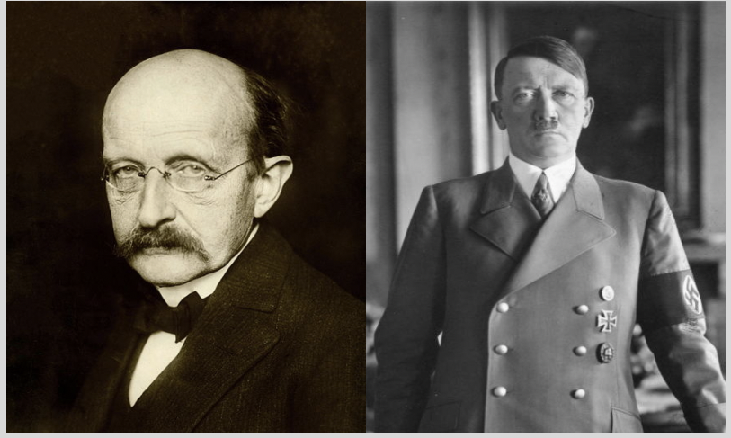
HITLER: “If the dismissal of Jewish scientists means the annihilation of contemporary German science, then we shall do without science for a few years.”
Kaiser-Wilhelm Institut in Berlin
See JewishGiftedness.com
for more about this meeting
PLANCK AND HITLER – THEIR INFAMOUS MEETING in MAY 1933

Slide 21
Jewish Giftedness and Genius
(Messianic Jewish
Publishers & Resources, 2017)
Looks at Jewish genius and giftedness as connected to the blessings that God has poured out upon the Jewish people

Slide 22
World’s Most Famous Atheist Stumped!
RICHARD DAWKINS
“The number of Jews who have won Nobel Prizes is phenomenally high...I don't think it is a minor thing; it is colossal. I think more than 20 percent of Nobel Prizes have been won by Jews." [The number won for scientific work] "is exceedingly high. That is a point that needs to be discussed. I don’t have the answer to it. I am intrigued by it. I didn't even know this extraordinary effect until it was pointed out to me by the [former] chief rabbi of Britain, Jonathan Sacks...I thought it was astounding, and I am puzzled by it.” (DAWKINS, 2013)

Slide 23
In his antisemitic book, The Track of the Jew through the Ages (1920, 1937), Rosenberg - whose views represented official Nazi policy - proclaimed that "It is now not hard to outline the sphere of the Jewish mind with total strictness...The lack of imagination and inner quest, which damned the Jew to sterility in religion and philosophy, emerges also in science. Not a single creative scientific idea sprang from a Jewish mind, nowhere has it pointed out new paths.”
Alfred Rosenberg, The Track of the Jew through the Ages (1920, 1937 - Alexander Jacob translation), 162.

Slide 24
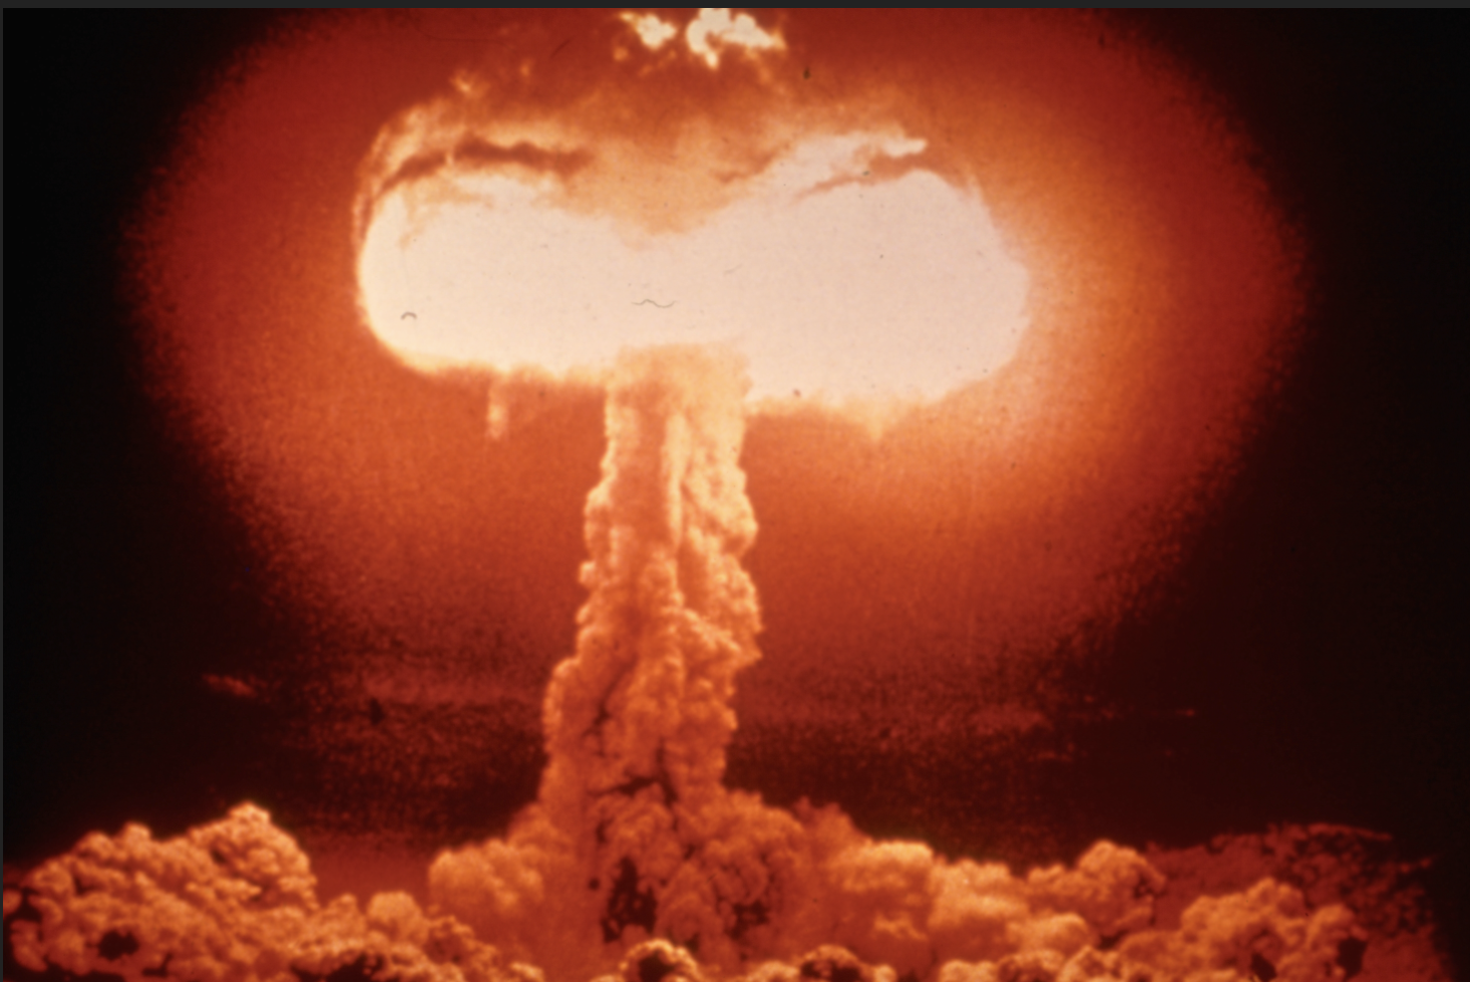
“…an irony of fate is that Hitler’s actions removed the one group of people who would have been able to provide him with the instrument for world dominance he so eagerly sought.”
Brian VanDeMark, Pandora’s Secrets: Nine Men and the Atomic Bomb (2003), 1.
THE ATOMIC BOMB
"The exodus of Jewish scientists was devastating in its consequences for Germany...Most of the lost physicists were scientists of high originality and unique experience; they were irreplaceable. Almost half of Germany's theoretical physicists went, and many of its top experts in quantum mechanics and nuclear physics.”
John Cornwell, Hitler's Scientists: Science, War, and the Devil's Pact, New York: Viking, 2003, 139-140).

Slide 25
Einstein and Planck were friends
or acquaintances and shared a love of music together

Slide 26
Individual German-Jewish friendships became a standing joke among the SS in terms of their implementation of the ‘Final Solution’

Slide 27
HEINRICH HIMMLER
Head of the SS
German-Jewish friendships among individuals became a standing joke among the SS in their implementation of the ‘Final Solution’

Slide 28
HEINRICH HIMMLER’s
Secret speech to SS generals
“…I am taking about the extermination of the Jewish people. It is one of those things that is easily said: ‘The Jewish people is being exterminated,’ every Party member will tell you, ‘perfectly clear, it’s part of our plans…’ And then they all come, all the 80 million upright Germans, and each one has his decent Jew. They say: ‘all the others are swine, but here is a first-class Jew.’”
Poznan, POLAND (October 4, 1943)

Slide 29
Himmler trying to ’explain’ and ‘justify’ “THE FINAL SOLUTION”
HEINRICH HIMMLER – in a
secret speech to his SS generals
Poznan, POLAND
October 4, 1943
“We have the moral right, we had the duty to our people to do it, to kill this people who would kill us. We however do not have the right to enrich ourselves with even one fur, one Mark, with one cigarette…That we do not have. Because we don’t want, at the end of all this, to get sick and die from the same bacillus that we have exterminated…We have carried out this most difficult task for the love of our people. And we have suffered no defect within us, in our soul, or in our character.”

Slide 30
EINSTEIN was the ARCH-ENEMY
of NAZI IDEOLOGY by HIS VERY
EXISTENCE!!! –
According to Nazi ideology, there could be no such thing as original JEWISH GENIUS. It had to be some sort of global Jewish conspiratorial ‘scam’

Slide 31
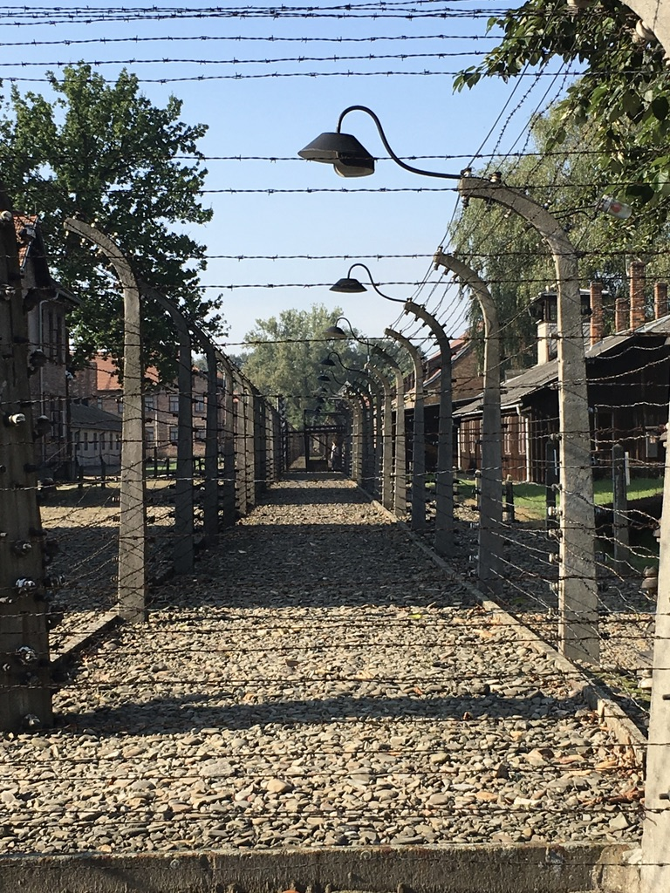
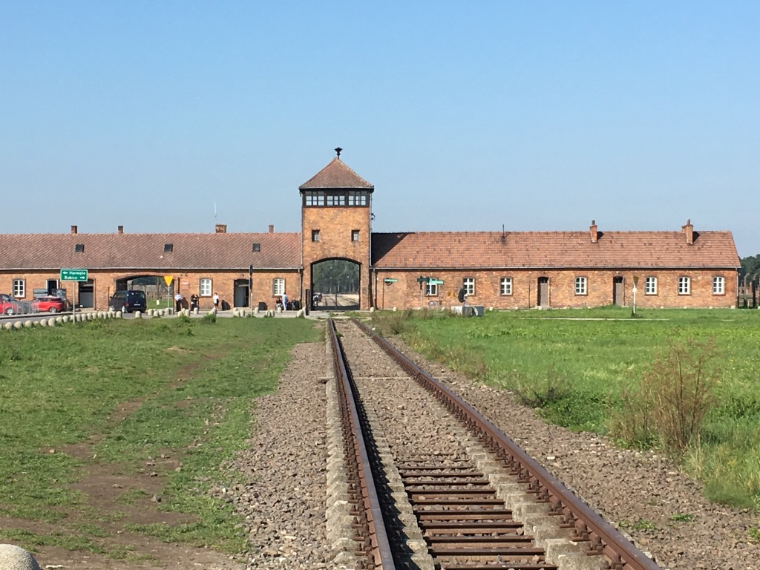
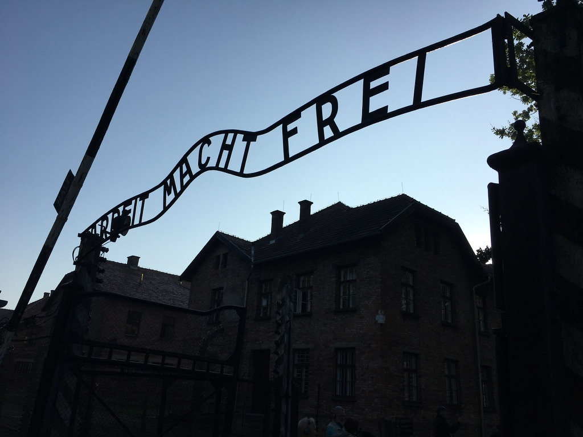
Auschwitz
JOSEF MENGELE
.

Slide 32
Mengele chose Jewish doctors of “world renown,” such as Dr. Epstein, to assist him. He was well aware of the quality of the background of the people he was destroying. Miklos was set apart: “Dr. Mengele questioned me at length, asking where I had studied, the names of my pathology professors, how I had acquired a knowledge of forensic medicine, how long I had practiced, etc.” (Dr. Miklos Nyiszli, pp. 19-20)
Auschwitz
JOSEF MENGELE
Dr. Miklos Nyiszli

Slide 33
Relying on Jewish expertise in any way went contrary to all Nazi ideology, but such Nazi ‘rules’ were ignored in the Hell of Auschwitz
JOSEF MENGELE
Auschwitz

Slide 34
“Because of their blood, the Jews were harmful to that great race [the Master Race of Aryans]. Moreover, they were dangerous because their teachers, their artists, their merchants and financiers had become so powerful they threatened to enslave the whole of Europe.” (Dr. Miklos Nyiszli, a Jewish doctor at Auschwitz who worked with Mengele, commenting on Nazi views of the Jews, Auschwitz: A Doctor’s Eyewitness Account, 1960, 2011, p. 110)
JOSEF MENGELE
“The Angel of Death”
Auschwitz
Dr. Miklos Nyiszli

Slide 35
Auschwitz
DR. ELLA LINGENS
An anti-Nazi German doctor, Ella Lingens was arrested, sent to Auschwitz as a camp doctor, saved many Jews there, survived the war and was later honored, along with her husband Kurt, at Yad Vashem.
YAD VASHEM

Slide 36
“In Mengele’s view the biggest threat to the superiority of the German race was posed by the Jews. ‘He once told me there are only two gifted people in the world, Germans and Jews, and it’s a question of who will be superior,’ said Dr. [Ella] Lingens. ‘So he decided they had to be destroyed.’” (Gerald Posner and John Ware, Mengele: The Complete Story, 2000, p. 27)
JOSEF MENGELE
The Boston Jewish Times said of this book: “This is indeed the complete story, superior to other books on Mengele.”
Auschwitz
Also see: Jewish Telegraph Agency account (1985) https://www.jta.org/1985/02/07/archive/former-mossad-chief-discloses-that-its-agents-almost-captured-mengele-on-three-occasions-since-1960

Slide 37
Jews are mystical conspirators, “parasites,” part of a global network that threatens the Third Reich. They infect whatever they touch. They have no innate giftedness.
A Spectrum of Nazi Views
Jews are the only gifted people that threaten German superiority.
HIMMLER
MENGELE
HITLER & ROSENBERG
“We have the moral right, we had the duty to our people to do it, to kill this people who would kill us”

Slide 38
Arno Gaebelein

Slide 39
ARNO GAEBELEIN
Gaebelein was writing about the Holocaust before most people were paying attention… The liberal Protestant Christian Century publication did not believe the reporting

Slide 40
Arno Gaebelein
DAVID RAUSCH
“OUR HOPE: An American Fundamentalist Journal and the Holocaust, 1937-1945”

Slide 41
“To the historian of the Holocaust, there is another unique attribute of this periodical. It chronicles with unbelievable accuracy the plight of the Jews during the Nazi regime.” (p. 89)
DAVID RAUSCH
“OUR HOPE: An American Fundamentalist Journal and the Holocaust, 1937-1945”

Slide 42
“Gaebelein traveled to Germany in 1937 and gained a firsthand view of the Nazi regime...Throughout the 1930s, ‘Our Hope’ documented the rising anti-Semitism throughout the world.” (p. 90)
DAVID RAUSCH
“OUR HOPE: An American Fundamentalist Journal and the Holocaust, 1937-1945”
1937

Slide 43
“Our brethren in Germany need our prayers. [Alfred] Rosenberg seems to forge ahead; his work of destruction is unchecked. The most deplorable fact is that the so-called Hitler Youth is led astray by this misleader, led towards a terrible abyss. How long oh Lord? How long? Till He comes.”
ARNO GAEBELEIN
“Observations and Experiences,”
OUR HOPE 44 (1938): 750.
1938

Slide 44
“Poor mumbling, blind Rosenberg! He hates God’s Word. He despises the Old Testament! He wants to have it thrown out! German youth are warned against reading it. Soon the day will come…when the kingdom will be restored to Israel, when God’s covenant promises to His earthly people will all be fulfilled, when glory will dwell in ‘Immanuel’s Land’.
ARNO GAEBELEIN
“Alfred Rosenberg, the German Anti-Christian Leader Speaks Again”
OUR HOPE 45 (1939): 689.
1939

Slide 45
- Rosenberg was tried by the Nuremberg tribunal, found guilty and hanged on 16 October 1946.
- The Rosenberg diary was obtained by the U.S. Holocaust Memorial Museum in 2013.

Slide 46
ISRAEL RE-BORN! - 1948

