Slide 1
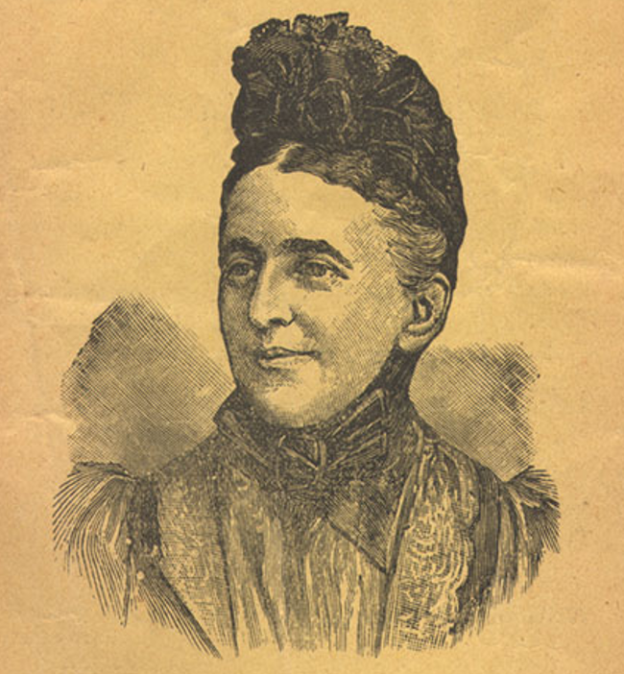
Emilia Baeyertz, the “Jewish Lady Evangelist”
Richard A. Robinson
Lausanne Consultation on Jewish Evangelism, June 7–9, 2021,
Dallas, Texas

Slide 2
Emilia’s Upbringing in Wales

Slide 3
Jews in Wales

Slide 4
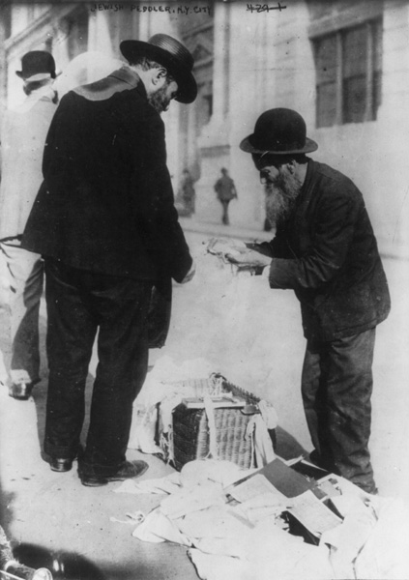
From Prussia to England to peddling in Wales

Slide 5
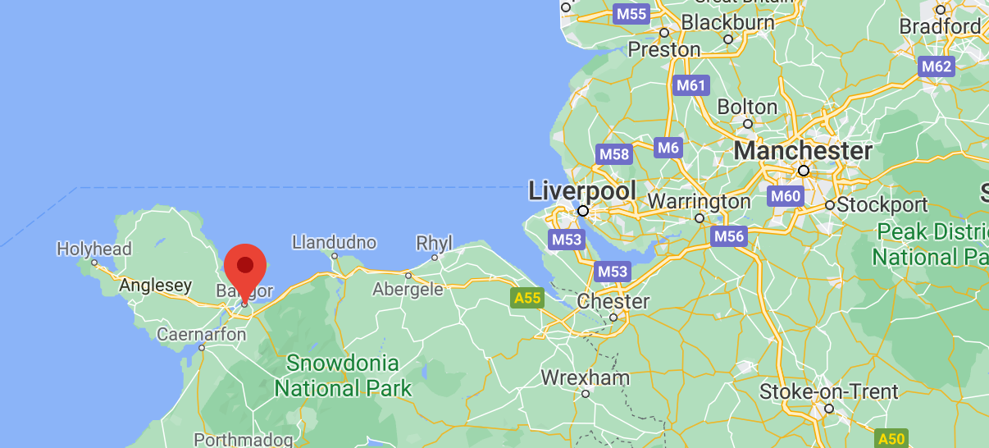
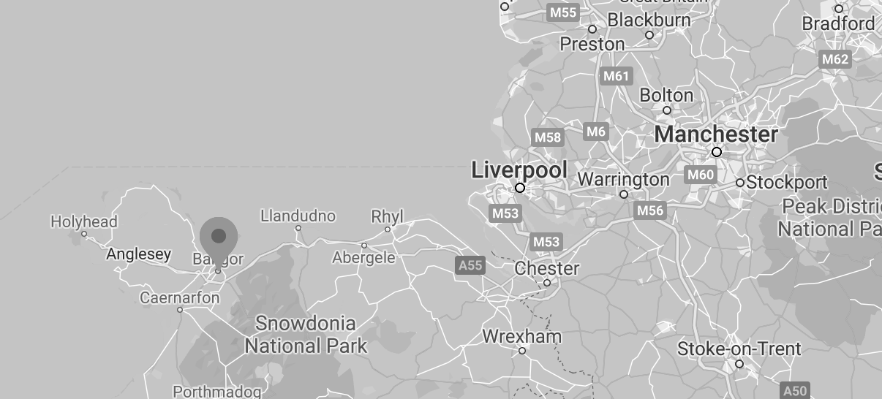

Slide 6
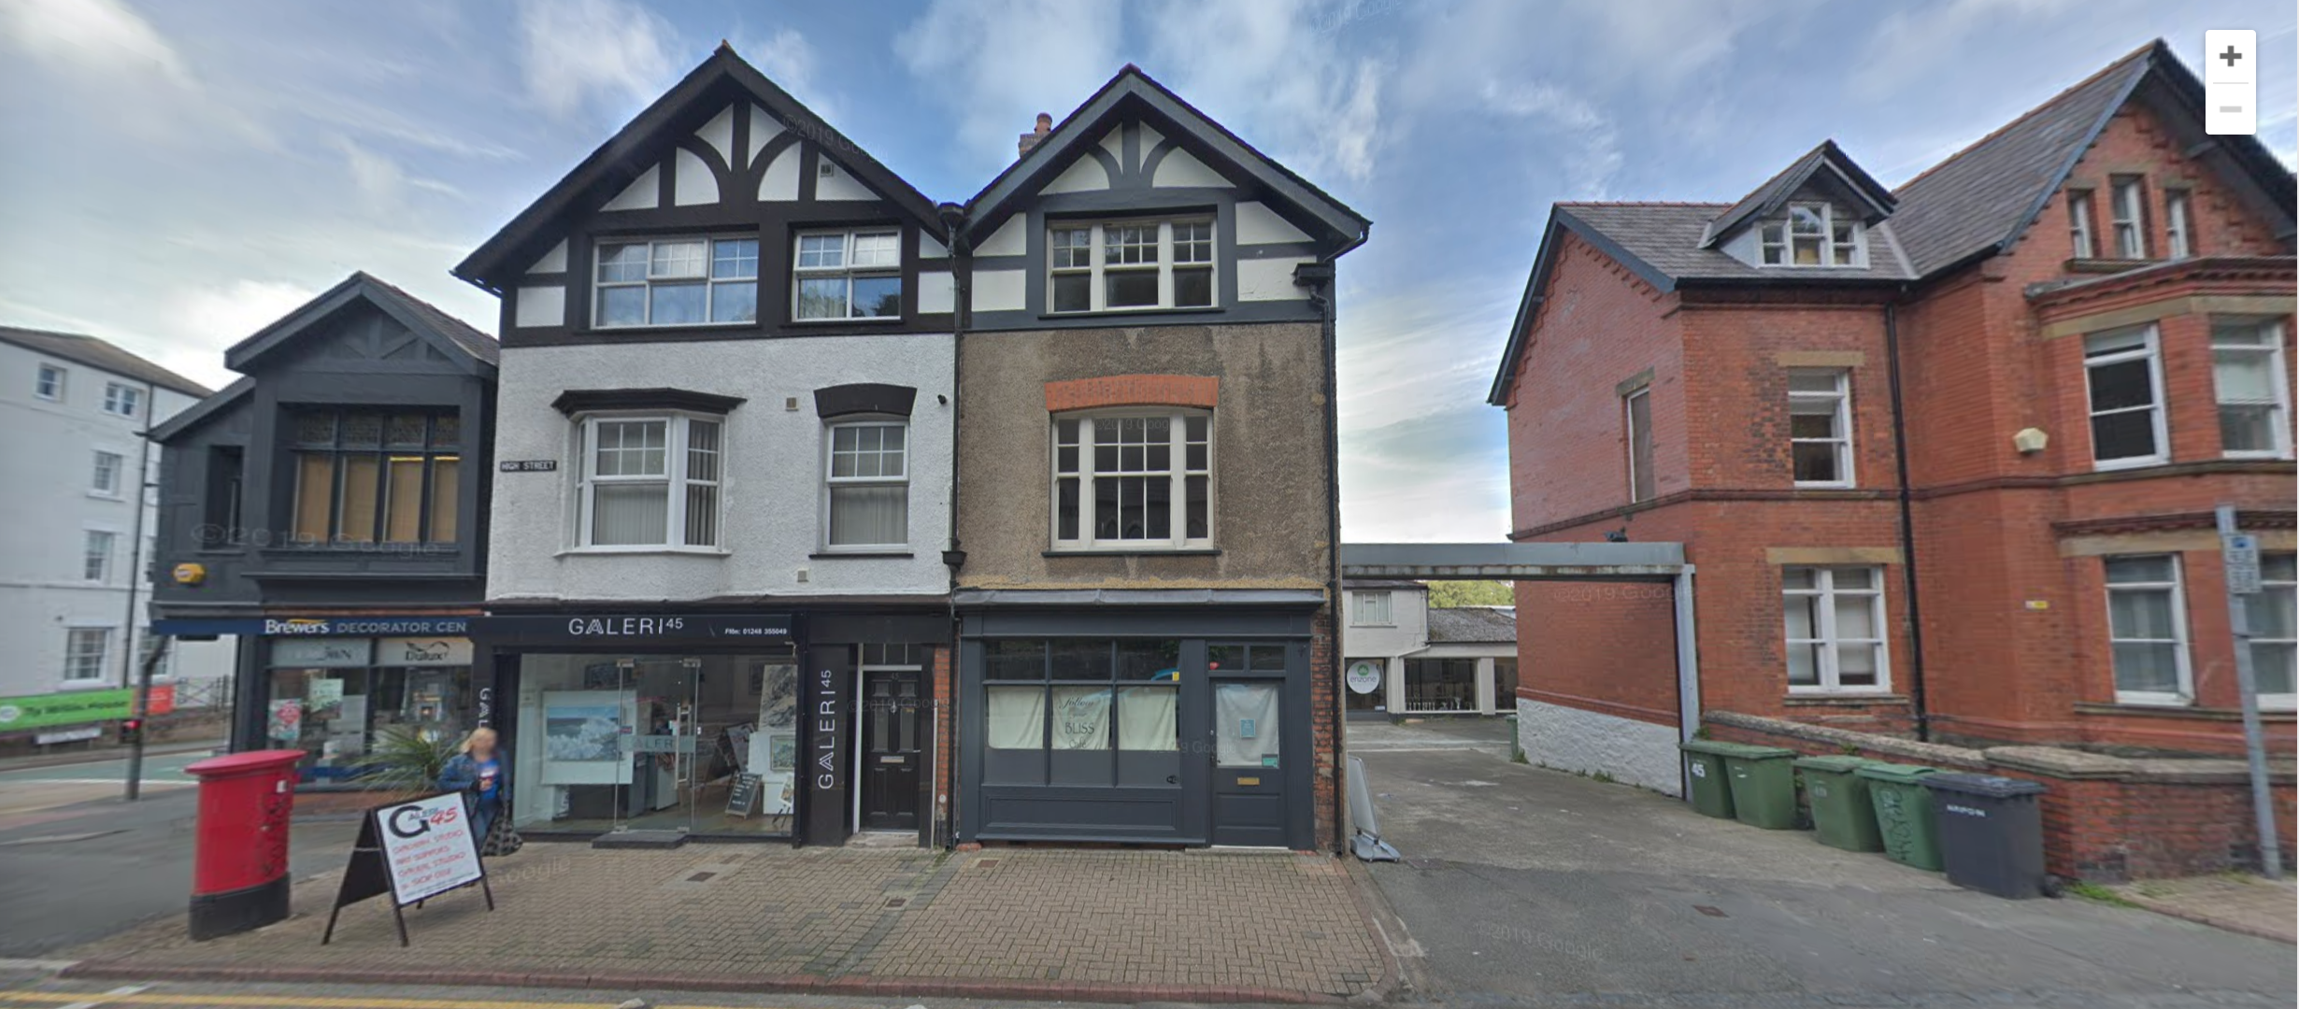
Born Emilia Louisa Aronson, March 29, 1842 in Bangor, Wales
to John and Maria Aronson

Slide 7
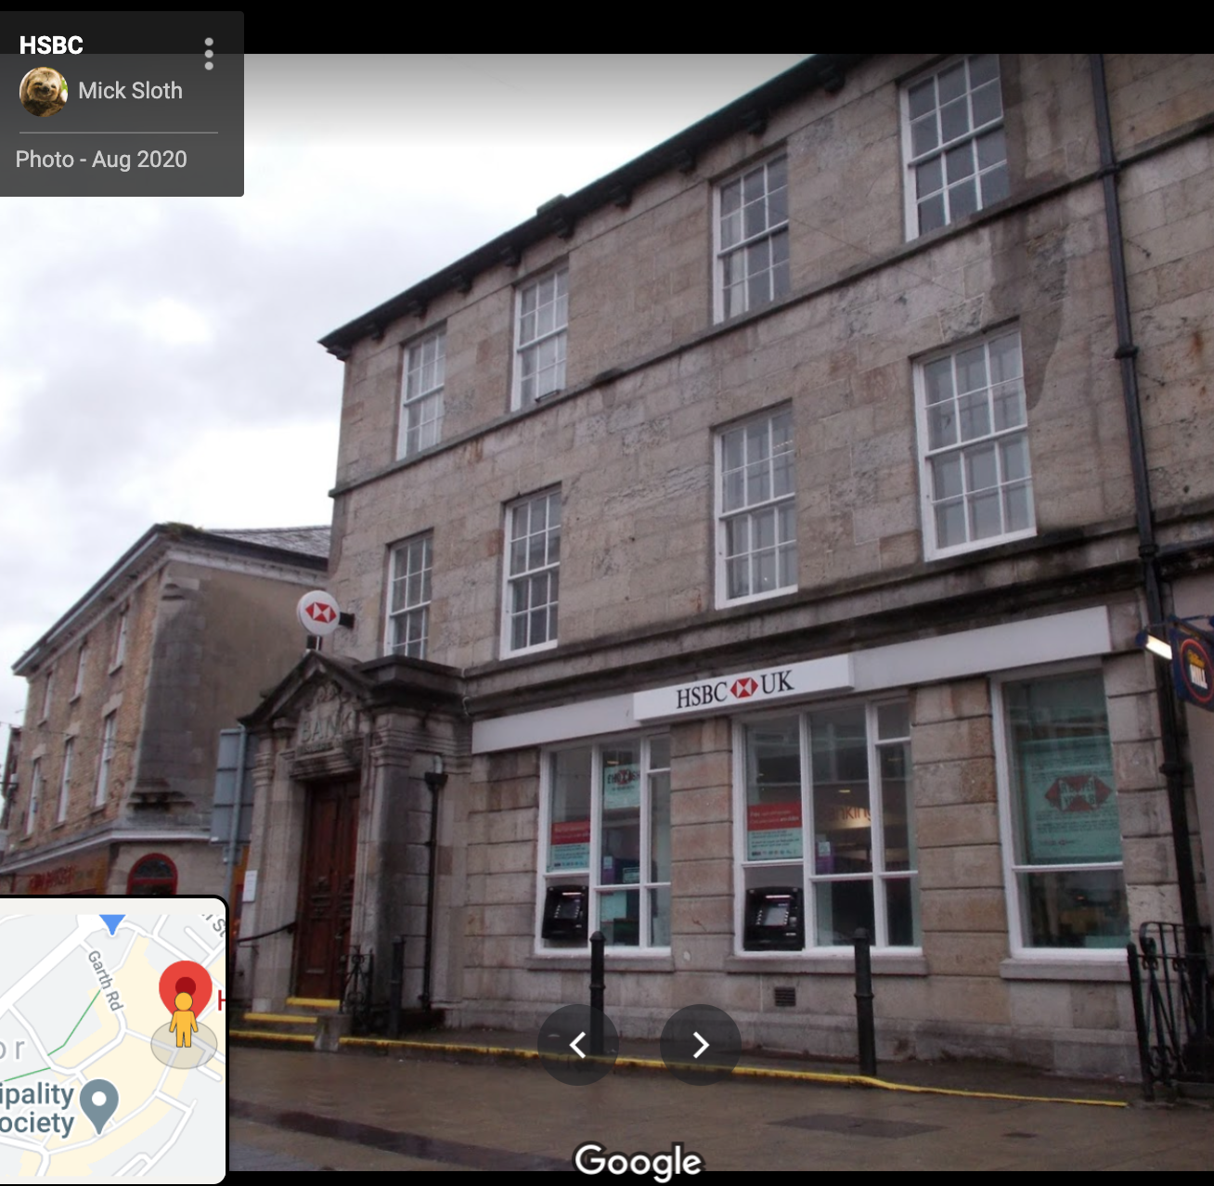
John Aronson’s
jewelry store, opened 1851.
Original building, today the HSBC Bank.

Slide 8
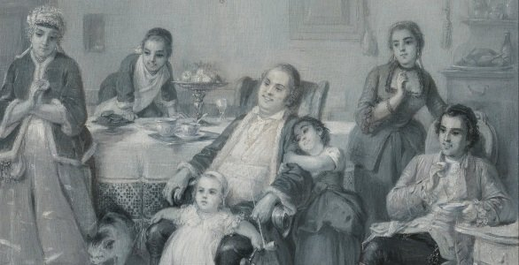
A warm Jewish home life with an eventual eleven siblings.

Slide 9
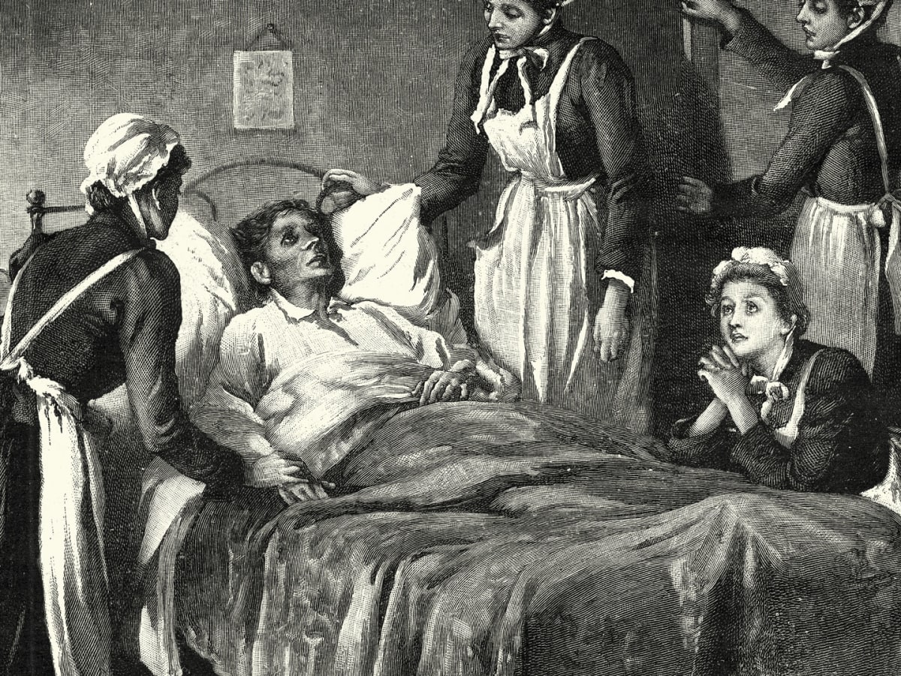
The first tragedy: death of fiancé to tuberculosis when Emilia was about 21 or 22 years of age.

Slide 11
The Move to Australia and Emilia’s Journey to Faith

Slide 12
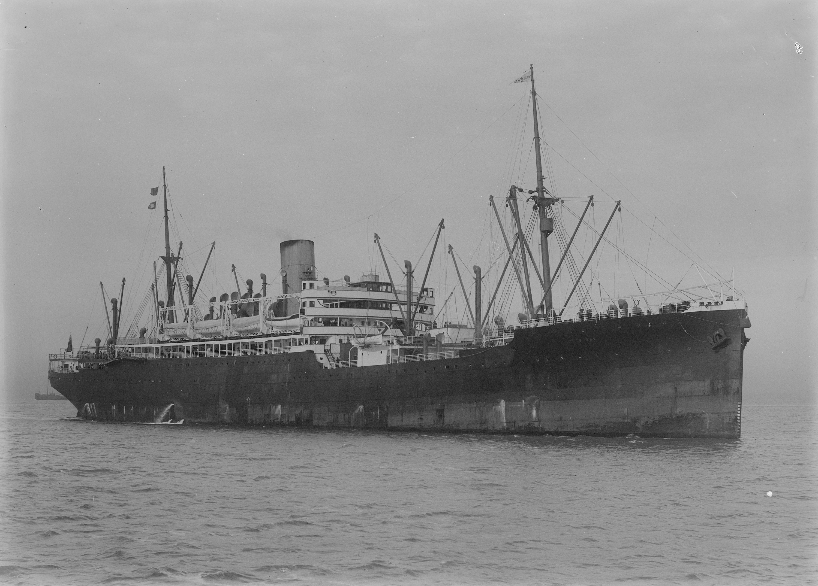
Relocates to Australia for emotional and physical health, joins family members.

Slide 13
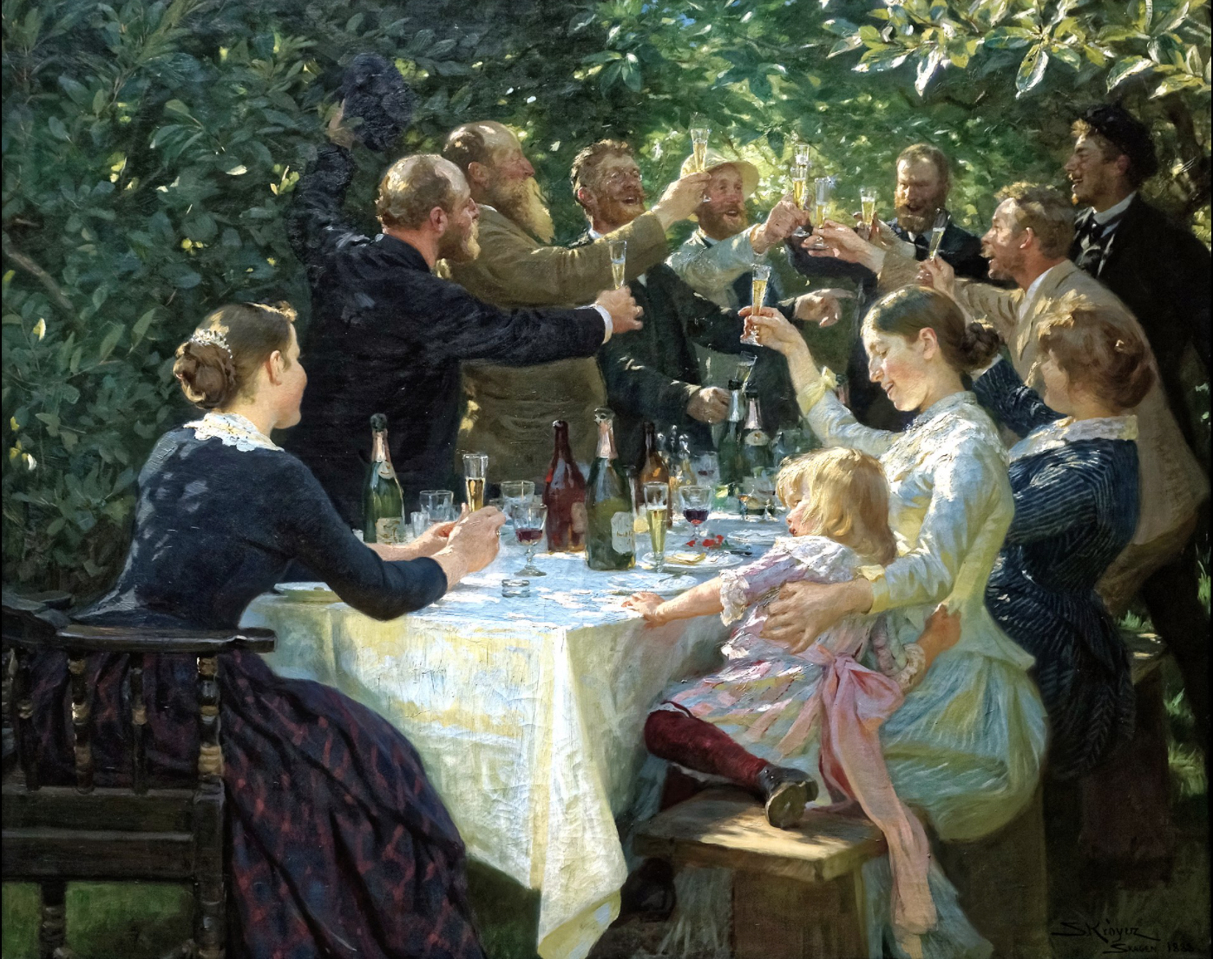
Embarks on a life of “pleasure.”

Slide 14
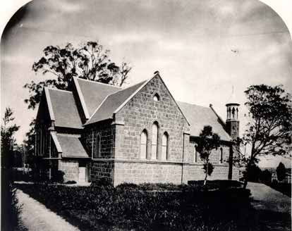
Meets Anglican banker Charles Baeyertz.
Secretly married at Christ Church, October 16, 1865—Emilia 23 years of age.

Slide 15
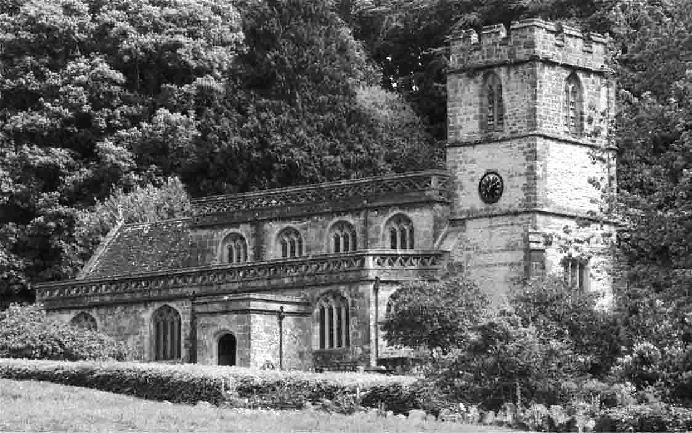
Raises two children as Anglicans
Becomes a “pseudo-Anglican” herself.

Slide 16
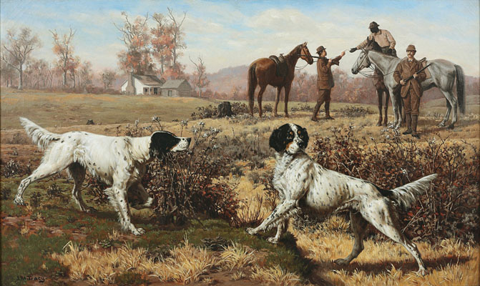
The second tragedy: Charles dies in a hunting accident at age 29.

Slide 17
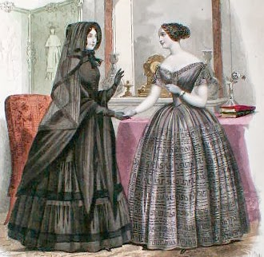
Emilia mourns, contemplates the afterlife.

Slide 18
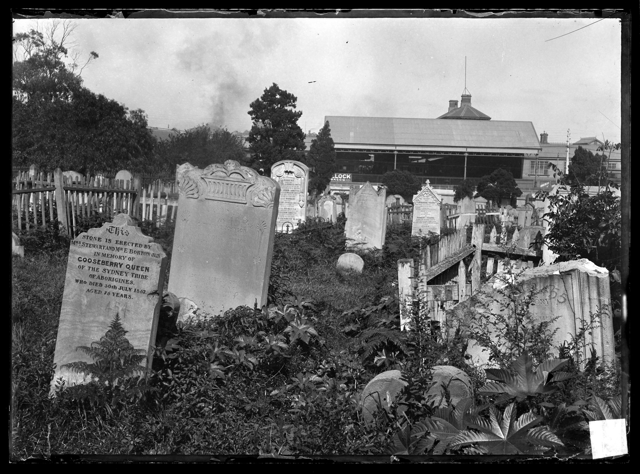
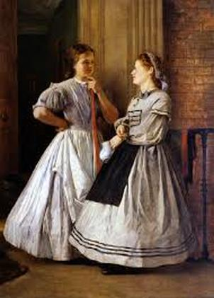
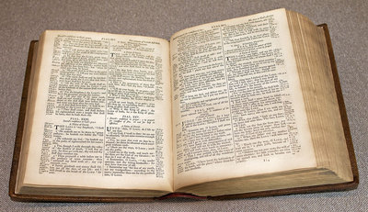
Existential questions
+
Christian friends
+
Reading the New Testament (John’s Gospel)

Slide 20
The Beginnings of an Evangelistic Career

Slide 21
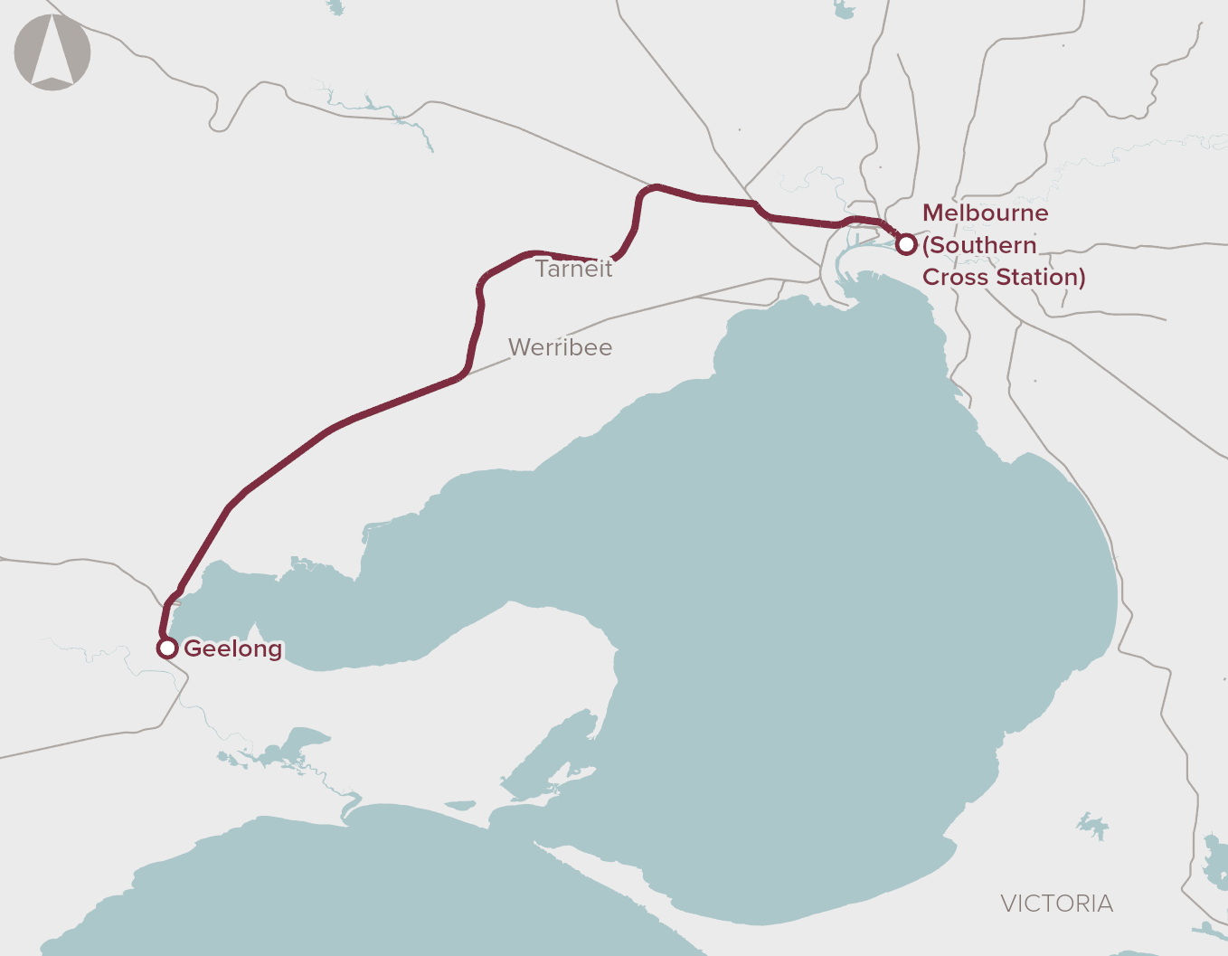
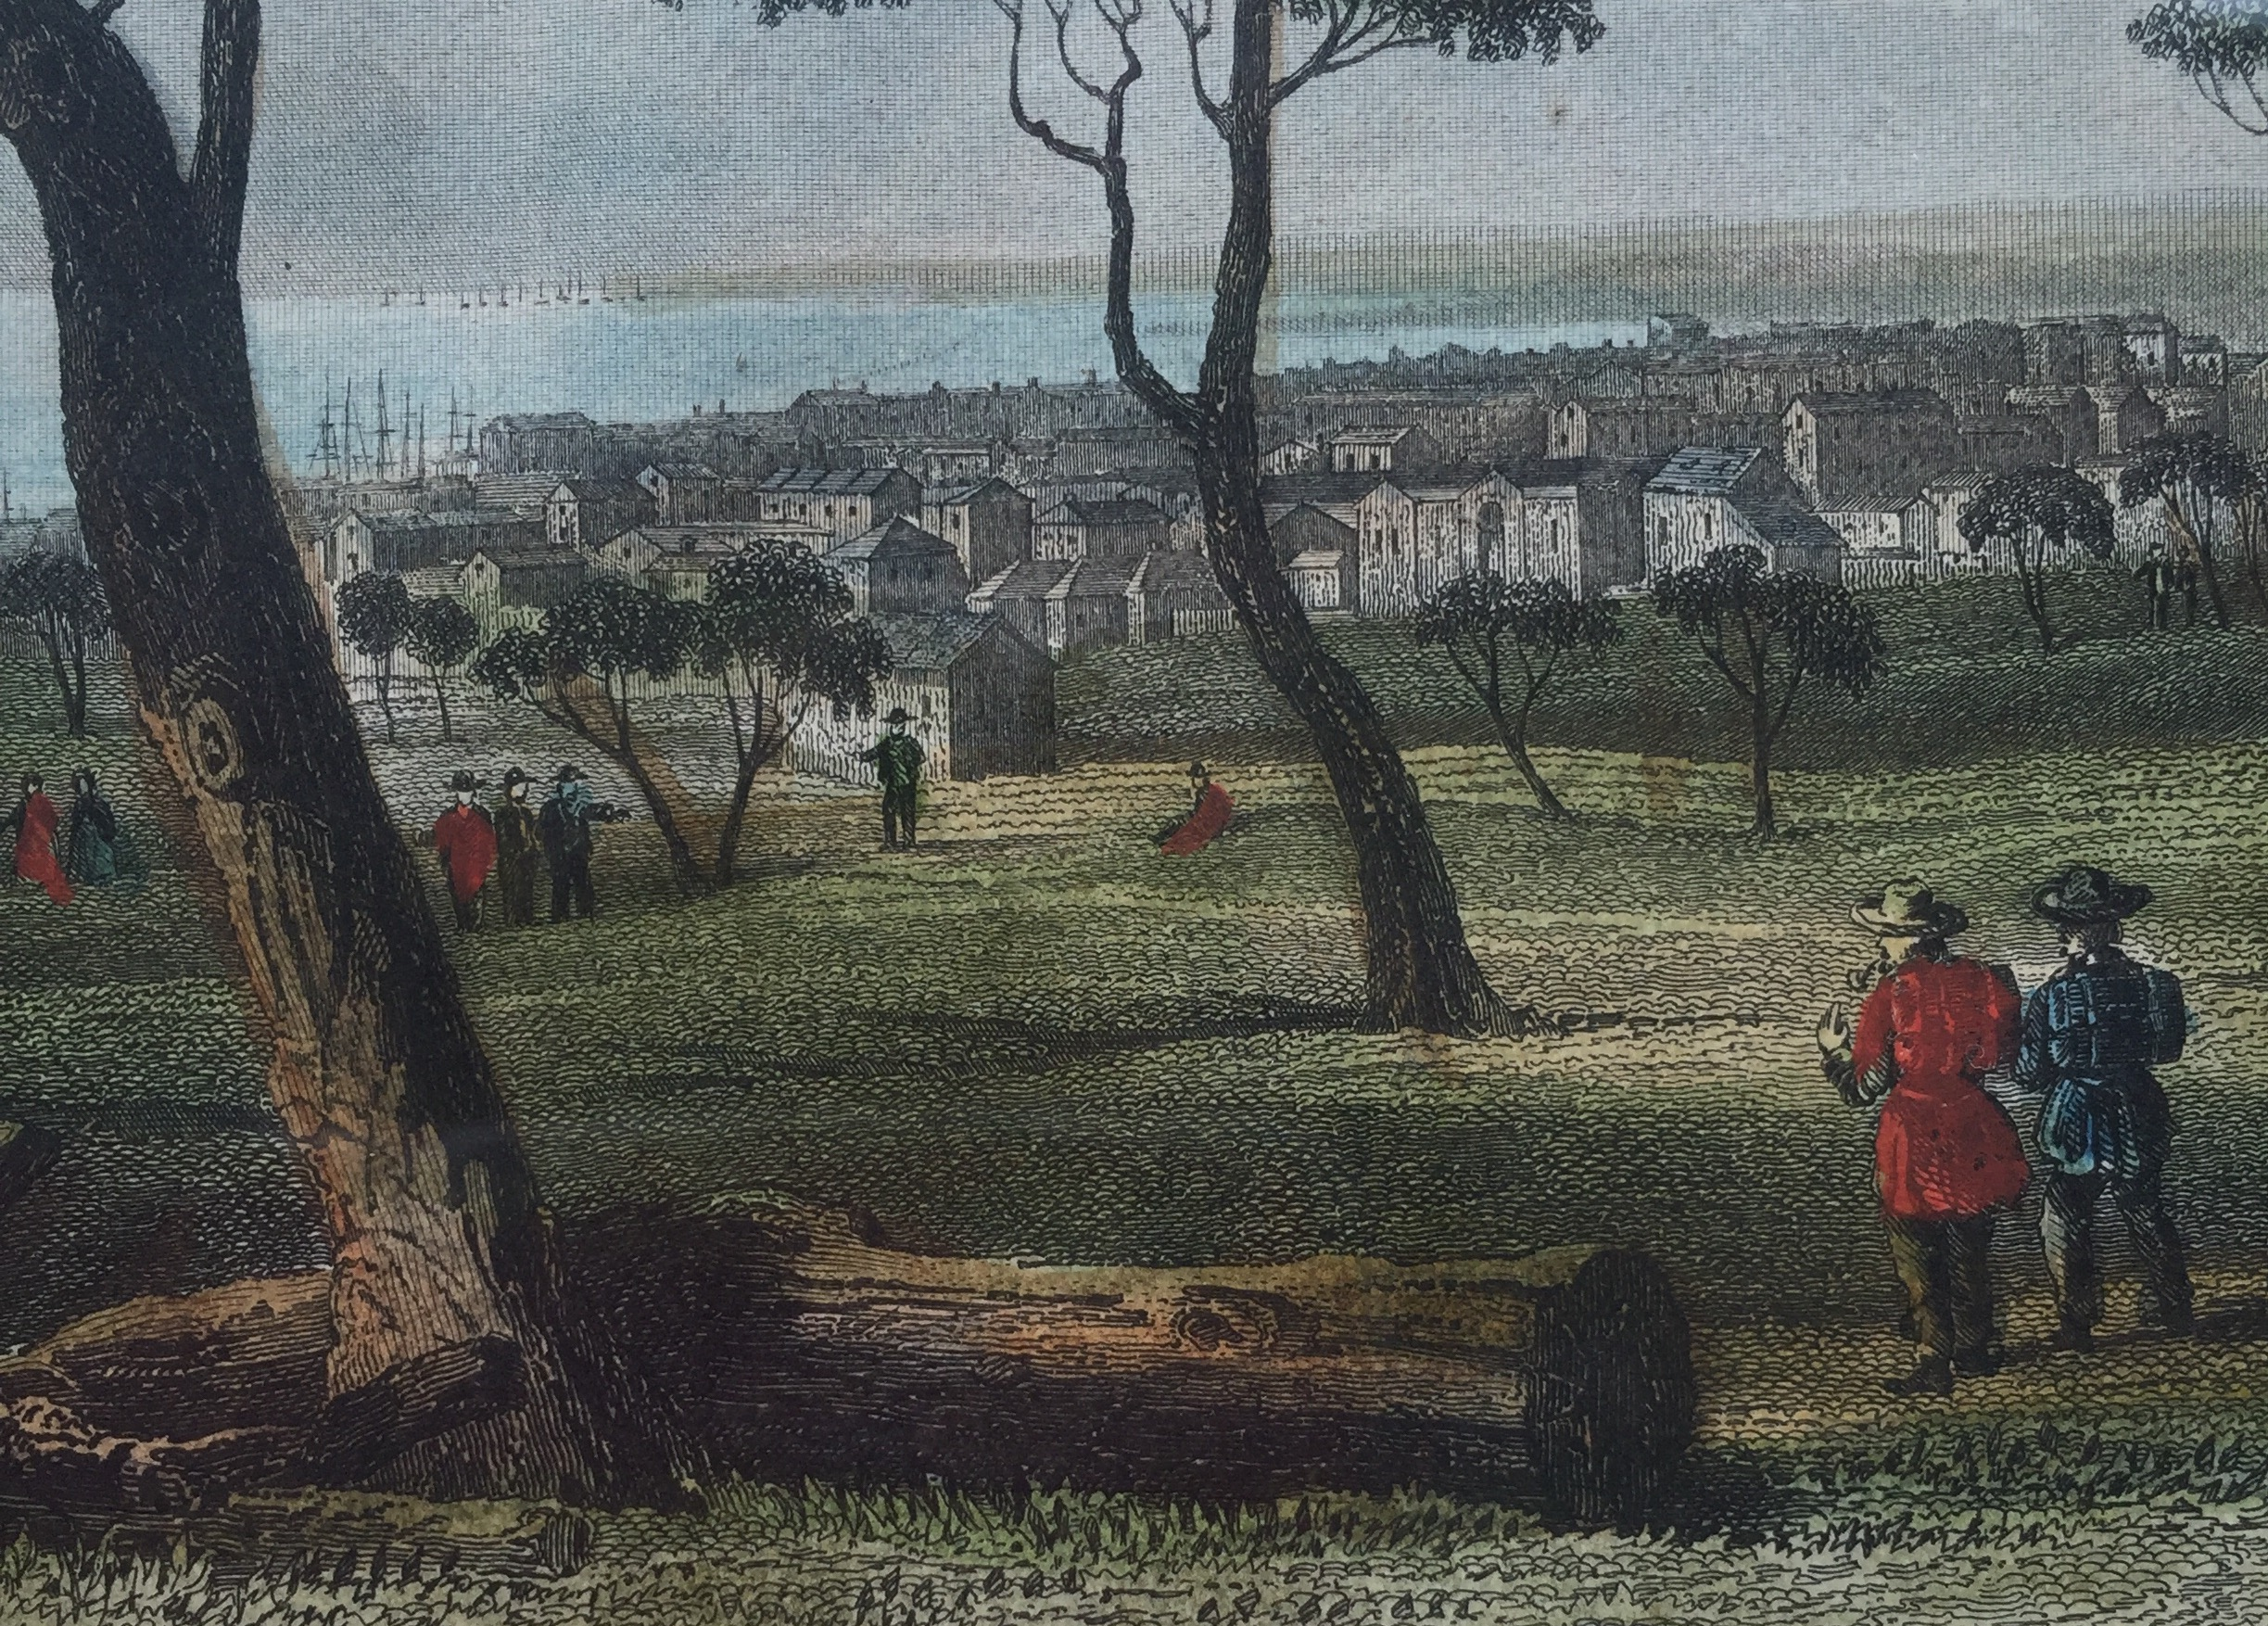
Relocates with children to Geelong

Slide 22
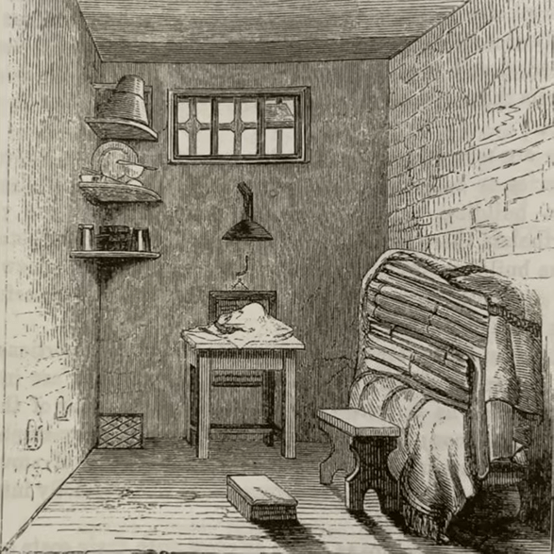
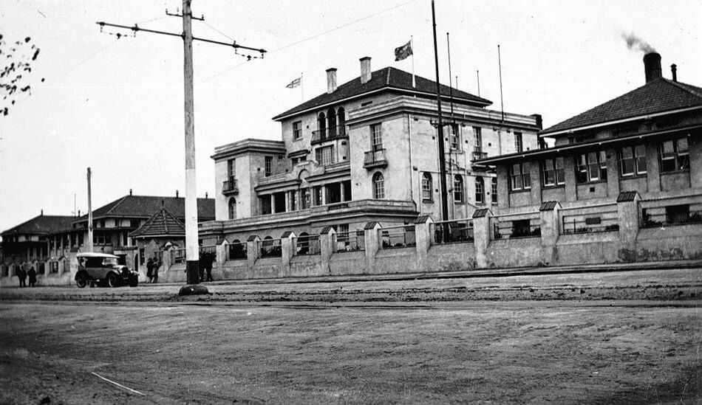
Evangelizes in the prison and hospital …

Slide 23
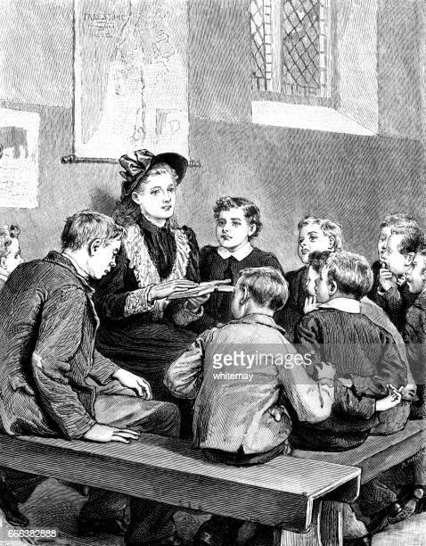
… and teaches Sunday School to teens

Slide 24
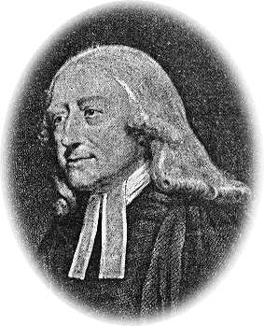
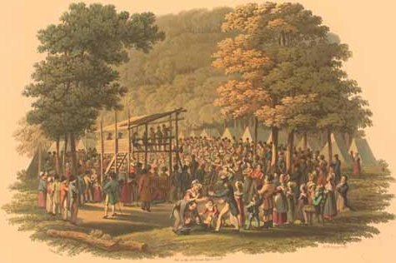
Undergoes a period of great consciousness of sin, leading to the “baptism of the Holy Spirit” and involvement in the “Holiness” movement.
This orientation would characterize the rest of her ministry.

Slide 26
The Overall Context of Emilia’s Ministry

Slide 27
1. The Social and Theological Context

Slide 28
1. The Social and Theological Context
Some holiness groups allowed women preachers
But a counter-current saw women’s place as in the home

Slide 29
1. The Social and Theological Context
She struggled with whether to do mixed-gender meetings.
Eventually held those along with gender-segregated meetings.

Slide 30
1. The Social and Theological Context
Men-only meetings attracted men who would not otherwise come
Poorer families could not attend together, so allowed them to alternate

Slide 31
1. The Social and Theological Context
“Fundamentalist” in her approach to the ”world”
Opposed the theater, concerts, dancing, card playing, and reading novels

Slide 32
2. Her Schedule, Audiences, and Follow Up

Slide 33
2. Her Schedule, Audiences, and Follow Up
Two-week long “missions”
Cross-denominational sponsorship

Slide 34
2. Her Schedule, Audiences, and Follow Up
Afternoon meetings for Christians, evenings for evangelism
Wednesdays for women and girls; Thursdays for men and boys

Slide 35
2. Her Schedule, Audiences, and Follow Up
“After-meetings” a unique features of her work
Overflow crowds

Slide 36
2. Her Schedule, Audiences, and Follow Up
Dignified, forceful, effective
Black clothing
Sample schedule (from 1897) follows on next slides

Slide 37
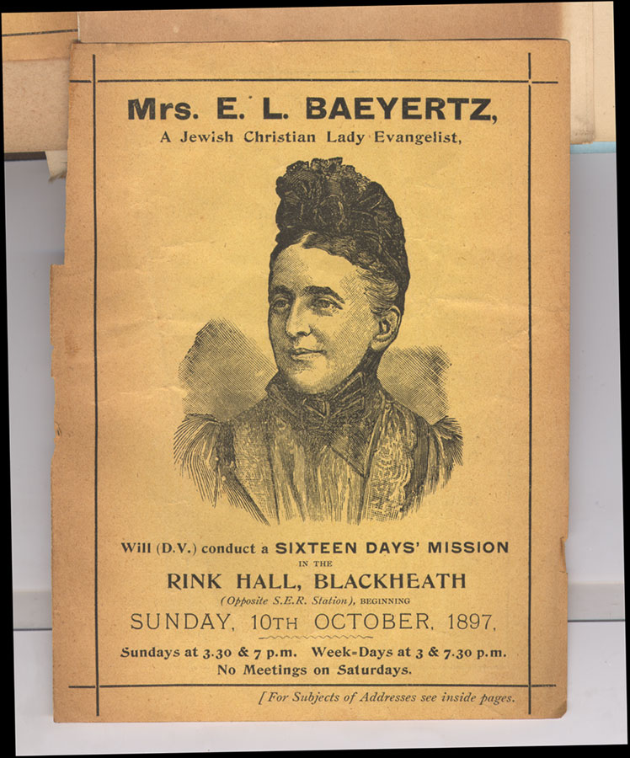

Slide 38
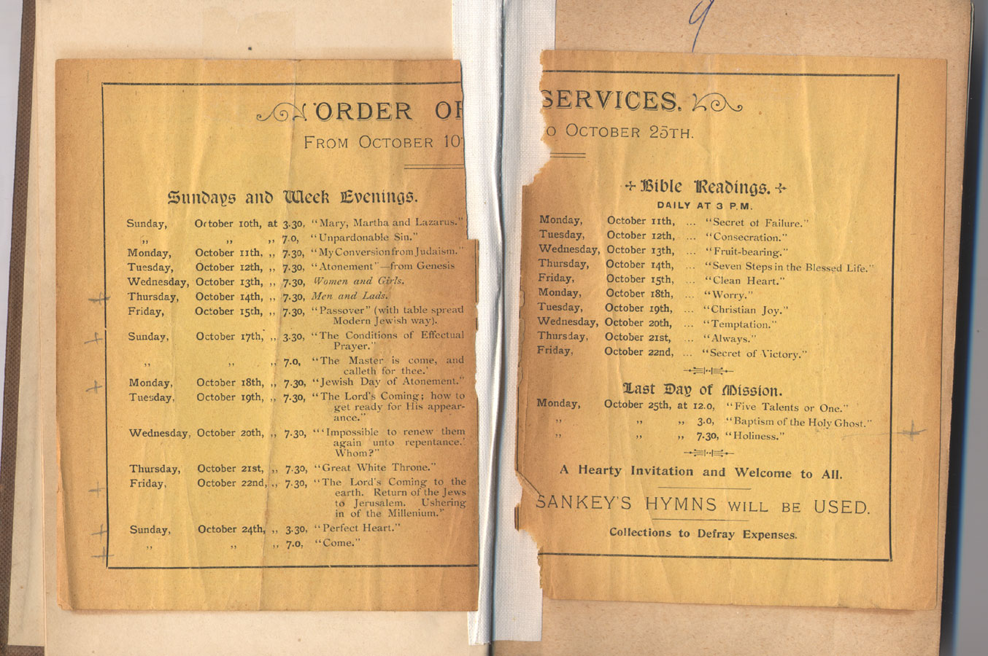

Slide 39
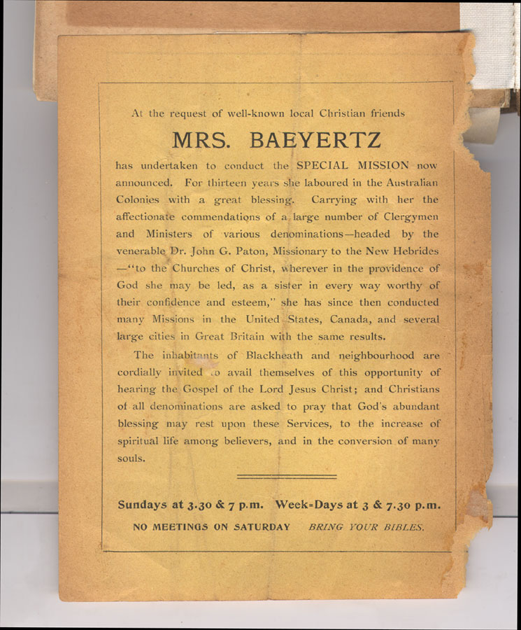

Slide 40
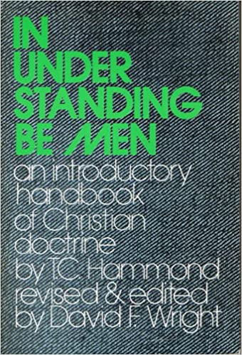
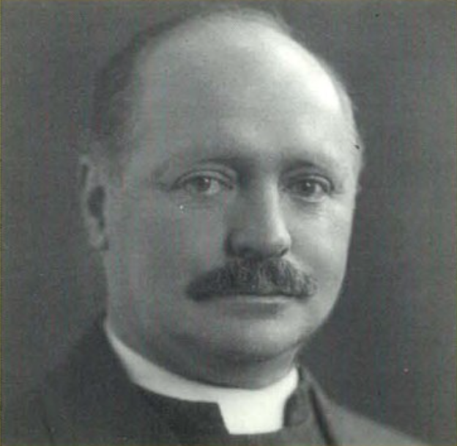
2. Her Schedule, Audiences, and Follow Up
One famous convert: T. C. Hammond

Slide 42
3. Emilia Baeyertz and Jewish Evangelism

Slide 43
3. Emilia Baeyertz and Jewish Evangelism: Direct Outreach
Initial foray into direct Jewish evangelism

Slide 44
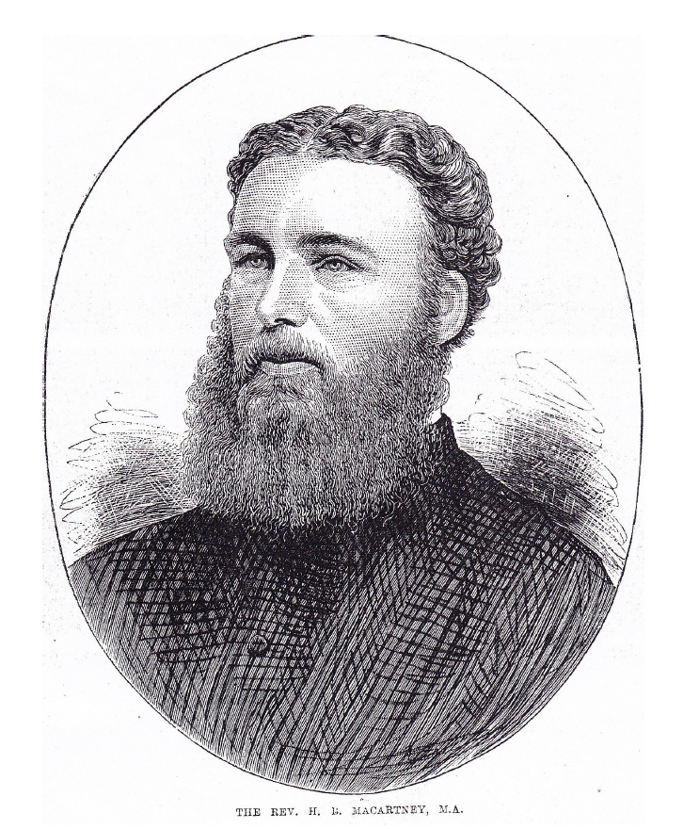
3. Emilia Baeyertz and Jewish Evangelism: Direct Outreach
Encouraged by missions enthusiast H. B. Macartney Jr.

Slide 45
3. Emilia Baeyertz and Jewish Evangelism: Direct Outreach
Worked in Melbourne for about two years.
Experienced opposition, at least one death threat.

Slide 46
3. Emilia Baeyertz and Jewish Evangelism: Direct Outreach
But sources suggest under-funding was also a problem.
No special training or team.

Slide 47
3. Emilia Baeyertz and Jewish Evangelism: Direct Outreach
Expectations may have been high in a “revival” era.
After two years, left Jewish evangelism for general outreach.

Slide 48
3. Emilia Baeyertz and Jewish Evangelism: Jewish Attendees at her Missions
Jews “flocked,” inquired “anxiously,” and “came wonderfully.”
May have reached more Jews this way.

Slide 49
3. Emilia Baeyertz and Jewish Evangelism: Jewish Attendees at her Missions
One Jewish troublemaker changed his mind.
Two of her brothers were in Melbourne in the jewelry business —did they ever attend?

Slide 50
3. Emilia Baeyertz and Jewish Evangelism: No Involvement with Jewish Missions Organizations
Speculations as to why not

Slide 52
4. Jewish Influence on Her Messages and Meetings

Slide 53
4. Jewish Influence on Her Messages and Meetings: Her Passover and Yom Kippur Messages
Passover the most popular message.
One man willing to walk four miles to hear it!

Slide 54
4. Jewish Influence on Her Messages and Meetings: Her Passover Table
Table set up as done in her home growing up.

Slide 55
4. Jewish Influence on Her Messages and Meetings: Her Passover Table
Homemade non-intoxicating wine, matzah, hyssop, roasted blackened lamb bone, maror, secret-recipe charoset.

Slide 56
4. Jewish Influence on Her Messages and Meetings: Her Passover Message
Wove in her Jewish upbringing.
Assumed Bible knowledge.

Slide 57
4. Jewish Influence on Her Messages and Meetings: Her Passover Message
Distinctively “Christian” applications — a kind of Christian midrash

Slide 58
4. Jewish Influence on Her Messages and Meetings: Her Day of Atonement Message
Again talks about her upbringing.
Focuses on Leviticus 16 …

Slide 59
4. Jewish Influence on Her Messages and Meetings: Her Day of Atonement Message
… with again a kind of “Christian midrash” applied to that chapter.

Slide 60
4. Jewish Influence on Her Messages and Meetings: Influence from Midrash?
Overheard as a child?
“Midrashic” explanations of single words

Slide 61
4. Jewish Influence on Her Messages and Meetings: Her “Fundamentalism”—Jewish or not?
Holiness movement? Orthodoxy? Both?

Slide 63
5. Conclusion
Emilia Baeyertz died in London April 26, 1926.
She was 84 years of age.

Slide 64
5. Conclusion
Future research will include her descendants.

Slide 65
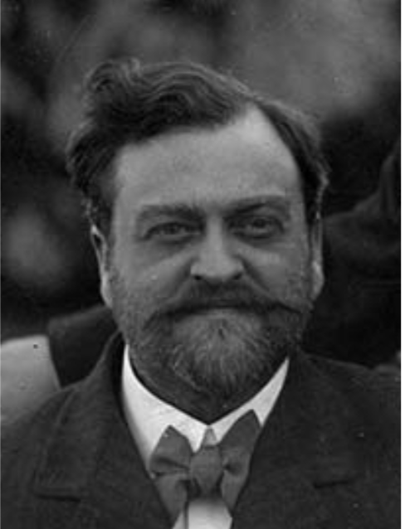
5. Conclusion
Son Charles Nalder Baeyertz became a teacher, journalist, editor, publisher and music critic.
He edited the journal The Triad, “the most successful literary magazine of the time.” (Wikipedia)

Slide 66
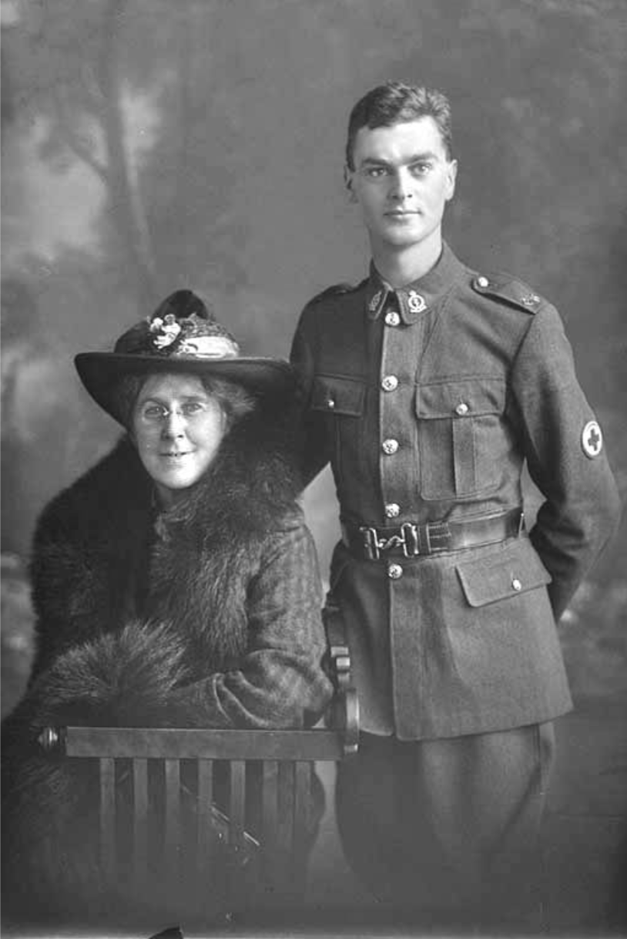
5. Conclusion
One grandson adopted the original family name:
Rudolph Emil Aronson Baeyertz.
He was a lawyer and a chess player.

Slide 67
5. Conclusion
A great-grandson, John Desmond Baeyertz,became a noted New Zealand obstetrician and gynecologist.

Slide 68
Full paper available in forthcoming edition of Mishkan

Slide 69
In lieu of in-person Q&A, email me at: rich.robinson@jewsforjesus.org

