Slide 1
Media Report 2023
Susan Perlman February 27, 2023

Slide 2
Anti-Missionaries Israel

Slide 3
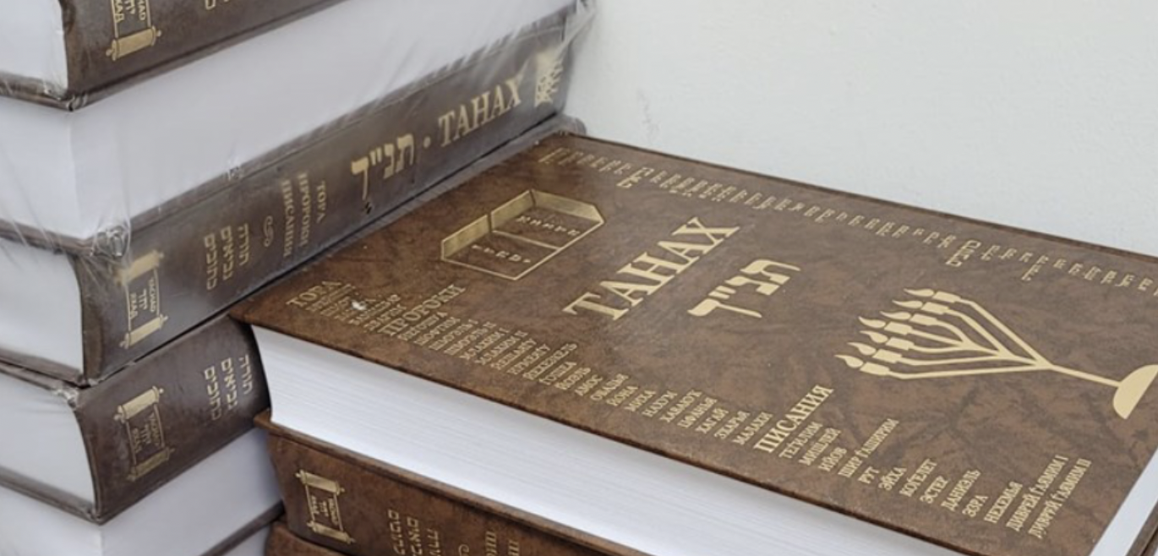
How missionary bibles are finding their way into Orthodox synagogues
Israel National News

Slide 4
Israel Focused

Slide 5
School Kids Draw Pictures of Jesus, Israeli Parents Complain of “Missionary Influence”
Israel Today

Slide 6
Israel Today
Young Messianic Jewish Pilot Defending and Contending

Slide 7
Israel Hayom
PM's wife demands apology for rumors she 'believes in Jesus'

Slide 8
High Profile Antisemitism

Slide 9
Neo-Nazis Are Celebrating Kanye West and Calling Him the Greatest 'Since Adolf Hitler'
Gizmodo

Slide 10
Jewish Community Not Buying Kyrie’s Apology
The Jewish Star

Slide 11
Antisemitism

Slide 12
Rise in antisemitism should prompt evangelism
MBC Pathway

Slide 13
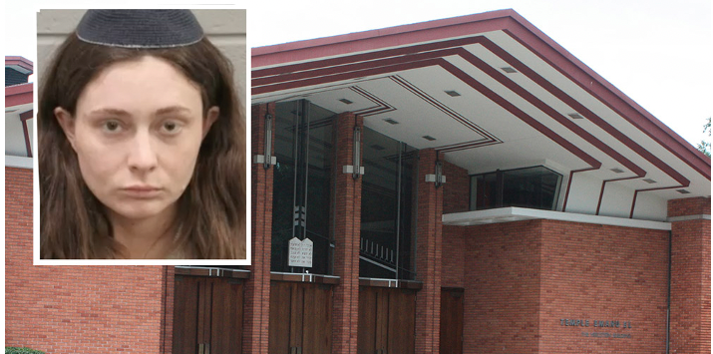
Jewish Herald Voice
Woman arrested after breaking into Congregation Emanu El, spilling wine on Torah, harassing preschool students

Slide 14
Jewish Evangelism

Slide 15
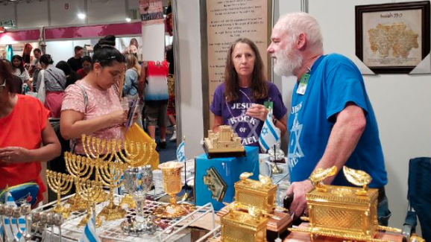
Jesus Made Me Kosher Conversations
News AG

Slide 16
THE HARBINGER’ AUTHOR JONATHAN CAHN: ‘GOD IS REAL ... BUT AMERICA IS IN TROUBLE’
Movie Guide

Slide 18
Demographics

Slide 19
Rabbi Reflections

Slide 20
RNS
What Jews don’t know about Christianity could fill a book

Slide 21
Potpourri

Slide 22
World Israel News
Vulgar, offensive’: GOP candidate’s novel on Anne Frank a ‘wake-up call,’ says anti-missionary activist

Slide 23
Walmart pulls $40 elegant sunscreen
scarves that
were actually Jewish
prayer
shawls
Israel National News

Slide 24
The Forward
Michigan GOP candidate who was raised Jewish now says she’s a Messianic Jew

Slide 25
JTA
Soviet Jewry protest leaders in San Francisco secretly recruit help from Jews for Jesus

Slide 26
Weekend Essay: For the Ultimate in Preparedness, Add a Messiah Clause
NY Sun

