Slide 1
He Opened Their Minds
A New Book on Messianic Prophecy
David Brickner | CEO

Slide 2
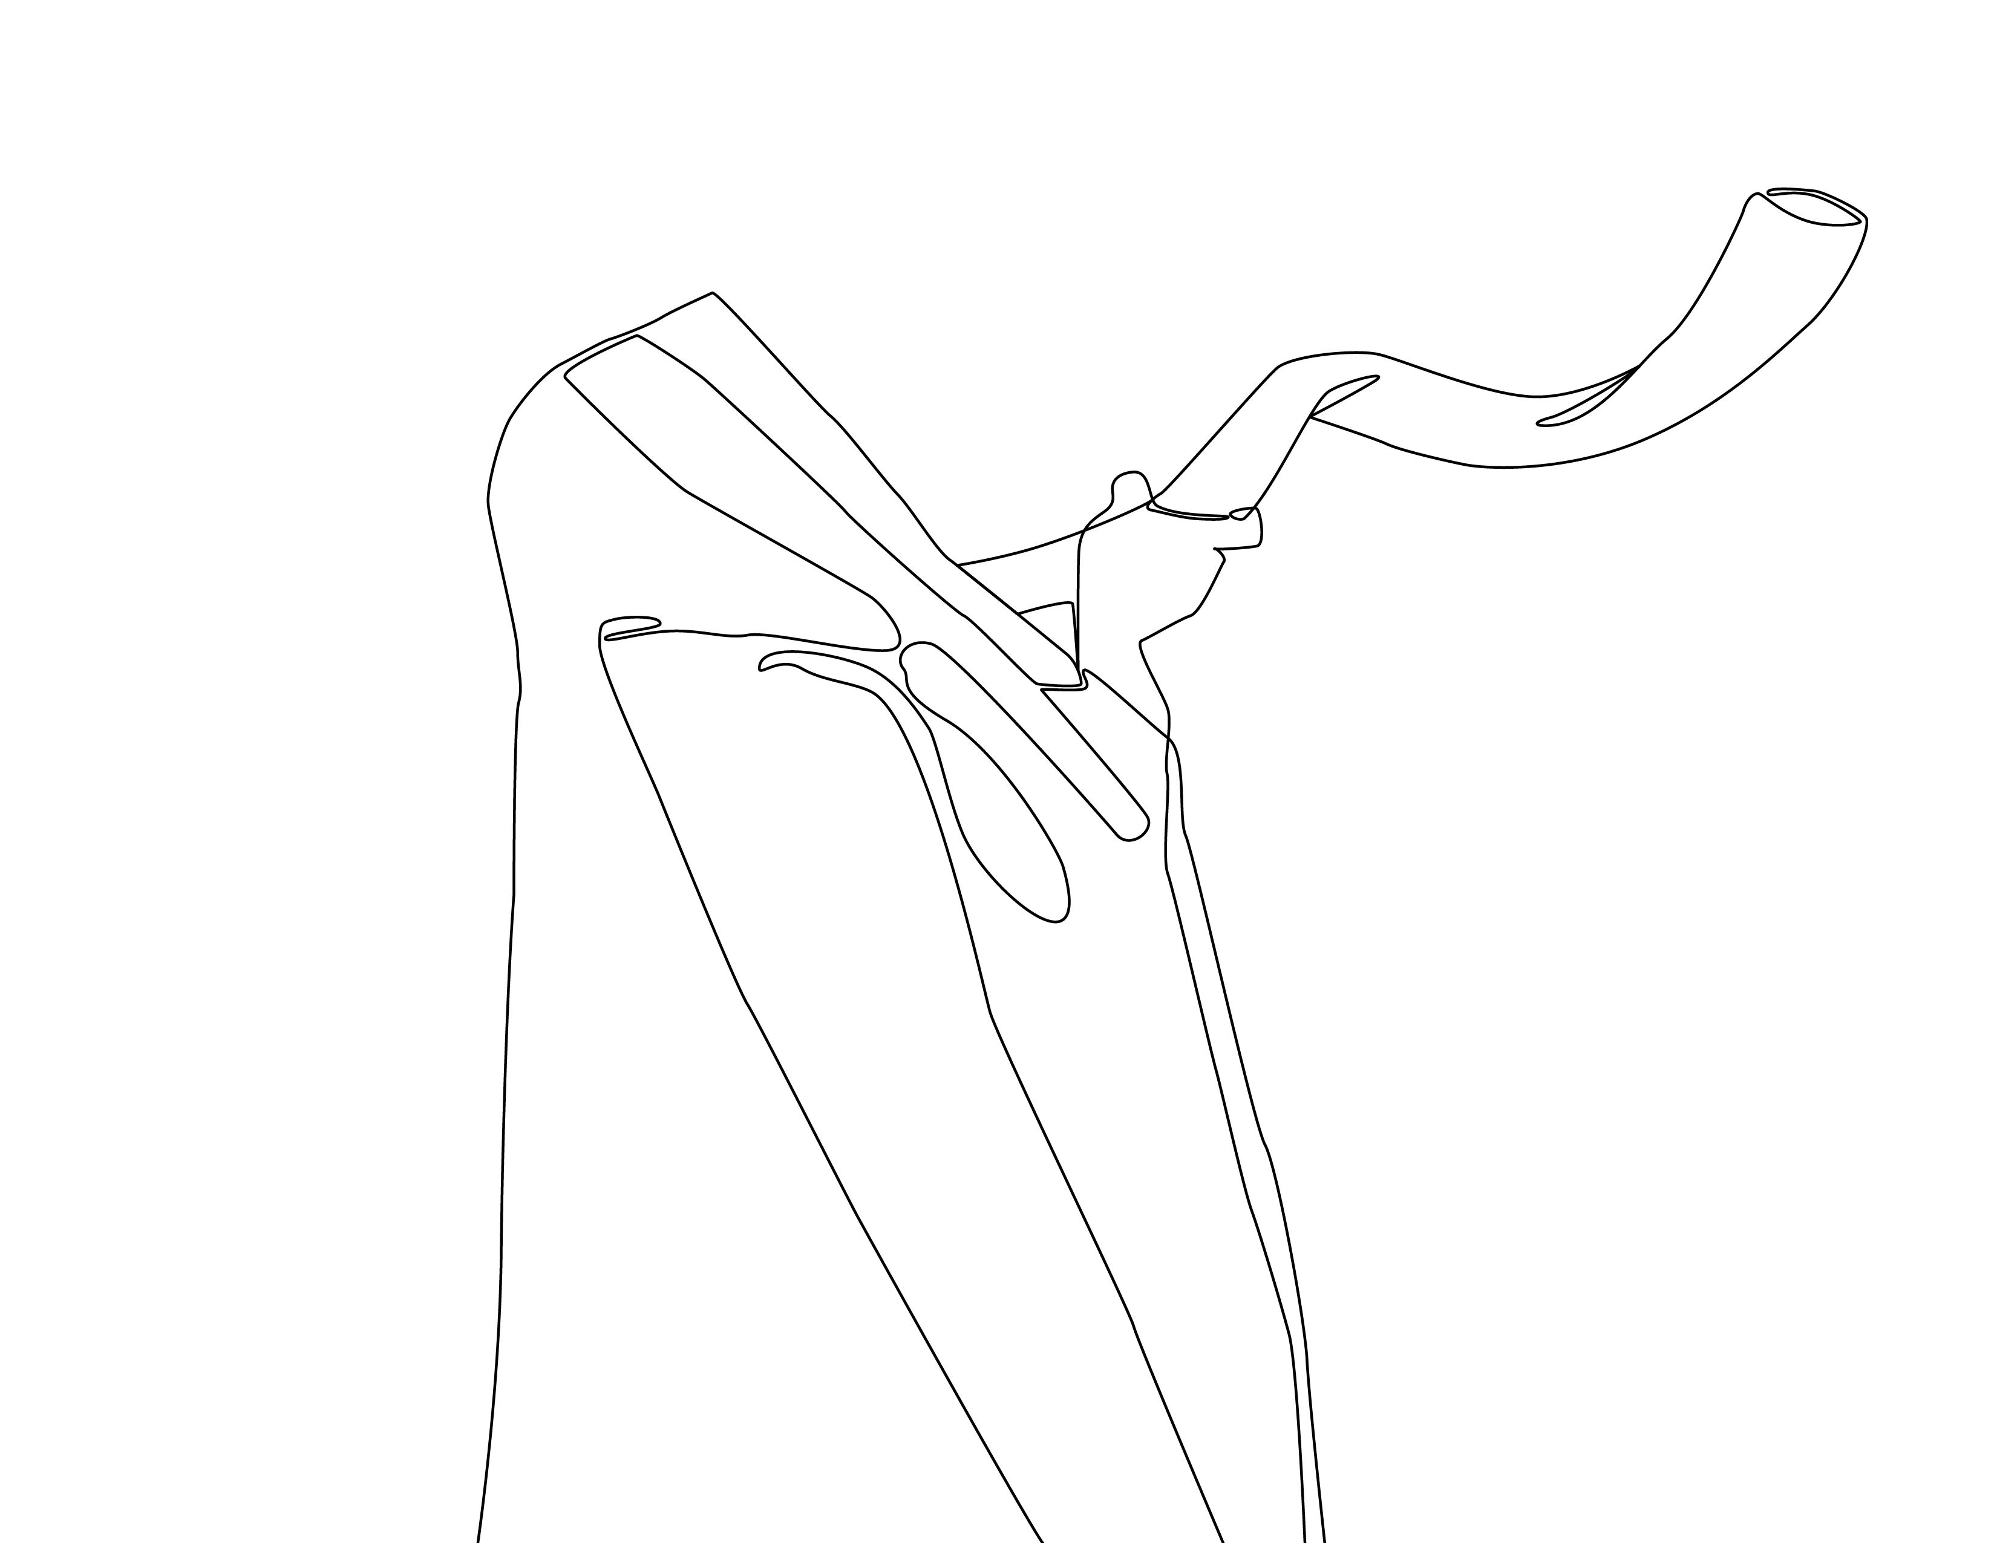
Messianic Prophecy Books
The Messianic Hope: Is the Old Testament Really Messianic? (2010 Michael Rydelnik)
The Moody Handbook of Messianic Prophecy: Studies and Expositions of the Messiah in the Old Testament (2019 Michael Rydelnik and Edwin Blum)
Answering Jewish Objections to Jesus: Volume 3: Messianic Prophecy Objections (2003 Michael L. Brown)
The Messiah in the Old Testament (1995 Walter C. Kaiser)
The Lord’s Anointed: Interpretation of the Old Testament Messianic Texts (1995 Philip E. Satterthwaite, Richard S. Hess and Gordon J. Wenham

Slide 3
Messianic Prophecy Books, cont.
The Real Messiah: Prophecies Fulfilled (2008 D. James Kennedy and Jerry Newcomb)
Refuting Rabbinic Objections to Christianity & Messianic Prophecies (2019 Eitan Bar)
The Messiah in the Old Testament in the Light of Rabbinical Writings (1992 Risto Santala)
All the Messianic Prophecies of the Bible (1988 Herbert Lockyer)
Y’shua: The Jewish Way to Say Jesus (1982 Moishe Rosen)
Reading Moses, Seeing Jesus: How the Torah Fulfills Its Goal in Yeshua (2019 Seth Postell)

Slide 4
Messianic Prophecy Books, cont.
The Messianic Vision of the Pentateuch (2019 Kevin S. Chen)
The Serpent in Samuel: A Messianic Motif (2020 Brian A. Verrett)
The Gospel According to Isaiah 53: Encountering the Suffering Servant in Jewish and Christian Theology (2012 Darrell L. Bock and Mitch Glaser)
Isaiah 53 Explained: This Chapter Will Change Your Life (2010 Mitch Glaser)
The Suffering Servant: Isaiah 53 in Jewish and Christian Sources (2004 Peter Stuhlmacher)
Jesus and the Suffering Servant (1998 William H Bellinger, Jr. and William R. Farmer)

Slide 5
Messianic Prophecy Books, cont.
The Mother of the Infant King Isaiah 7:14: ‘alma and Parthenos in the World of the Bible: a Linguistic Perspective (2020 Christopher Rico and Peter J. Gentry
The Miseducation of Isaiah 53 (2019 Dayvaughn Mays)

Slide 6
Y’shua
The Jewish Way to Say Jesus
(1982 Moishe Rosen)
350k copies sold

Slide 7
He Opened Their Minds:
Amazing Prophecies about the Messiah
Outline
Table of Contents
Intro: He Opened Their Minds: a story
Section One: The Torah
Chapter 1 What is Wrong with the World?
The Messiah would be the seed of the woman
Chapter 2 It’s a Family Affair
The Messiah would be the descendant of Abraham through whom all nations would be blessed
Chapter 3 M.O.T. A Member of the Tribe
The Messiah would be the ruler from the tribe of Judah
Chapter 4 The Most Luminous Person
The Messiah would be the Star out of Jacob

Slide 8
He Opened Their Minds:
Amazing Prophecies about the Messiah
Outline
Chapter 5 Holy Moses!
The Messiah would be a prophet like Moses
Section Two: The Prophets
Chapter 6 A Most Unusual Birth
The Messiah would be born of a virgin
Chapter 7 The House of Bread
The Messiah would be born in Bethlehem
Chapter 8 The Rabbi’s Dilemma
The Messiah would be the suffering servant
Chapter 9 The New Deal
The Messiah would bring in a new covenant
Chapter 10 Tik Tok Tik Tok
The Messiah would come according to a timetable

Slide 9
Section Three: The Writings
Chapter 11 Who Should I Kiss?
The Messiah would deserve worship
Chapter 12 Beyond the Grave
The Messiah would be resurrected
Chapter 13 From the Jaws of Defeat
The Messiah would be forsaken and pierced, but vindicated
Chapter 14 King of Kings
The Messiah would be greater than David
Chapter 15 The Most Important Riddle
The Messiah would be God’s Son
APPENDIX ONE - Typology
Pictures of Messiah in the Hebrew Scripture
APPENDIX TWO – Theophanies
Mysterious appearances of Messiah in the Hebrew Scripture End Notes
Bibliography
He Opened Their Minds:
Amazing Prophecies about the Messiah
Outline

Slide 10
The Introduction

