Slide 2
The Messianic Hope: A Case for an
Identifiable
Messianic Jewish Community
Rabbi Kirk Gliebe
Devar Emet Messianic Synagogue & Outreach, Skokie, IL
Presented at the LCJE in Ft. Lauderdale/Coral Springs, FL – February 28, 2023

Slide 3
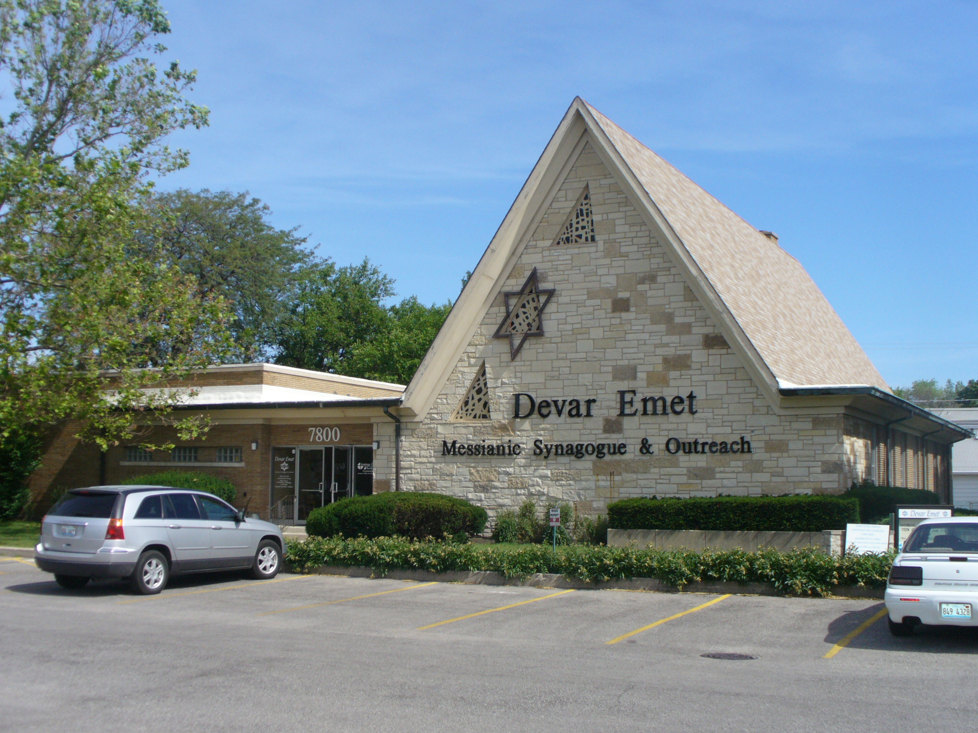
Devar Emet: an Outreach
& a Synagogue
A Jewish Community that believes and teaches that Yeshua, Jesus, is the promised Jewish Messiah
In Skokie on the North Side of Chicago, central to 200,000 Jewish people within a 20 minute drive, most religiously observant & committed to living Jewish life

Slide 4
The purpose of this presentation is to provide one perspective on how a clearly identifiable and tradition respecting Jewish community of Jewish Yeshua followers can help partially fulfill the Messianic Hope of G-d’s Redemption of his creation through effective witness and discipleship within the Jewish Community.

Slide 5
Backgrounds & Definitions:
Jewish identity is sociological, and can best be understood practically as an identity of unique communal distinction based on the understanding of a common peoplehood, and observance of and loyalty to the Mosaic Covenant (Torah) preserved within the Scripture and applied by the traditions of the Jewish people.

Slide 6
Backgrounds & Definitions:
Messianic Faith is theological. It is the belief that G-d sent the Messiah of Israel in the person of Yeshua, and that based on one’s personal faith in him and the atonement for sin he has provided through his death alone, G-d grants grace and forgiveness for the consequences of one’s sin.

Slide 7
Backgrounds & Definitions:
Messiah’s Community (ecclesia) is a single community expressed in diverse forms within the Jewish community and among the nations. All are called to a dedicated life of worship, neighborly service, and public testimony to Yeshua. Unity and love throughout the entire community confirm Yeshua’s role, as the One sent by the Father, and G-d’s purpose in Messiah for Israel and the Nations. (UMJC Statement of Faith)

Slide 8
Backgrounds & Definitions:
Messianic Communities (local physical gatherings) are places where individuals professing faith in Messiah Yeshua grow in their relationship with G-d together with others, forming a communal testimony to live out their faith; they also serve as a support for passing down that faith to the children of these believers. These communities vary greatly from group to group based on local, national, political, ethnic & cultural values and traditions.

Slide 9
Backgrounds & Definitions:
Messianic Jewish Communities were conceived to be places where Jewish believers in Messiah Yeshua could grow in their relationship with G-d as a communal testimony and live out their unique G-d given identity as Jewish people; they were to also serve as a support for passing down Jewish identity to the children and grandchildren of these believers.

Slide 10
Did Israel’s Messiah Yeshua Really Come to Terminate the Mosaic Covenant?
“The Torah is G-d’s gift to Israel. It serves as the constitution of the Jewish people and thus also of the Messianic Jewish community, which comprises Israel’s eschatological first fruits. The Torah does not have the same role for Messianic communities from the nations, though it does provide spiritual nourishment as a witness to the Messiah. The Torah also provides universal norms of behavior and practical life teaching for all. The Torah is to be applied anew in every generation, and in this age as is fitting to the New Covenant order.” (from the UMJC Statement of Faith)

Slide 11
Did Israel’s Messiah Yeshua Really Come to Terminate the Mosaic Covenant? No!
First, G-d made the Mosaic Covenant as a contractual agreement specifically between Himself and the Jewish people, and no one else.
Second, G-d’s commitment to national Israel is secure, despite Israel’s failing.
Third, when we look at the Post-Exilic literature within the Tanakh we do not find any hint of an anticipated termination of the Mosaic Covenant or of any cessation in expected observance of the Covenant in the lifestyle of the restored Jewish nation.
Fourth, the New Covenant text never speaks against zealous Jewish identity or Torah observance by Jewish believers, except when either Jews or Gentiles tried to impose Jewish observance and/or the Mosaic Covenant on Gentile believers in Messiah.

Slide 12
Did Israel’s Messiah Yeshua Come to Assimilate His Jewish Followers into the Nations?
Stats show clearly that Jesus faith historically leads to loss of Jewish identity, and does not even guarantee multi-generational Jesus faith
Well meaning Churches, Missions and Christians often continue to believe and teach that Jewish people need to be set free from the burden of Jewish religion and cultural practices, forgetting that this is ethnocentric, religious arrogancy, supersessionist and elitist!

Slide 13
Did Israel’s Messiah Yeshua Come to Assimilate His Jewish Followers into the Nations?
Of course not!
The Messianic Hope includes Israel’s national fullness under Messiah’s Reign, so encouraging and strengthening Jewish identity in Jewish followers of Messiah Yeshua just makes sense!

Slide 14
How come Chabad is doing so much better then we are?
Chabad is a fringe movement, but so are we!
Chabad sends out more Shlichim (missionaries) on a per capita basis than our Messianic or Evangelical Christian Congregations do, all without saving faith in Yeshua!
Chabad builds identifiable communities that grow with Jews, while the long term results of our efforts are often hard to find, even just a generation later.

Slide 15
Why is Chabad so successfully making an impact within the Jewish community?
They focus their outreach on Jewish people,
They build Jewish community, &
They raise their children and the children impacted by their outreaches
to be committed Jews.

Slide 16
I encourage us to reconsider our approach!
Let us question whether we are sowing smart, producing Jewish fruit that endures, encouraging an identifiable Jewish remnant, one capable over time to reach an even greater Jewish remnant within the Jewish community, as we eagerly await our Messianic Hope, the return of our Jewish Messiah, Yeshua, to judge sin and establish righteousness, AND to establish his earthly Jewish Kingdom of Israel!

