Slide 1
Israeli Traveler Ministry
An intentional missions response to contemporary Israeli culture
Aaron Trank, Minister-At-Large aaron.trank@jewsforjesus.org
Download Paper and Slide deck:
http://aarontrank.com/lcje2014

Slide 2
Israeli Trekking
A well-documented cultural phenomenon

Slide 3
“Exile is the Jewish condition, so perhaps it is no surprise that travel away from Israel has become central to the Israeli identity.”
Patrick Symmes

Slide 4


Slide 5
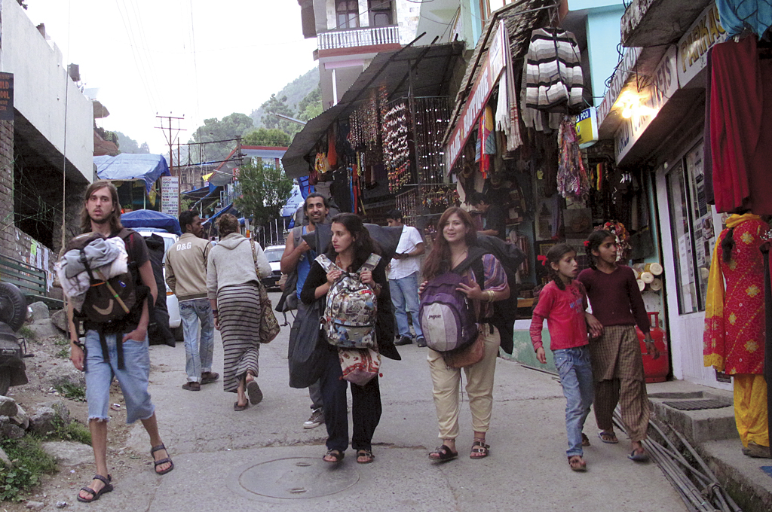

Slide 6
A brief History
The development of Post-Army Trekking

Slide 7
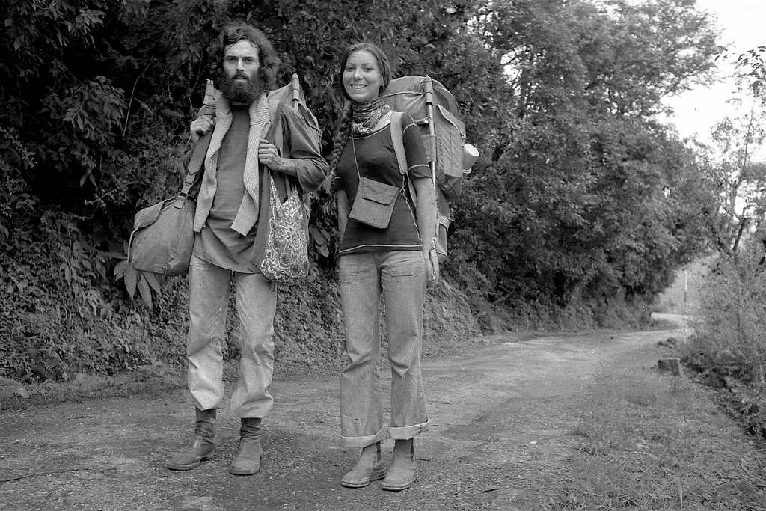

Slide 8
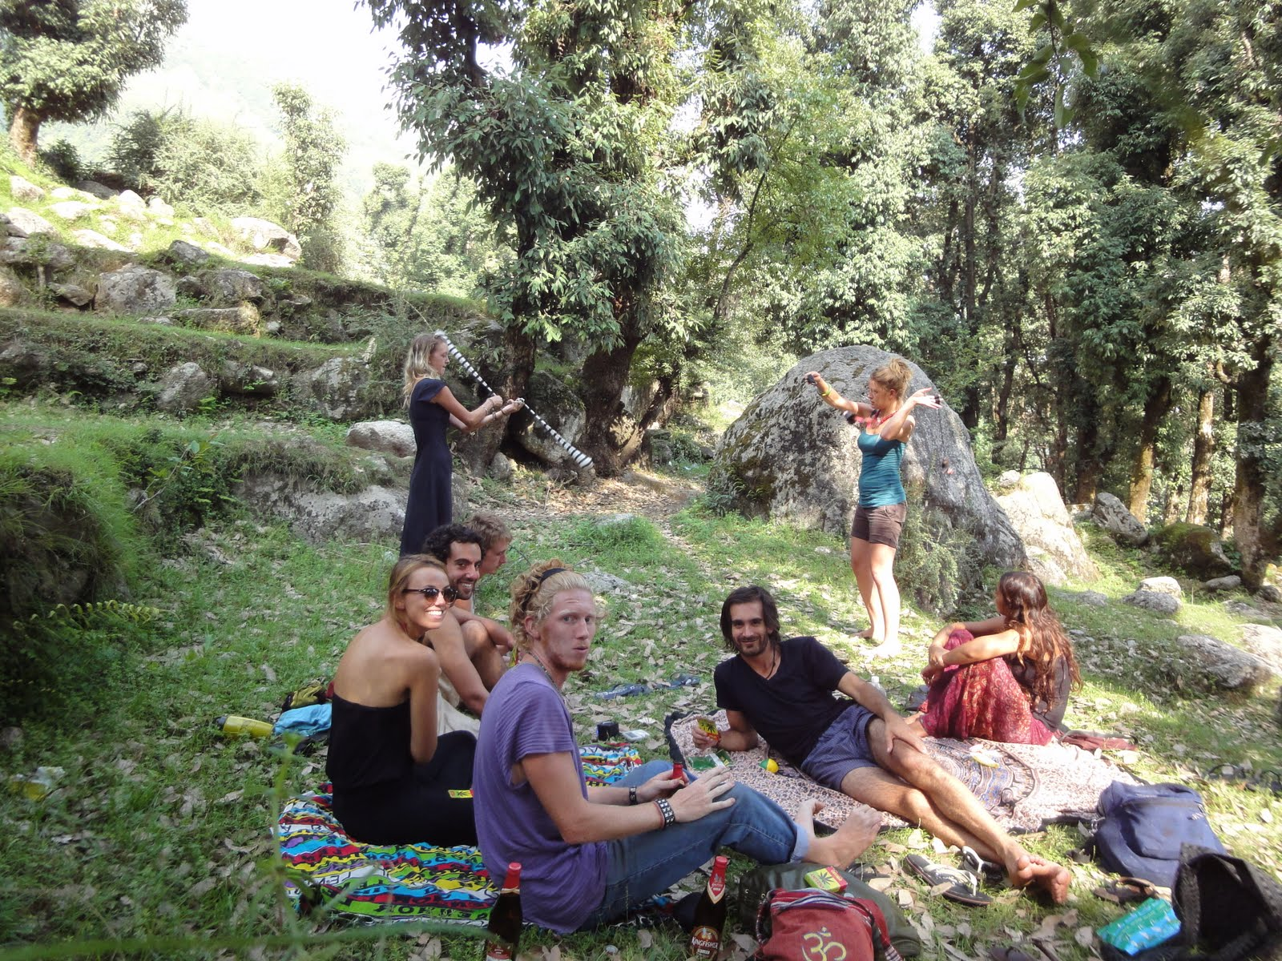

Slide 9
Trekking and Army Service
Reaction or Continuity?

Slide 10


Slide 11
“… there is an interesting point to these journeys, which can be seen as a sort of rite of separation from the compulsory part of military service. These travels very frequently include treks that are carried out in a “military” mode including precise planning, walking in small cohesive groups, and repeated tests of people’s abilities to withstand hardship and take risks.”
Eyal Ben-Ari

Slide 12
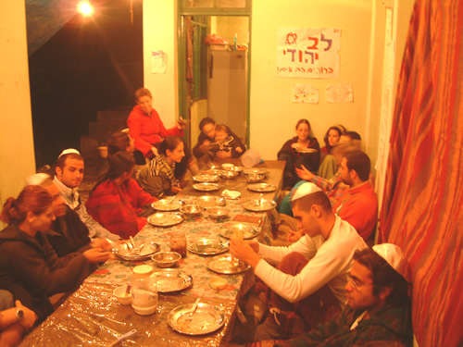

Slide 13
Israeli Enclaves
Around the Globe

Slide 14
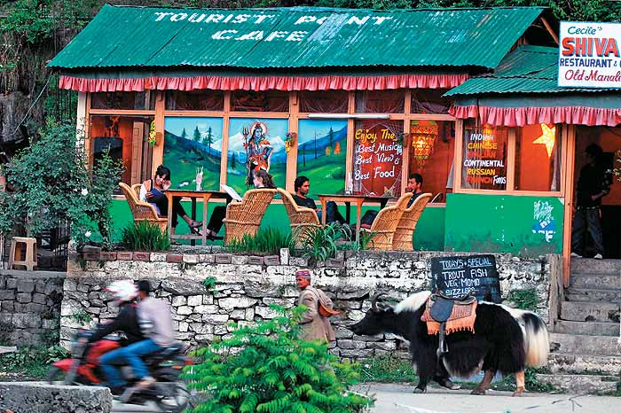
Old Manali, Himachal Pradesh, India

Slide 15
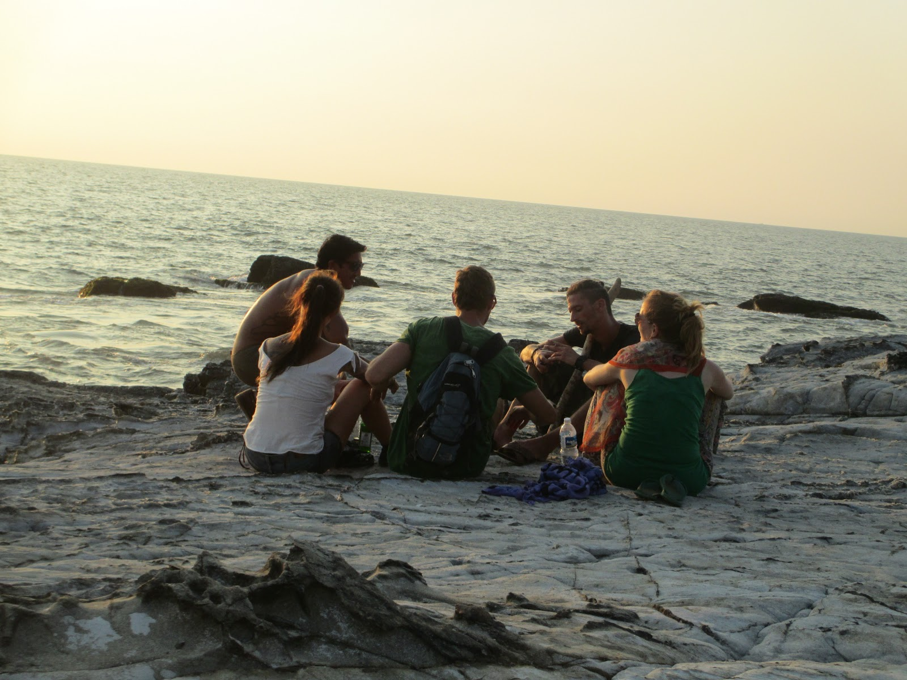
Arambol, Goa, India

Slide 16
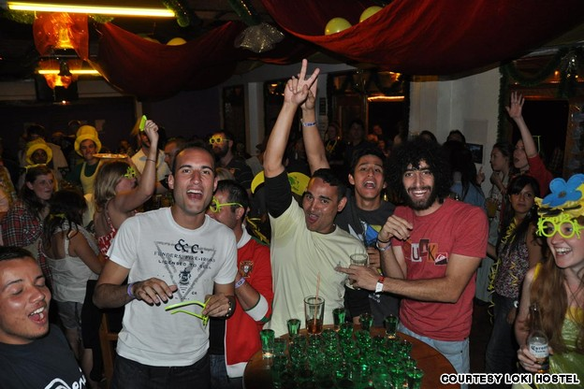
Cusco, Peru

Slide 17
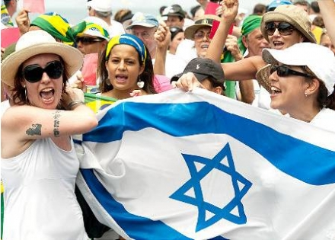
Rio De Janeiro, Brazil

Slide 18
Types of Trekkers
And their destinations of choice

Slide 19
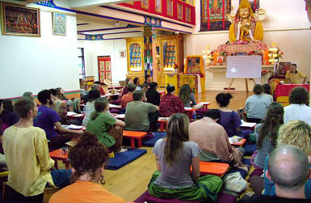
Meditation Center in Dharamsala, India

Slide 20
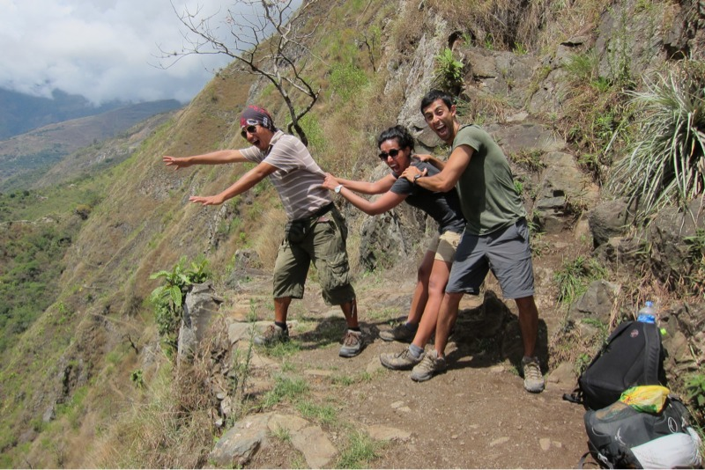
Trekking in Machu Picchu, Peru

Slide 21
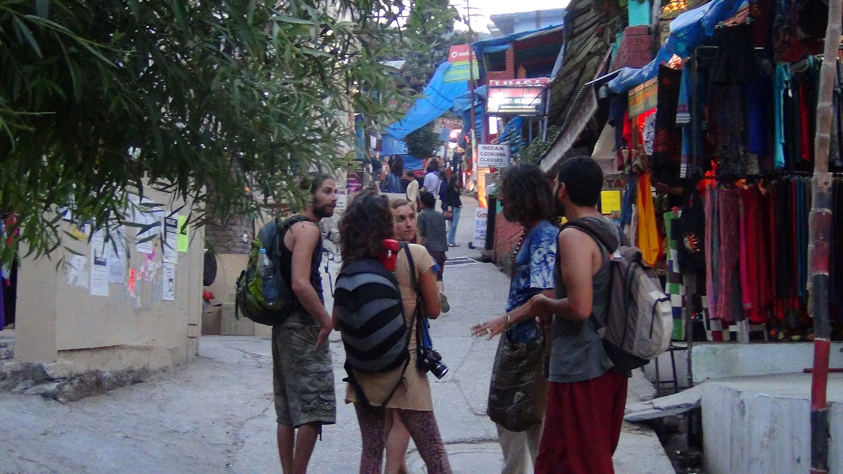
Himachal Pradesh, India

Slide 22
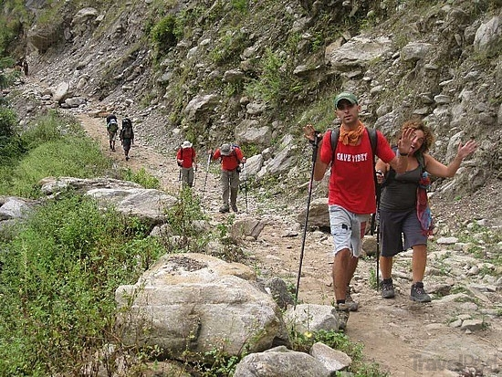
Pohkara, Nepal

Slide 23
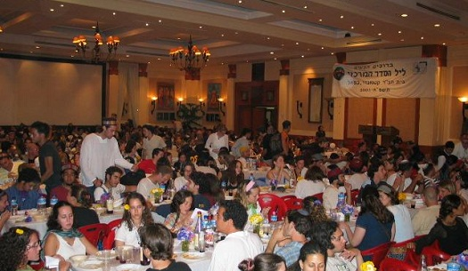
Passover in Kathmandu, Nepal

Slide 24
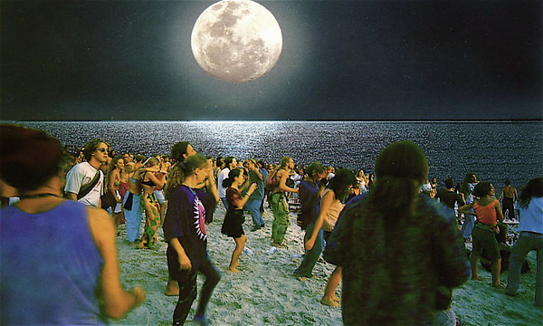
Koh Phi Phi, Thailand

Slide 25
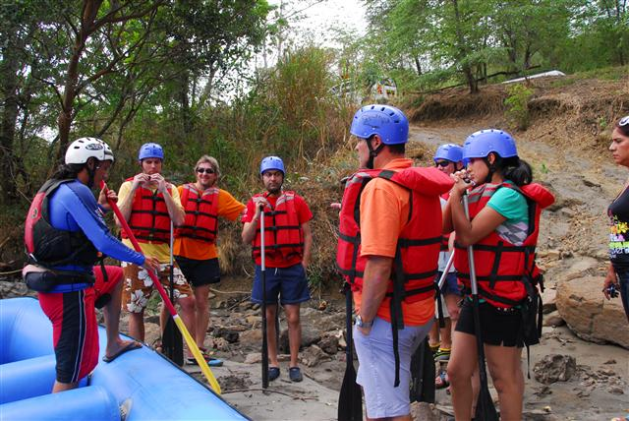
San Gil, Columbia

Slide 26
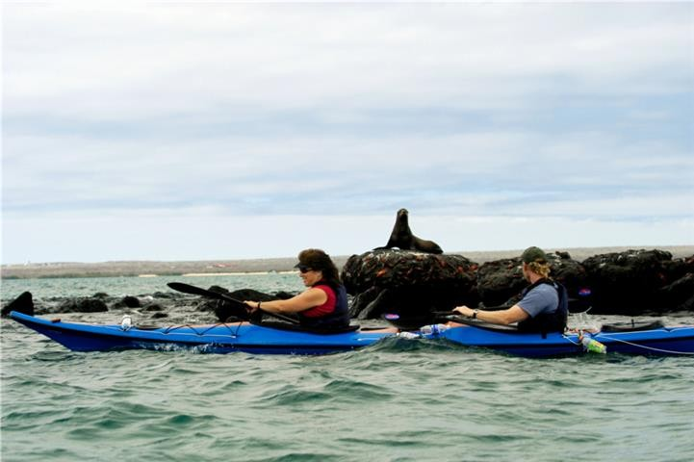
Galapagos, Ecuador

Slide 27
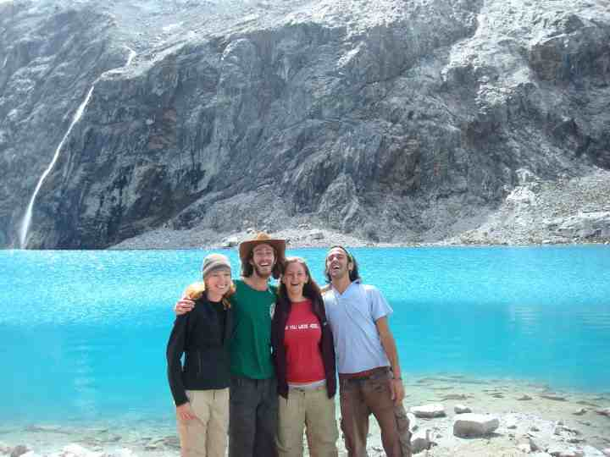
Huarez Trail, Peru

Slide 28
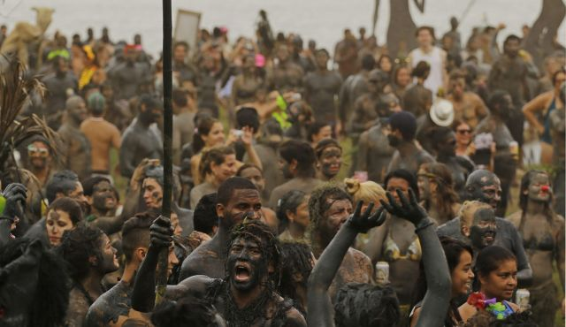
Carnival 2014, Rio De Janeiro , Brazil

Slide 29
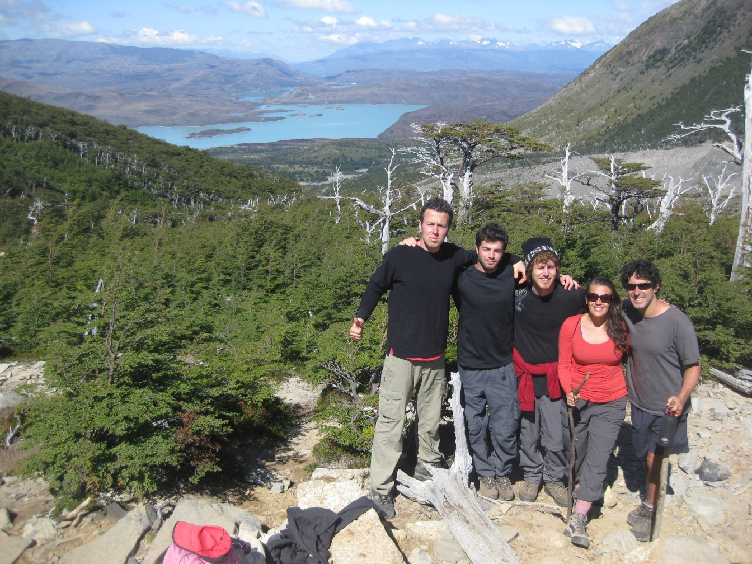
Torres Del Paine Trail, Chile

Slide 30
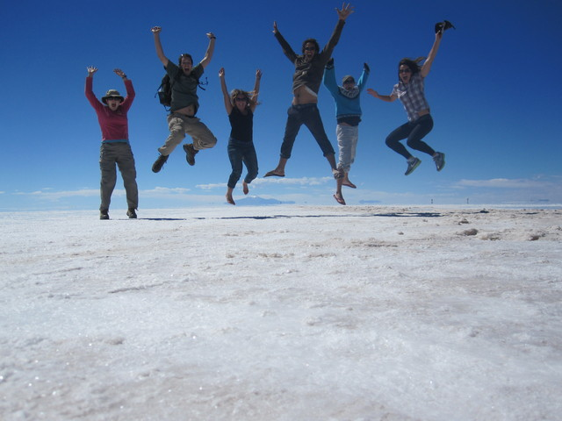
Salar Salt Flats, Argentina

Slide 31
Eastern Spirituality
And the Religious response

Slide 32
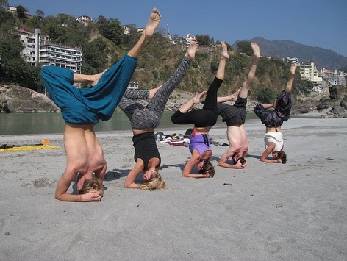

Slide 33
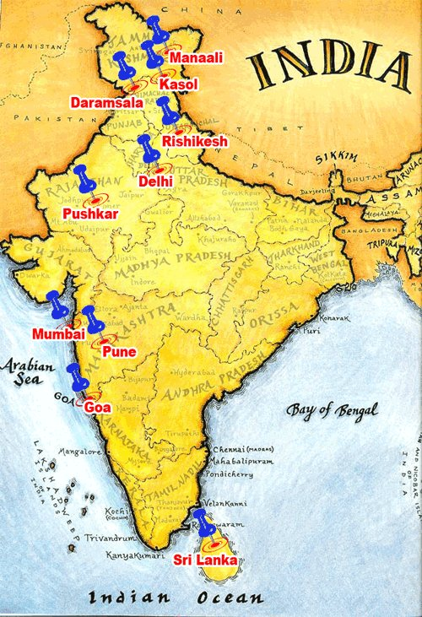
Chabad in India, Circa 2009

Slide 34
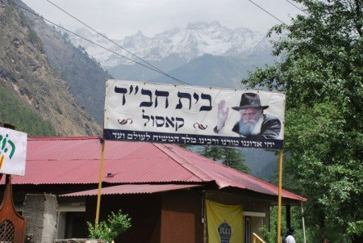

Slide 35
Life in Israel Versus Trekking
Understanding the Contrast

Slide 36
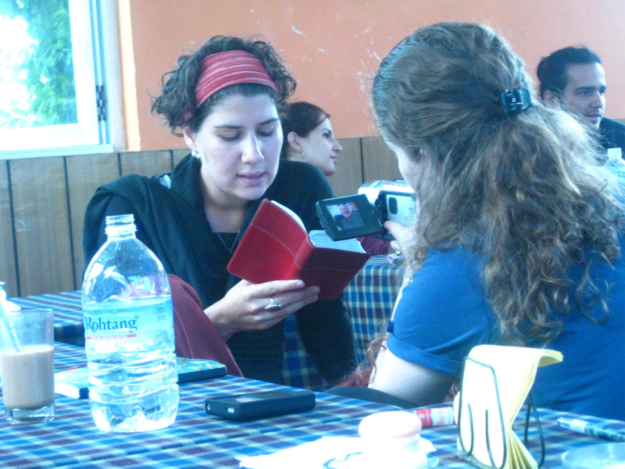

Slide 37
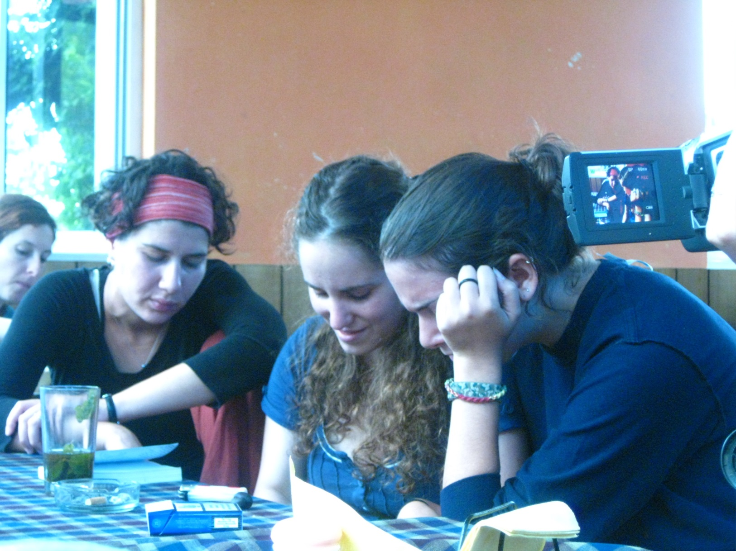

Slide 38
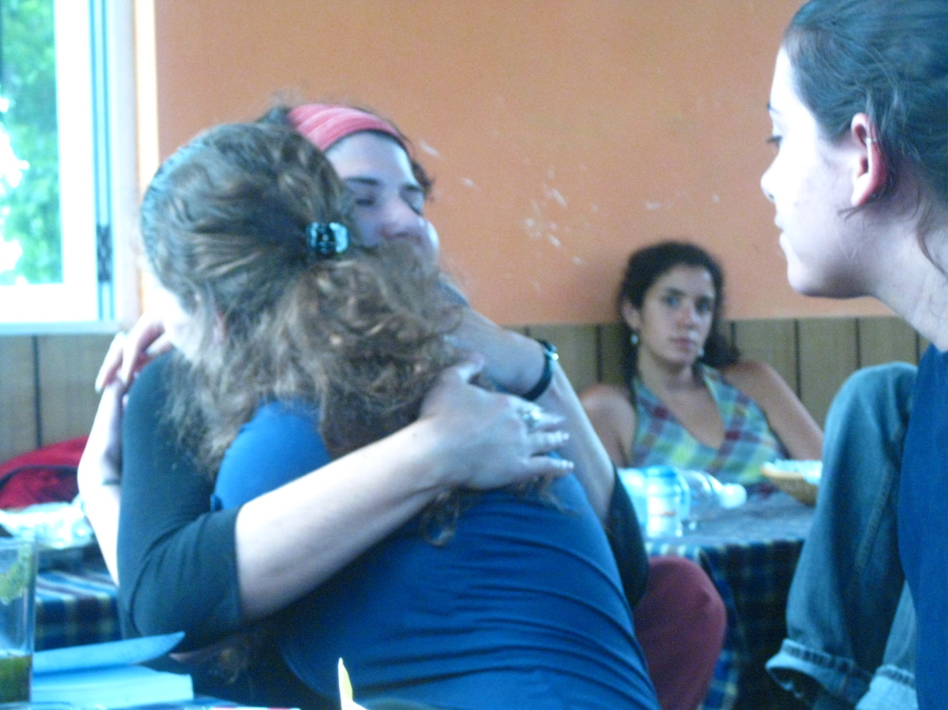

Slide 39
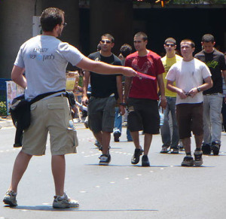

Slide 40
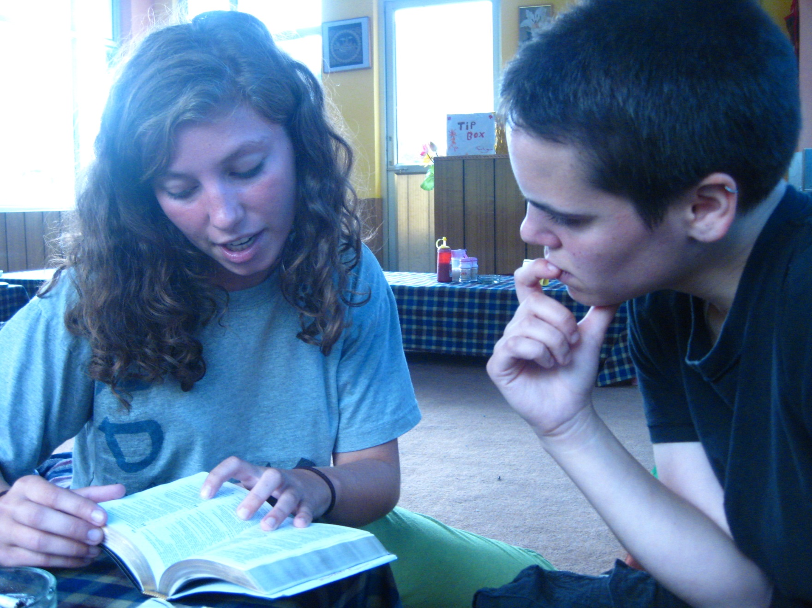

Slide 41
The “Lifecycle”
Of Israeli Trekking

Slide 42
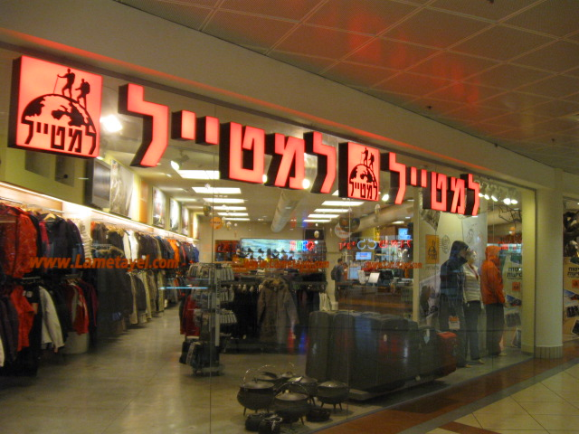

Slide 43
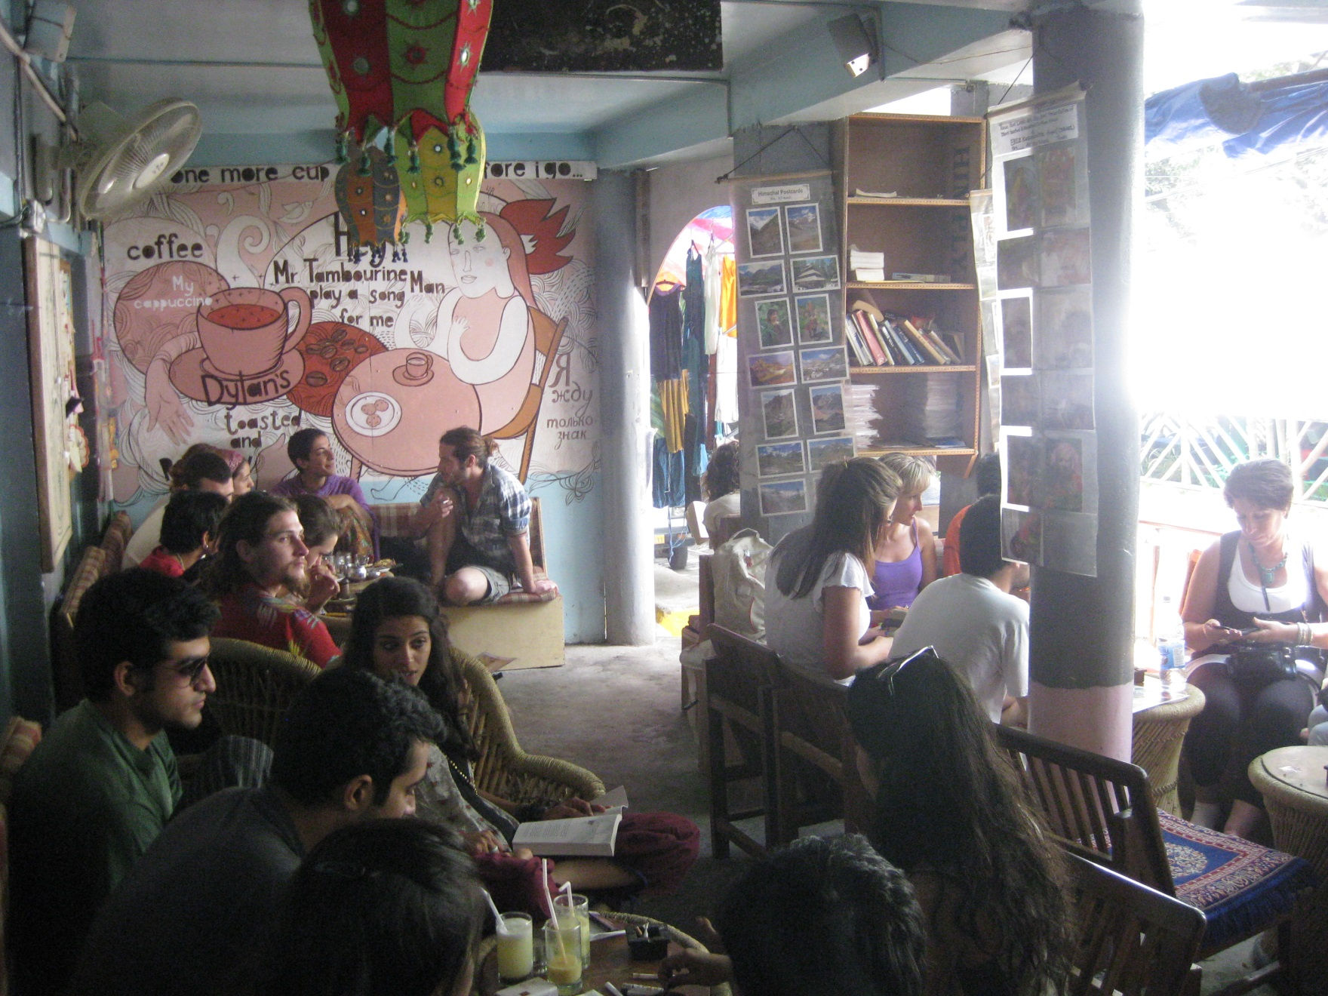

Slide 44
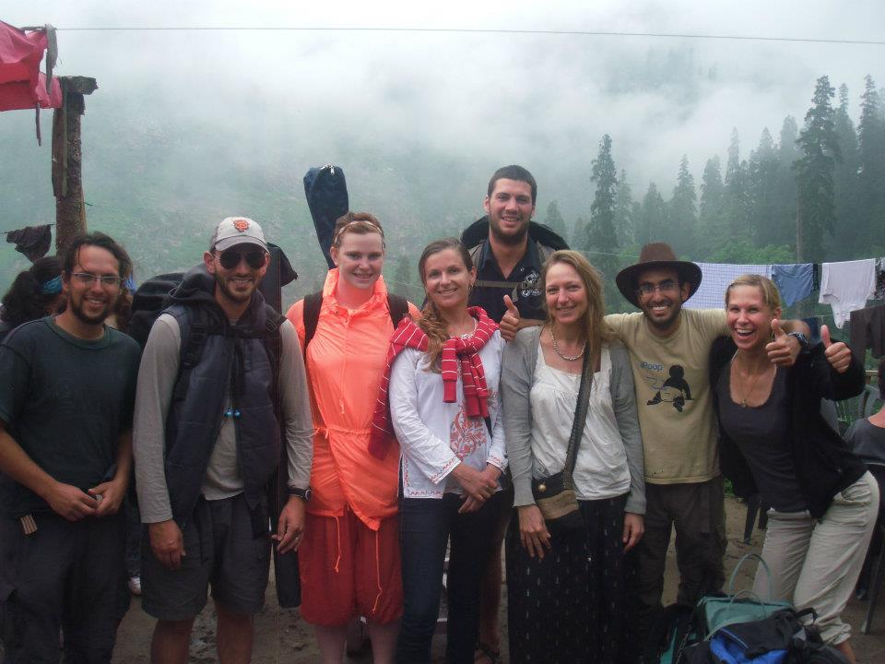

Slide 45
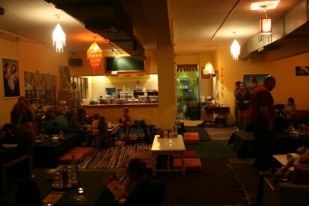
24 Rupee Restaurant, Tel Aviv

Slide 46
From Analysis to Strategy
Modes of Engagement with Israeli Trekkers

Slide 47
From Analysis to Strategy

Slide 48
From Analysis to Strategy
The development of Information centers for Israelis planning their trek itineraries from Israel.

Slide 49
From Analysis to Strategy
The development of Information centers for Israelis planning their trek itineraries from Israel.
The establishment of co-trekking programs for Israeli and non-Israeli believers who can share the Gospel with Israelis while trekking with them

Slide 50
From Analysis to Strategy
The development of Information centers for Israelis planning their trek itineraries from Israel.
The establishment of co-trekking programs for Israeli and non-Israeli believers who can share the Gospel with Israelis while trekking with them
The creation of services for Israelis in recognized trekker enclaves including the establishment of restaurants, cafes, guest houses, and other businesses

Slide 51
From Analysis to Strategy
The development of Information centers for Israelis planning their trek itineraries from Israel.
The establishment of co-trekking programs for Israeli and non-Israeli believers who can share the Gospel with Israelis while trekking with them
The creation of services for Israelis in recognized trekker enclaves including the establishment of restaurants, cafes, guest houses, and other businesses
The equipping and encouragement of Native Christians to think “missionally” about the Israelis who are traveling in their regions

Slide 52
From Analysis to Strategy
The development of Information centers for Israelis planning their trek itineraries from Israel.
The establishment of co-trekking programs for Israeli and non-Israeli believers who can share the Gospel with Israelis while trekking with them
The creation of services for Israelis in recognized trekker enclaves including the establishment of restaurants, cafes, guest houses, and other businesses
The equipping and encouragement of Native Christians to think “missionally” about the Israelis who are traveling in their regions
The development of follow up centers – “trampoline sites” – where Israelis who heard the Gospel while trekking can continue the discussion back in Israel.

Slide 53
Information Centers
For Israelis planning their treks from Israel

Slide 54
Co-Trekking Programs
Sharing the Gospel while Trekking with Israelis

Slide 55
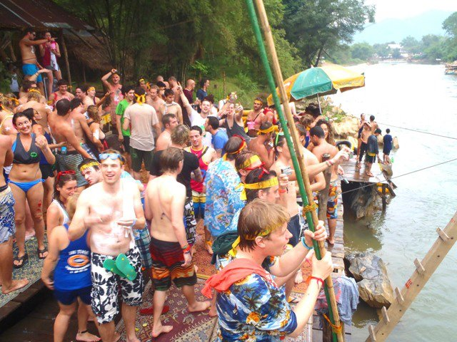

Slide 56
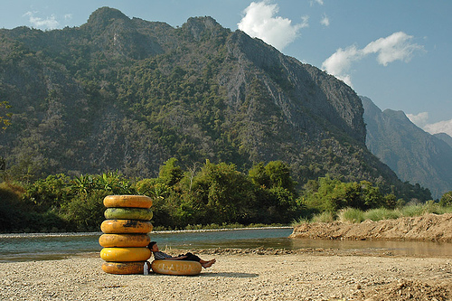

Slide 57
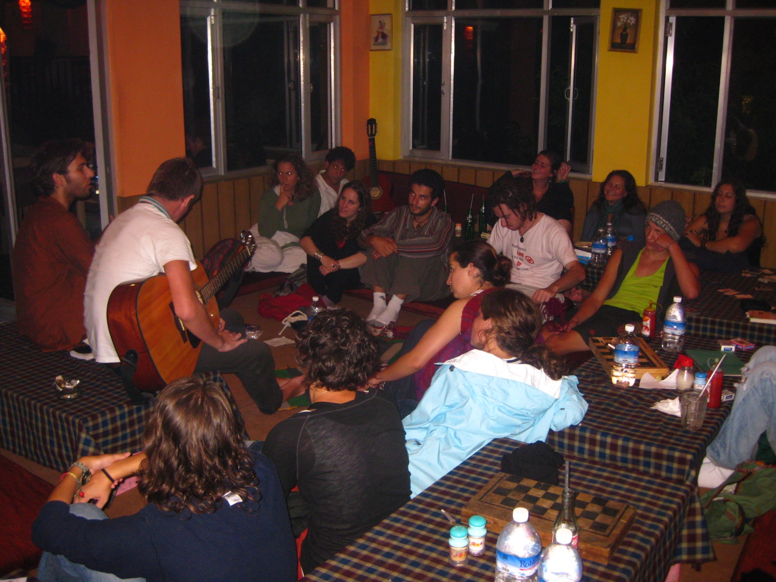

Slide 58
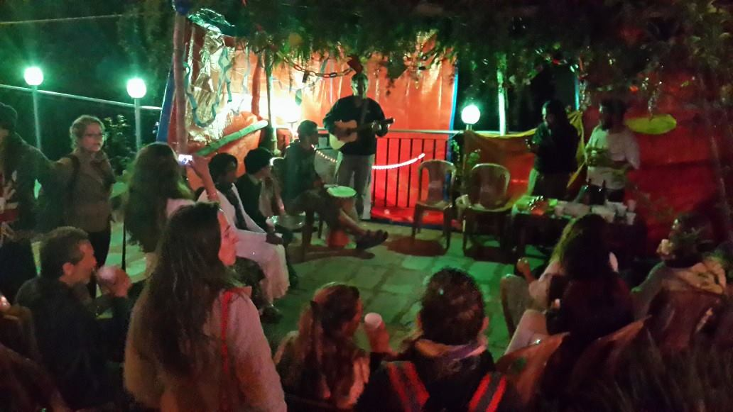

Slide 59
Services for Israeli Trekkers
Restaurants, Cafes, Guest Houses, Courses, Volunteer Opportunities, etc...

Slide 60
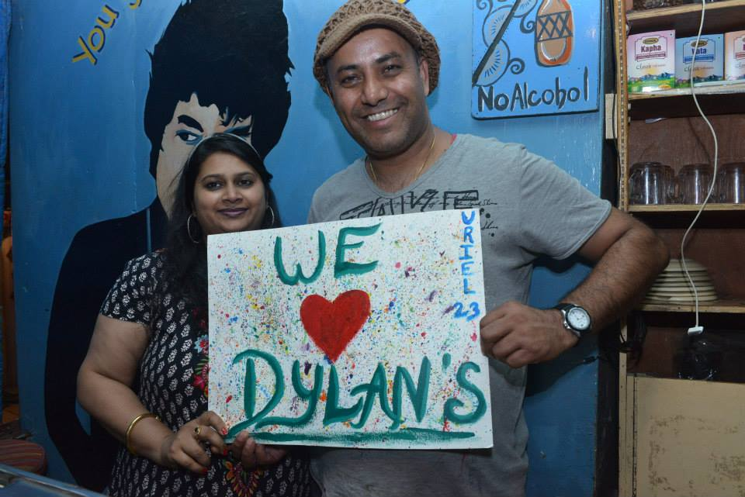

Slide 61
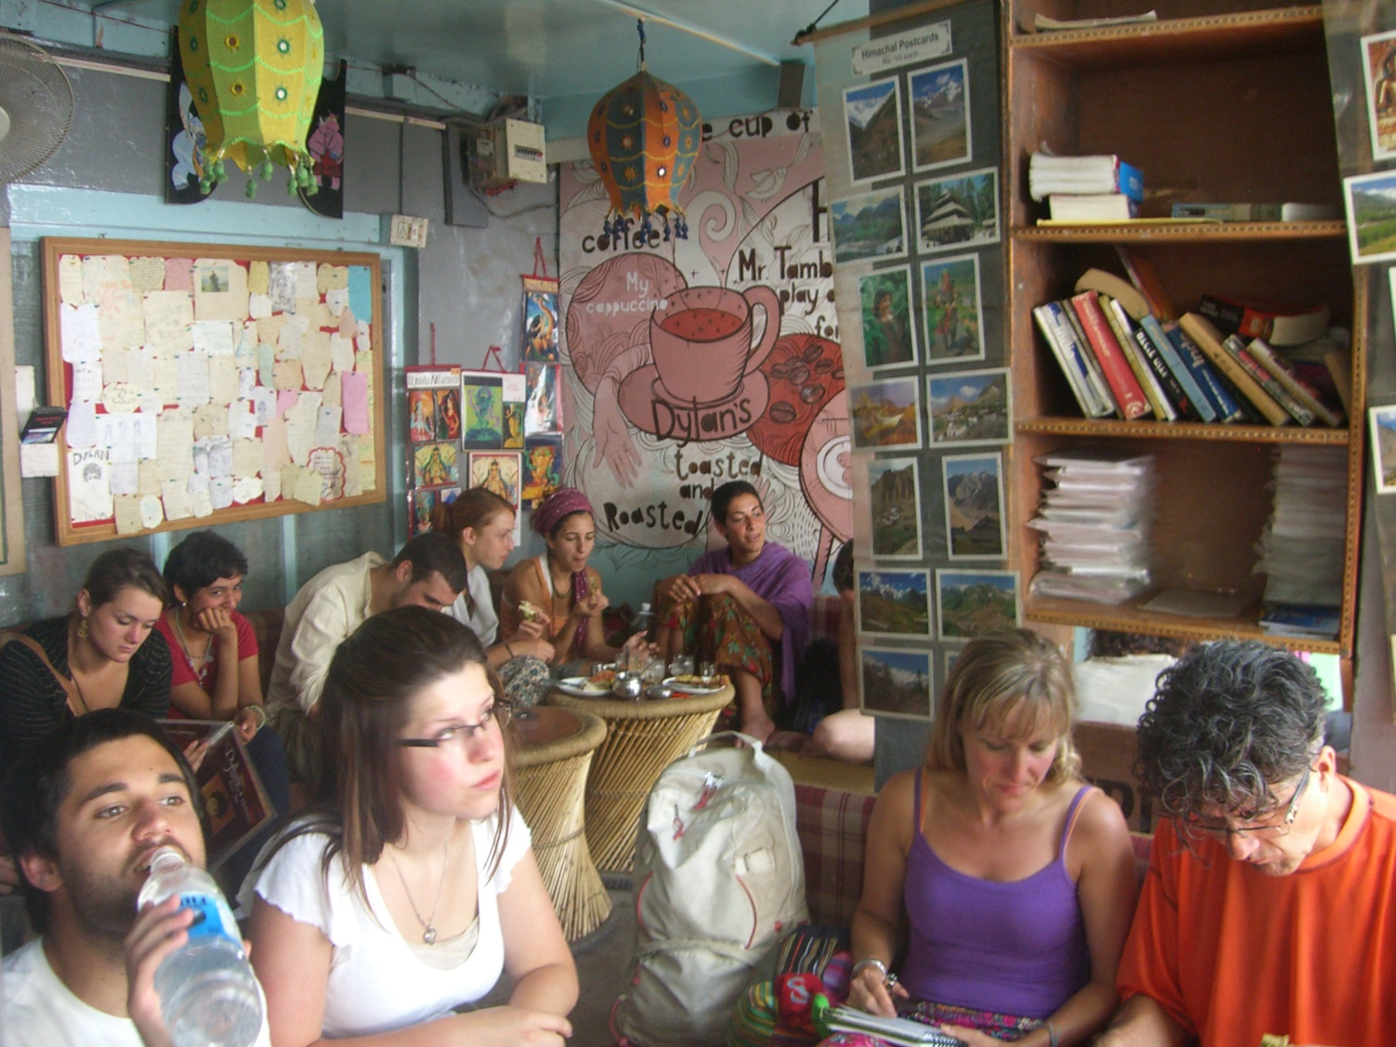

Slide 62
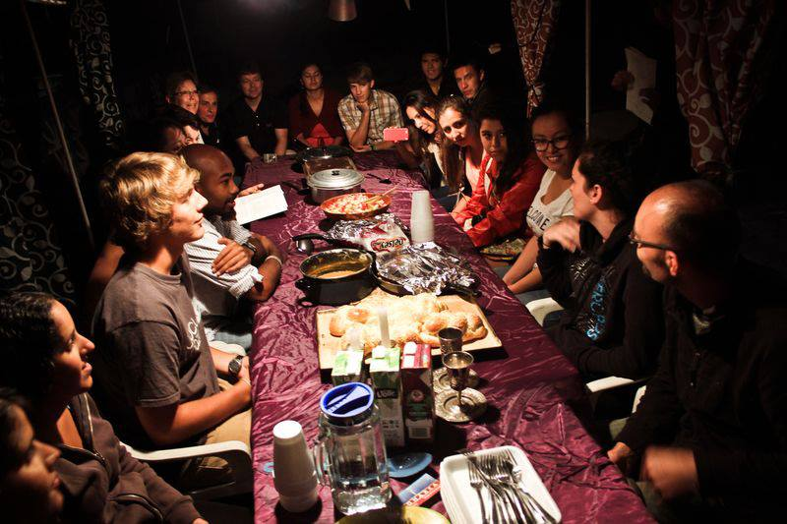

Slide 63
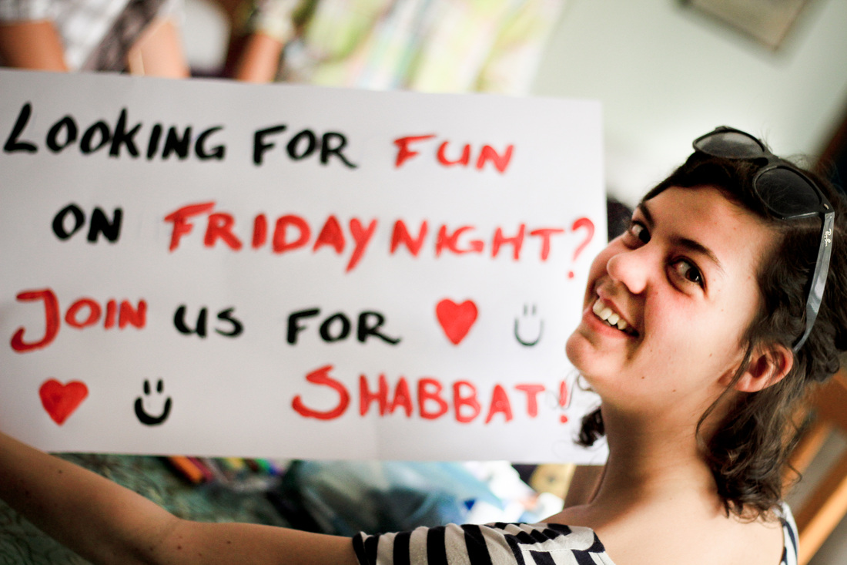

Slide 64


Slide 65
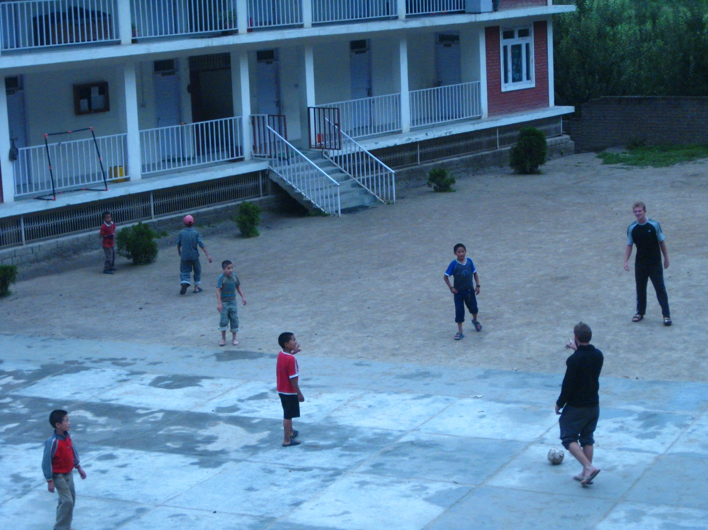

Slide 66
Native Christian Ministry
Empowering locals to share with Israelis

Slide 67
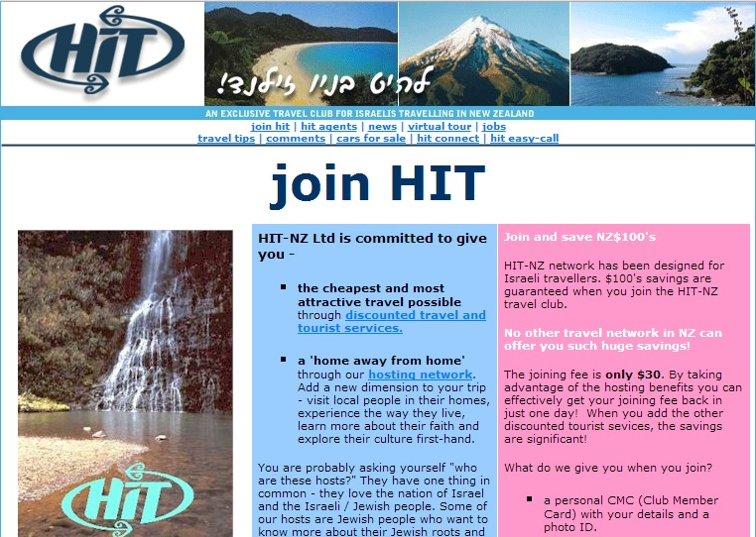

Slide 68
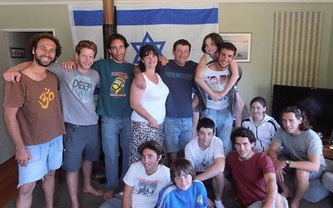

Slide 69
Follow Up Centers
Continuing the relationships back in Israel

Slide 70
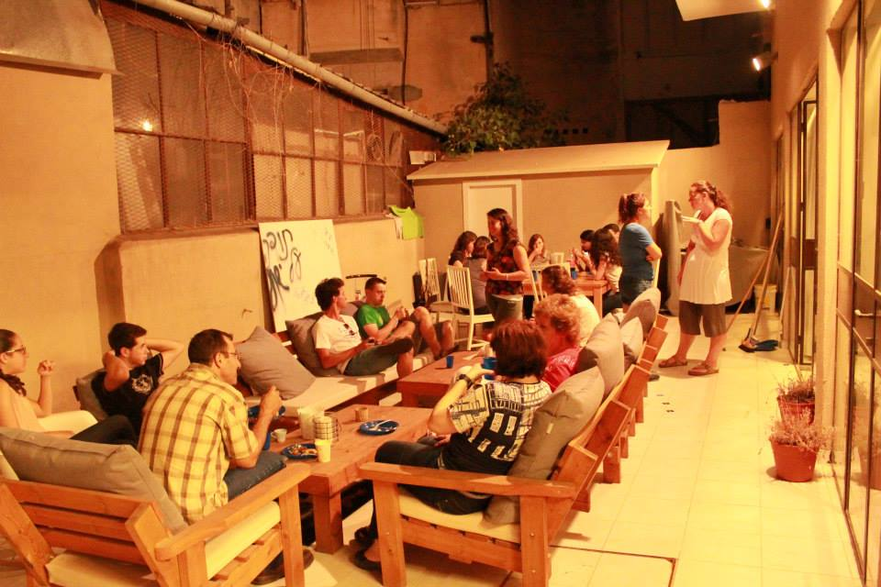

Slide 71
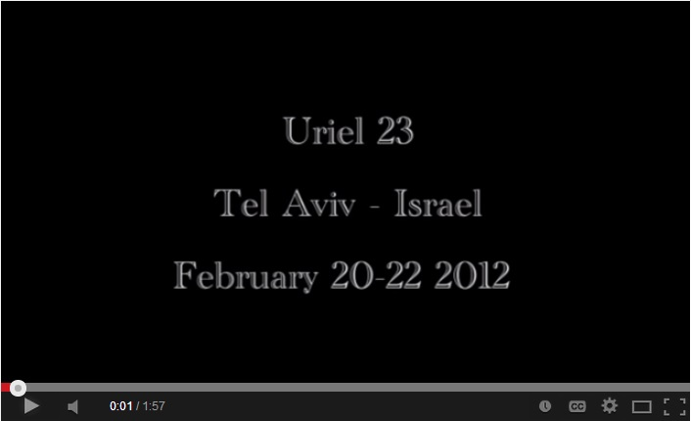

Slide 72
Final Reflections
Opportunities for Collaboration and Cooperation

Slide 73
Download Paper and Slide deck:
http://aarontrank.com/lcje2014
CONTACT:
Aaron Trank, Minister-At-Large aaron.trank@jewsforjesus.org

