Slide 1
Messianic Jews in Pre-War Germany – A Sequel
Christiane Jurik
Director of Publications
Ariel Ministries

Slide 2
A Brief History
of the Messianic Jewish
Movement in Europe

Slide 3
Julius Bamberger
My ancestor through the male line
Son of Lazarus Loew, a door-to-door salesman
Got baptized so that he could teach at the Maximilian University in Munich and took on the name Karl Friedrich Neumann
Orientalist, started the first department of Chinese Studies at a German university

Slide 4
Caroline of Baden
1776-1841
Queen of Bavaria (1806-1825)

Slide 5
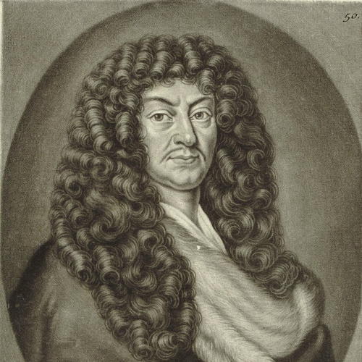
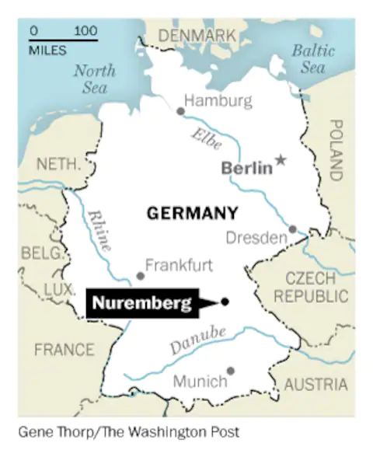
Pioneers
Johann Christoph Wagenseil (1633-1705)
Peaceful outreach to Jews
Hope in the Redemption of Israel

Slide 6
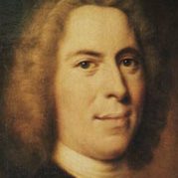
Pioneers
Nikolas Ludwig von Zinzendorf (1700-1760)
Encouraged faith in Yeshua while observing Jewish practices, such as Shabbat traditions and the observance of Yom Kippur
Started a kehillah in Moravia
Paradigm shift

Slide 7
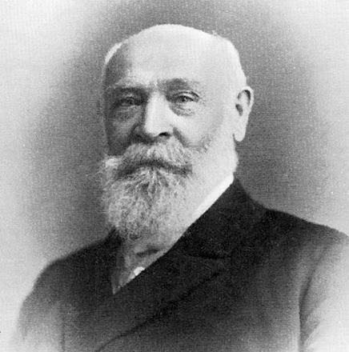
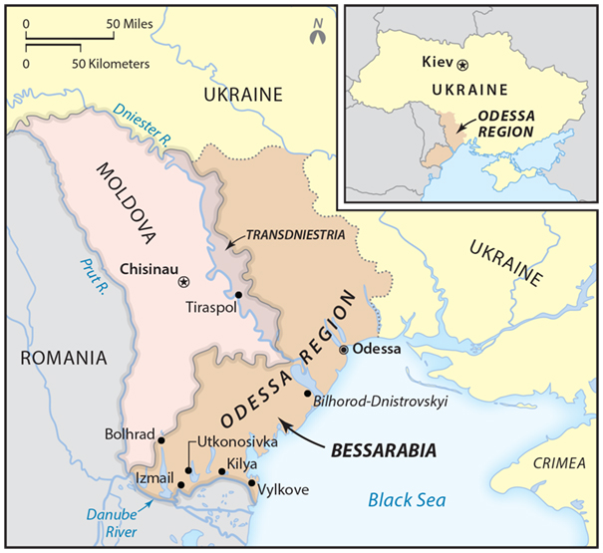
Pioneers
Joseph Rabinowitz (1837-1899)
Founded a Messianic congregation in Bessarabia, Congregation of Israelites of the New Covenant
Active in Romania, Hungary, and Russia
Called “Herzl of Messianic Judaism”

Slide 8
Abram Poljak
1900-1963

Slide 9
Abram Poljak
Born 1900 in Ukraine
Jewish parents
Grandfather Russian rabbi

Slide 10
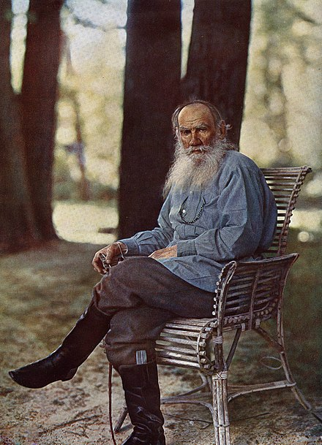
Leo Tolstoy
1828-1910
“Tolstoy showed me a Christianity I had not held to be possible. I thought that Christians learned from Jesus to murder Jews and torment Jewish children at school. But in Tolstoy’s books I read that Jesus taught boundless love”
- Abram Poljak

Slide 11
Salvation
“Scales fell from my eyes. Now I saw Yeshua inwardly and outwardly – the Master of love, the Lord of grace, the Redeemer of the world, the Son of God and the King of the Jews! The One in everything and everything in the One: the King of the Jews.”
-Abram Poljak

Slide 12
Career
University
1927
Journalism
Parents hoped that he would become rabbi
Poljak studied philosophy instead
Taught on Jewish topics at Institutum Judaicum Delitzschianum in Leipzig
Worked as journalist until the Nazis forced his dismissal in 1930

Slide 13
Publications
1927
Between Man and God

Slide 14
Party Affiliations
1930-1933
1933
1933
German Social Democratic Party
Founding of Communist Party
Disbanding of Communist Party by Nazis
Arrest

Slide 15
Palestine
1933
1934
1936
Fled to France
Wanted to get to Palestine
Arrived in December of 1934
Left Palestine because his plans to establish a safe-haven for Jewish believers did not work out

Slide 16
Important Meetings
Rabbi Moshe Immanuel ben Meir
Rabbi Daniel Zion
1905-1978
1883-1979

Slide 17
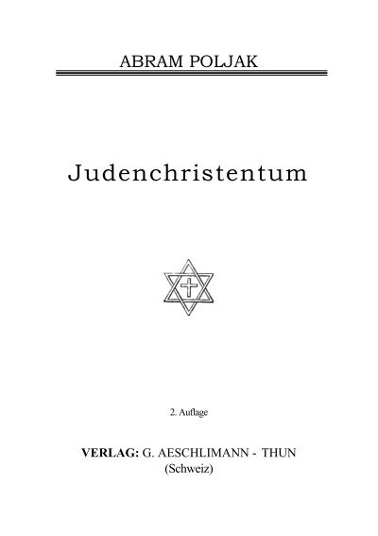
Publications
1936
1936
1937
Jewish Christians in the Holy Land
The Jewish Christian Community
The Cross in the Star of David

Slide 18
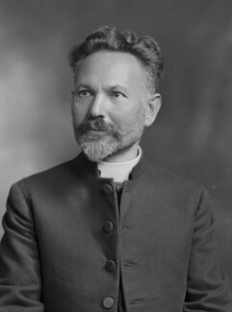
Paul Levertoff
1878-1954
Born in Belarus into Hassidic family
Studied in Yeshiva in Waloshyn
After coming to saving faith, studied theology in Russia and Germany
Taught at Institutum Judaicum Delitzschianum in Leipzig
1918 – moved to London
Became priest in Anglican Church where he was active in the outreach to the Jewish people

Slide 19
Levertoff’s Mission
“Levertoff rescued the Jewish Christian idea by uniting it to an ancient Christian tradition and placing it within the ordered forms of a securely founded church… Levertoff had a historic task to fulfill. He could go no other way. He thus showed a twofold courage: courage in the face of the Christians in erecting a synagogue within the church and courage in the face of the Jews by setting up his synagogue with the church.”
-Abram Poljak

Slide 20
Return to Palestine
1940-1944
After the War
Definition of “Jewish Christian”
Imprisoned on the Isle of Man and in Canada
Return to Palestine
Reconnected with ben Meir
“[I am] a Jewish Christian,” … “Why do you emphasize ‘Jewish’?” … ‘First of all because there are English, German, and Russian Christians, and second because I assume from your question that you make a difference between Jews and Christians. If you had asked me whether I am a German, I would have said simply ‘no’, because I’m not a German but a Jew. Here, there is actually a national difference. But if you make a difference between Jews and Christians, the way I understand things I cannot accept a radical division and must answer as my conscience demands… My Christianity is also a Jewish duty.”

Slide 21
Operation Mercy
“He who believes does not flee!” Stay in the land! Close ranks! Let us serve one another! If we must go hungry, let us be hungry together, and if we must die, we will die together. There is no fairer death than that on the way of faith in the Holy land. Let us give thanks to God that he has given us an opportunity to prove our faith, our sincerity and faithfulness and to glorify the name of Christ in Israel—in the hour of need!
- Abram Poljak

Slide 22
Poljak’s Interpretation of the Shoah - 1
Our belief that Hitler is merely a tool of Satan leaves the question unanswered. Instead, we should direct the question toward God. The “tools of Satan” and Satan himself are ultimately dependent upon God. Nothing in the heavens, in hell, or on earth happens without God’s knowledge and permission. So also, Hitler is, in the final analysis, like Nebuchadnezzar, “a servant of God” (Jeremiah 27:6), a scourge in the hand of God.

Slide 23
Poljak’s Interpretation of the Shoah - 2
His war against Judaism and Christianity has been decreed. If we find ourselves in the hands of Satan, it is not God, but our sins that have driven us there. God does not create these clouds of misfortune; we do. We bring down punishment, and punishment comes to correct us from walking the wrong paths…

Slide 24
Poljak’s Interpretation of the Shoah - 3
The crooked path is assimilation, the desire of the Jewish people to no longer be Jews, but to be reckoned as Germans. The Jews and Germany are not suffering today because they are bad Germans, as the Nazis maintain, but because they were too good at being Germans. In reality, the assimilated Jews have sacrificed everything for Germany, even truth itself and their own honor…

Slide 25
Poljak’s Interpretation of the Shoah - 4
They even took German names for themselves. And as if that were not enough for them, they were baptized and changed to own family names. So it was that a Kohen became a Mr. Karsten, and a Levy became a Mr. Ley. Instead of the Hanukkiah, they took a Christmas tree. The assimilated Jews wanted to forget Jerusalem completely. However, “If I forget you, O Jerusalem, may my right hand forget her skill” (Psalm 137:5).
And they forgot!

Slide 26
My Conclusion Regarding this Interpretation
Having studied under Dr. Fruchtenbaum, I personally believe that the Holocaust was permitted by God and was ultimately the result of Israel’s rejection of Yeshua’s Messiahship. However, Poljak presents a portion of this teaching and then attributes the Holocaust to the assimilation of Jews into European societies. I do not agree with this conclusion.

Slide 27
Poljak’s View of Hitler
In 1949, Poljak wrote Hitler as General and Spiritist.
Demonic influences on Hitler
Demon by the name of “Blessing Bringer”

Slide 28
Poljak’s Eschatology
Poljak was driven by a clear eschatology and believed that the rise of the Messianic movement was an indication of Yeshua’s imminent return:
“We also are signs of the times, pointing to Messiah in an era far away from Messiah. Therein lies our calling, the assignment of the Messianic Jewish community—the huge task of a small community.”

Slide 29
Conclusion
We at Ariel Ministries appreciate Poljak’s credo.
We further appreciate Poljak’s zeal to reach the Jewish people with the gospel without forcing them to give up their Jewish identity.
We see the passion with which Poljak loved his Savior, the King of the Jews, and we concur with him that the return of Yeshua is imminent.
But most of all, we so appreciate that there was a Jewish believer who saw the danger his people faced in Nazi Germany and tried to save some of them.

Slide 30
Selected Bibliography
Abram Poljak, Bram – The Life and Wisdom of Messianic Jewish Pioneer Abram Poljak in His Own Words (Marshfield, MO: Vine of David, 1976)
Abram Poljak, Hitler – Warlord and Spiritualist (Marshfield, MO: Vine of David, 2019)
Nathanael Riemer, “Messianische Juden und ihr Beitrag zu deutsch-jüdischen und deutsch-israelischen Begegnungen,” Juden und Nichtjuden nach der Shoah: Begegnungen in Deutschland, edited by Stefanie Fischer, Nathanael Riemer, and Stefanie Schüler-Springorum (Berlin, Boston: De Gruyter Oldenbourg, 2019), pp. 167-194.
Gershon Nerel, “Creeds among Jewish Believers in Yeshua between the World Wars,” Mishkan, 34 (2001), pp. 61-80.
Jorge Quiñónez, “Paul Phillip Levertoff: Pioneering Hebrew-Christian Scholar and Leader,” Mishkan, 37 (2002), pp. 21-34.

Slide 31
Thank you
Christiane Jurik
editorarielministries@gmail.com
www.ariel.org

