Slide 1
The Missing Link/Factor in Jewish Evangelism
Dr. Amy Downey – Tzedakah Ministries

Slide 2
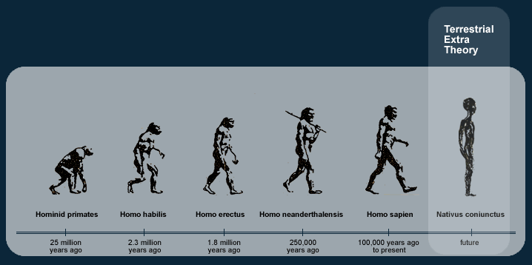
Whoa … Missing Link?... Are We About to Go All Evolutionary Here?
This Photo by Unknown Author is licensed under CC BY-SA

Slide 3
“Imaginary” Answers from LCJE Members & Participants…
Greater cooperation among the local churches and Jewish evangelism organizations/congregations
Greater independence and self-reliance for organizations/congregations from traditional churches

Slide 4
“Imaginary” Answers from LCJE Members & Participants…
Cautionary word for those who advocate greater “Talmudic-observance” as it does not make us relevant to Jewish society
Return to a greater reliance on “Talmudic-observance” as it will create a kinship with those within Jewish society

Slide 5
“Imaginary” Answers from LCJE Members & Participants…
Have Rob Styler take his Second Adam presentations to the street in the form of “Mime-Guerilla-Style Jewish Evangelism” outreaches

Slide 6
Downey’s Answer/ Opinion … Which I Really Like (and so does my mom!)
The one course never covered in seminary or missiology courses
The one issue that genetics or experience can never compensate for adequately

Slide 7
What is Sociology in this Context?
Is it simply the “study of human communities”? (Oxford Biblical Studies Online)
This Photo by Unknown Author is licensed under CC BY-NC-ND

Slide 8
Is it just simply “the systematic study of the development, structure, interaction, & collective behavior of organized groups of human beings” (Webster’s Dictionary)
This Photo by Unknown Author is licensed under CC BY-NC-ND

Slide 9
Or Is Sociology in a Missiological Context More? And if so … what could it could teach us in the Jewish Evangelism world?

Slide 10
Emile Durkheim’s 19th Century Definition of Jewish Society
“a small society, compact and cohesive, with a very keen self-consciousness and sense of unity” – Suicide (1897)
This Photo by Unknown Author is licensed under CC BY

Slide 11
Aaron J. Hahn Tapper’s 21st Century Definition of Jewish Society
“Are Jews best described as a religion, culture, ethnicity, nation, race, political orientation, or something else? And are Jews the only community that can be understood as an example of all of these categories at the same time?” – Judaisms (2016)

Slide 12
Theological Definition for Sociology (important for Jewish Evangelism)…
[Christian or] Theistic sociology is based on the belief that God created the world and gave instructions regarding the proper order of society based on his purposes. There is a way things ought to be, and it is up to believers to discern that right way based on the revelation of God. [We] are tasked to try and order [our evangelistic outreaches] based on that revelation. Theistic belief systems tend to organize around the traditional family, [community, and the state]. – Adapted from Freddy Davis (MarketFaith Ministries)
NOTE: words in brackets have been added by Downey to add emphasis to the Jewish missiological context.

Slide 13
KEY Sociological & Missiological Factors in Jewish Evangelism
Family…
Community…
Politics…

Slide 14
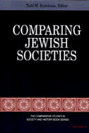
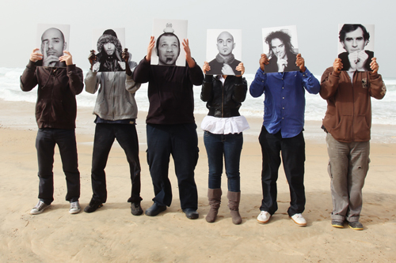
Do We Really Understand the Definitions of Jewish Sociology and Society?
This Photo by Unknown Author is licensed under CC BY-NC-ND

Slide 15
Defining Jewish Sociology of Religion for Missiology…
Ultra-Orthodox
Modern Orthodox
Open Orthodox
Traditional Orthodox
Conservadox
Conservative
Bridgers between Conservative/Reform
Reform (HUC-Cincinnati)
Reform (HUC-NYC)
The Reconstructing
Humanistic
Jewish Renewal Movement
Secular/Agnostic/Atheist
Messianic/Christian

Slide 16
Defining Jewish Cultural Sociology for Missiology…
Ashkenazi
Sephardic
Ladino
Israeli/Sabra
Arabic/Iraqi/Kurdish/ Persian/Yemeni/ Egyptian
Beta Israel of Ethiopia
Asian Communities – India and China
… and how do we respond to all the “lost tribes” in Africa?

Slide 17
Defining Jewish Emotional Sociology for Missiology…
Holocaust Survivor Guilt/Issues
Generational Differences
Israeli vs. United States Perspectives
Family Differences
Interfaith Marriage “Baggage” – The “Who Is A Jew?” Question
Old-School Zionism vs. Social Justice for Millennials
The Palestinian Question… Politics

Slide 18
Montgomery’s Sociological Steps for More Effective Missions
Social structures, roles, status
Socialization
Social relationships
Social movements
Intersocietal Relationships
Self- and Social Identity
Socio-cultural changes
“Can Missiology Incorporate More of the Social Sciences” – Missiology: An International Review (July 2012)

Slide 19
Example: Hasidic Understanding of the Word “Faith”
“… basis for Hasidic cultural beliefs about questioning and authority. [Faith] requires that each Jew practice Orthodox Judaism despite any individual feeling to the contrary.” – Ayala Feder, Mitzvah Girls (2009)
This Photo by Unknown Author is licensed under CC BY-SA

Slide 20
How Should All of This Information Impact the Sociological Construct of Jewish Evangelism?
This Photo by Unknown Author is licensed under CC BY-SA

Slide 21
Is It Time We Finally Answered Some Sociological Questions About Ourselves?
Missiological Question
Practical Question
WHAT IS OUR OVERARCHING PURPOSE AND CALLING TO THE WORLD?
HAVE WE IDENTIFIED OURSELVES TO THE CHRISTIAN WORLD?

Slide 22
Missiologically – What is Our Overarching Purpose and Calling to the World?
Are we seeking Jewish people to become Messianic Jews?
Are we seeking Jewish people to become believers in Jesus the Jewish Messiah?
What is our symbol to the world?

Slide 23
Definition of Symbol by Newton B. Fowler
“Shared symbols and meanings are essential for a cohesion of any society, political or religious… A shared symbol which provides self-consciousness for a people needs to be general enough to allow for a variety of specific interpretations.”
This Photo by Unknown Author is licensed under CC BY-SA

Slide 24
Practically – Have We Truly Identified Ourselves to the Christian World?
Question #1 – Does YOUR Jewish Evangelism world consider yourselves to be a part or apart from the Christian world? Corporately, Individually, Congregationally?

Slide 25
Practically – Have We Truly Identified Ourselves to the Christian World?
Question #2 – How does your answer to Question #1 impact your interaction with the Christian World? Are you John Donne or Daniel Defoe in your interaction with the Christian community?

Slide 26
Practically – Have We Truly Identified Ourselves to the Christian World?
Question #3 – Can the world of Jewish Evangelism reach the Jewish world without Christian communities and churches? If so, how? If so, where? If so, when? If so, with what?

Slide 27
Conclusion … We Must Begin to Truly Grapple with These Sociological Q/A’s
The Christian World is asking these questions of us as we are sending conflicting messages…
The Jewish World is asking these questions as we are failing to ID ourselves….
This Photo by Unknown Author is licensed under CC BY-SA

Slide 28
Theological Definition for Sociology (important for Jewish Evangelism)…
[Christian or] Theistic sociology is based on the belief that God created the world and gave instructions regarding the proper order of society based on his purposes. There is a way things ought to be, and it is up to believers to discern that right way based on the revelation of God. [We] are tasked to try and order [our evangelistic outreaches] based on that revelation. Theistic belief systems tend to organize around the traditional family, [community, and the state]. – Adapted from Freddy Davis (MarketFaith Ministries)
NOTE: words in brackets have been added by Downey to add emphasis to the Jewish missiological context.

