Slide 1
& Bonding in the Midst of Controversy
Curated by Susan Perlman

Slide 2
Lausanne 1974

Slide 3
Lausanne 1974

Slide 4
“World evangelization requires the whole Church taking the whole message to the whole world.”

Slide 5
Pattaya, Thailand

Slide 6
COWE – Pattaya 1980

Slide 7
David Harley

Slide 8
LCJE in Progress

Slide 9
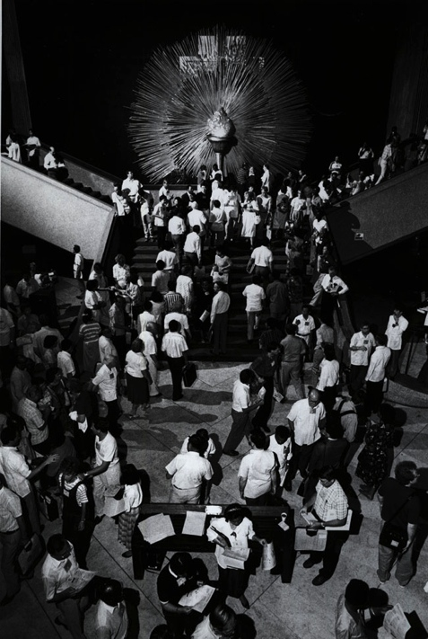
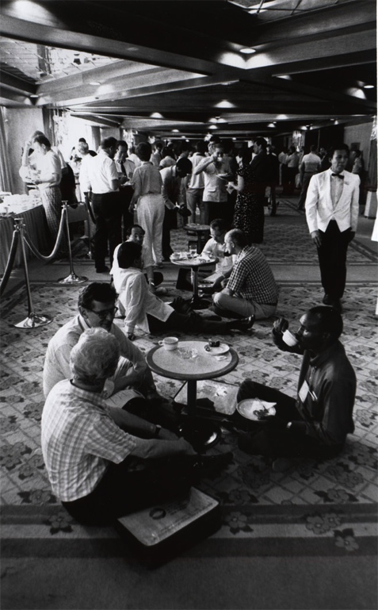
Manila 1989

Slide 10
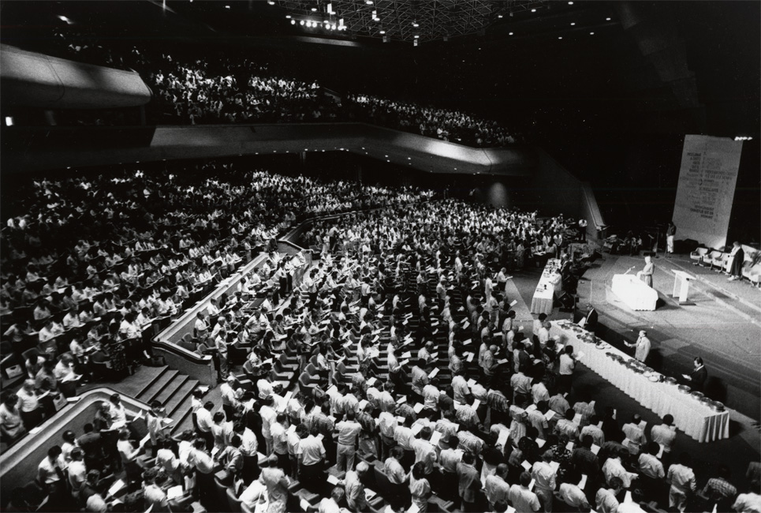
Manila 1989

Slide 11
Manila 1989

Slide 12
Doug Birdsall

Slide 14
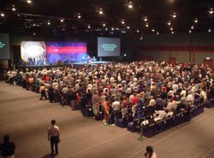
Forums – Pattaya 2004

Slide 15
Lake Balaton - 2007

Slide 16
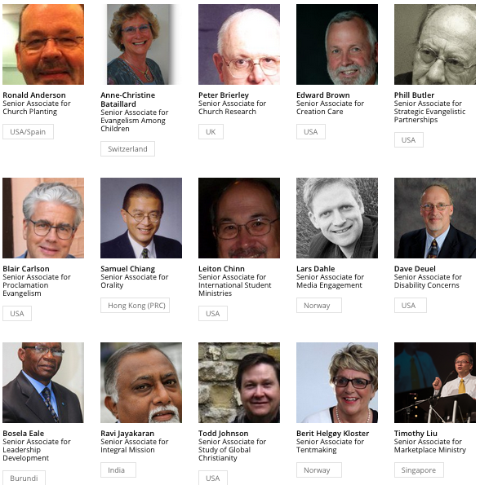
Senior Associates

Slide 17
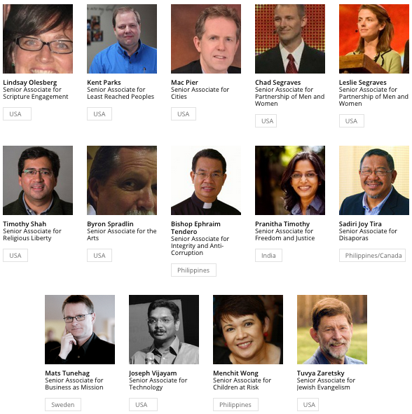
Senior Associates

Slide 18
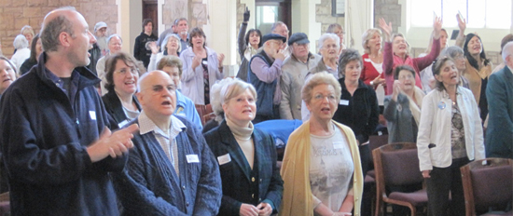
LCWE – Cape Town, South Africa

Slide 19
Dan Sered & Shadia Qubti

Slide 20
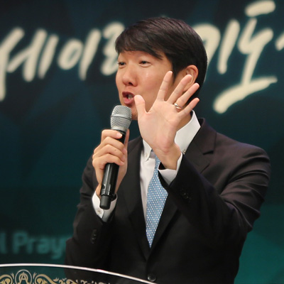
Michael Oh

Slide 21
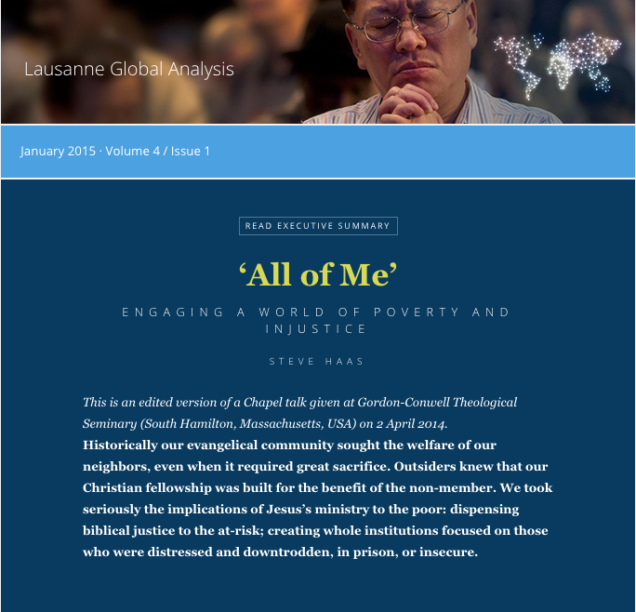
Lausanne Global Analysis

Slide 22
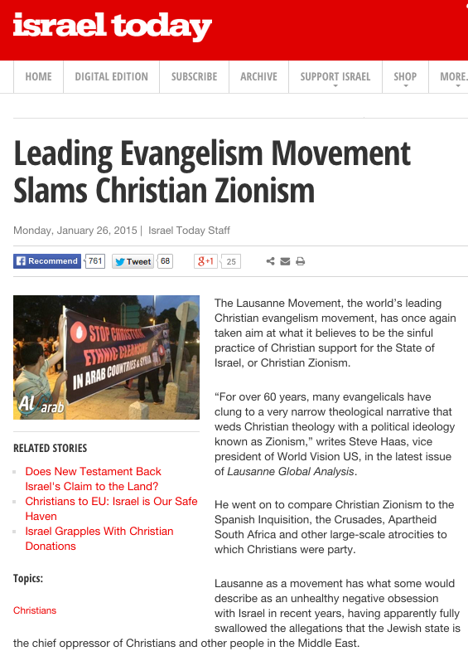
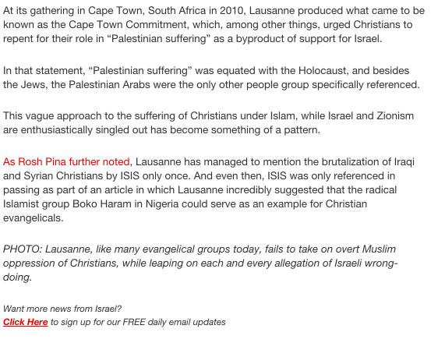
Israel Today – Haas Response
Israel Today Article
Breaking Israel News Article

Slide 23
Lessons Learned
1. Those of us in LCJE need to be clear in our understanding of the nature of the Lausanne Movement.

Slide 24
Lessons Learned
2. Having history is important.

Slide 25
Lessons Learned
3. Taking a proper course of action is paramount.
A. Public attacks need a public response.
B. We need to reach out to those who are in a position to respond.
C. We need to pull together the best strategic advice possible in such situations

Slide 26
Lessons Learned
4. Reflecting on the future, how we can help avoid such situations?

Slide 27
Lessons Learned
5. We need to be encouraged the the Lausanne Movement does believe that the issue of Israeli and Palestinian reconciliation is important.

