Slide 1
Johanna Cartwright & Elizabeth Finn:
Women who helped shape the modern zionist movement
Lcje na April 17, 2018

Slide 2
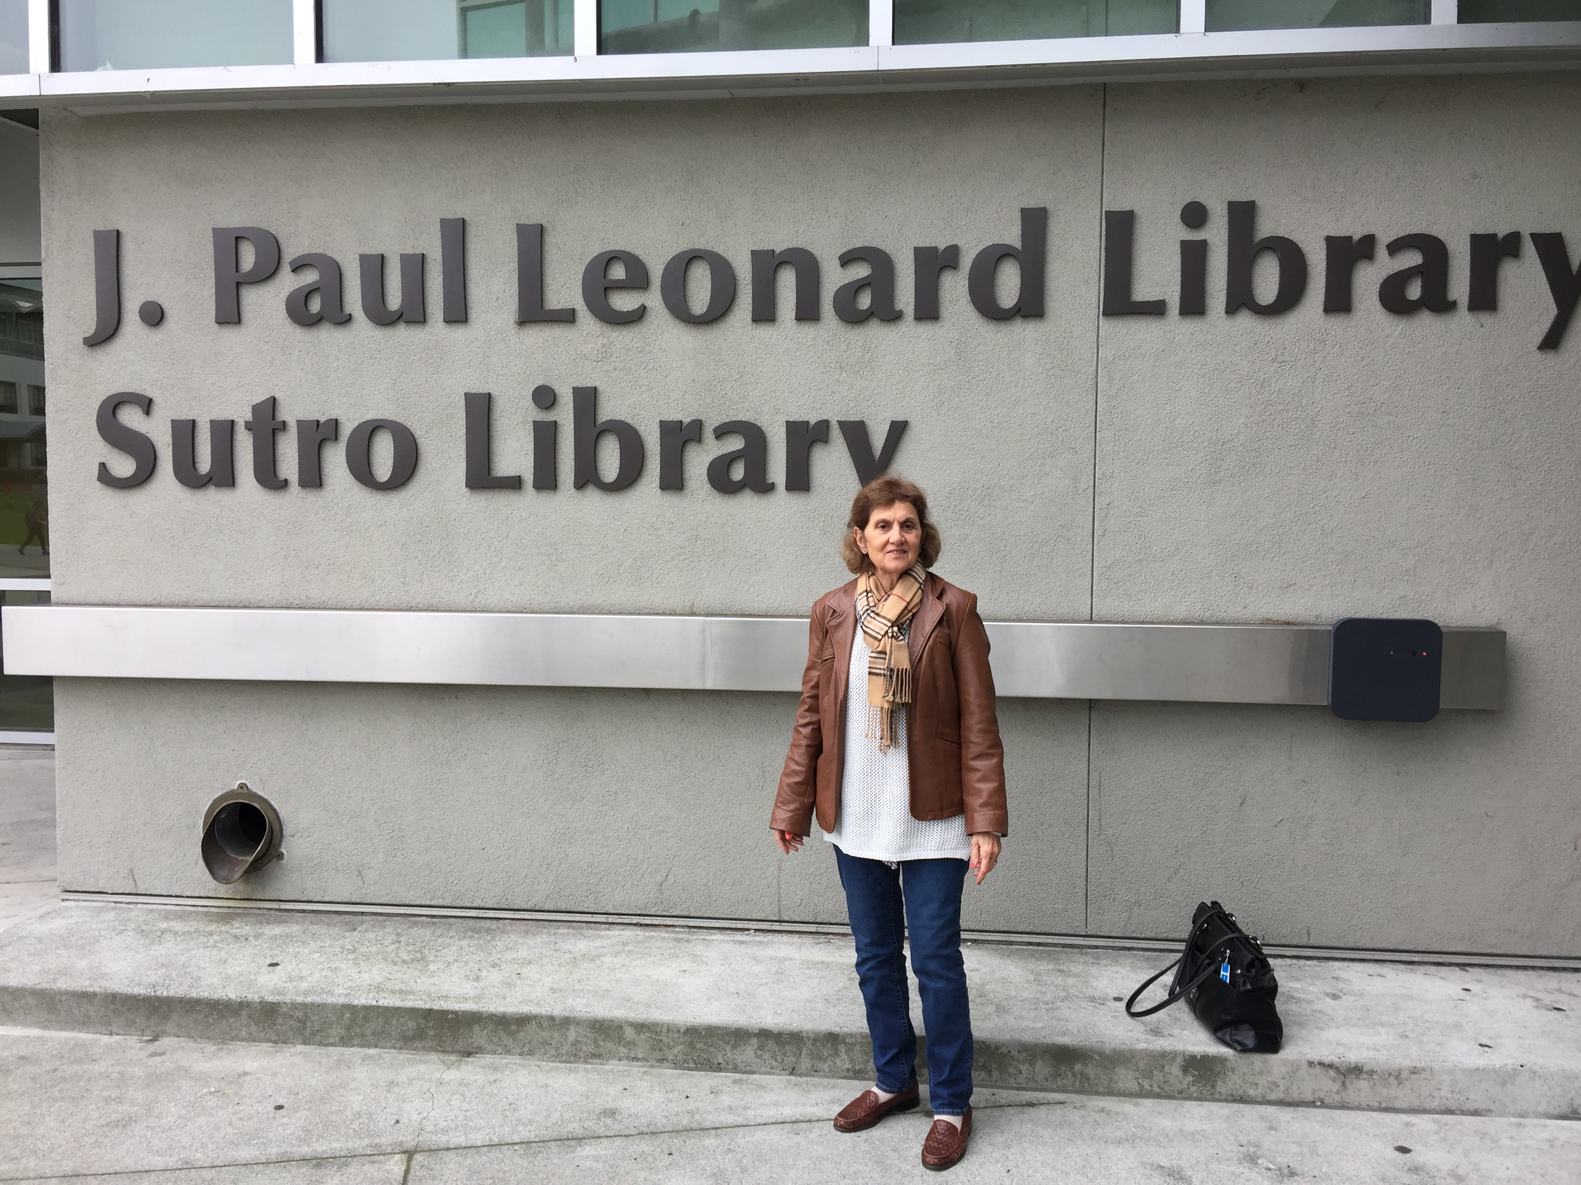
It started with jim melnick!

Slide 3
Johanna and the Puritans

Slide 4
OLIVER CROMWELL
War council – january 1649

Slide 5
England and the jews - 1290-1665

Slide 6
Cartwright Petition Demands
Readmission of the Jews into england
The “transport of Israells Sons & daughters in english and dutch ships to the land promised to their fore-fathers, abraham, isaac, and jacob, for an everlasting inheritance”
That in coming to england “they, together with us, shall come to know the emanuell, the lord of life, light, and glory”

Slide 7
Elizabeth anne mccaul finn

Slide 8
Biography
Born in warsaw in 1825; died in england 1921
Daughter of alexander mccaul, cmj missionary
Married james finn, 2nd british consul to jerusalem 1846-63
Writer, philantropist, linguist, zionist, photographer
Founder of agricultural training farm for jews of jerusalem
Founder of ”sarah Society” to aid poor jewish women in jerusalem

Slide 9
The dream comes true

Slide 10
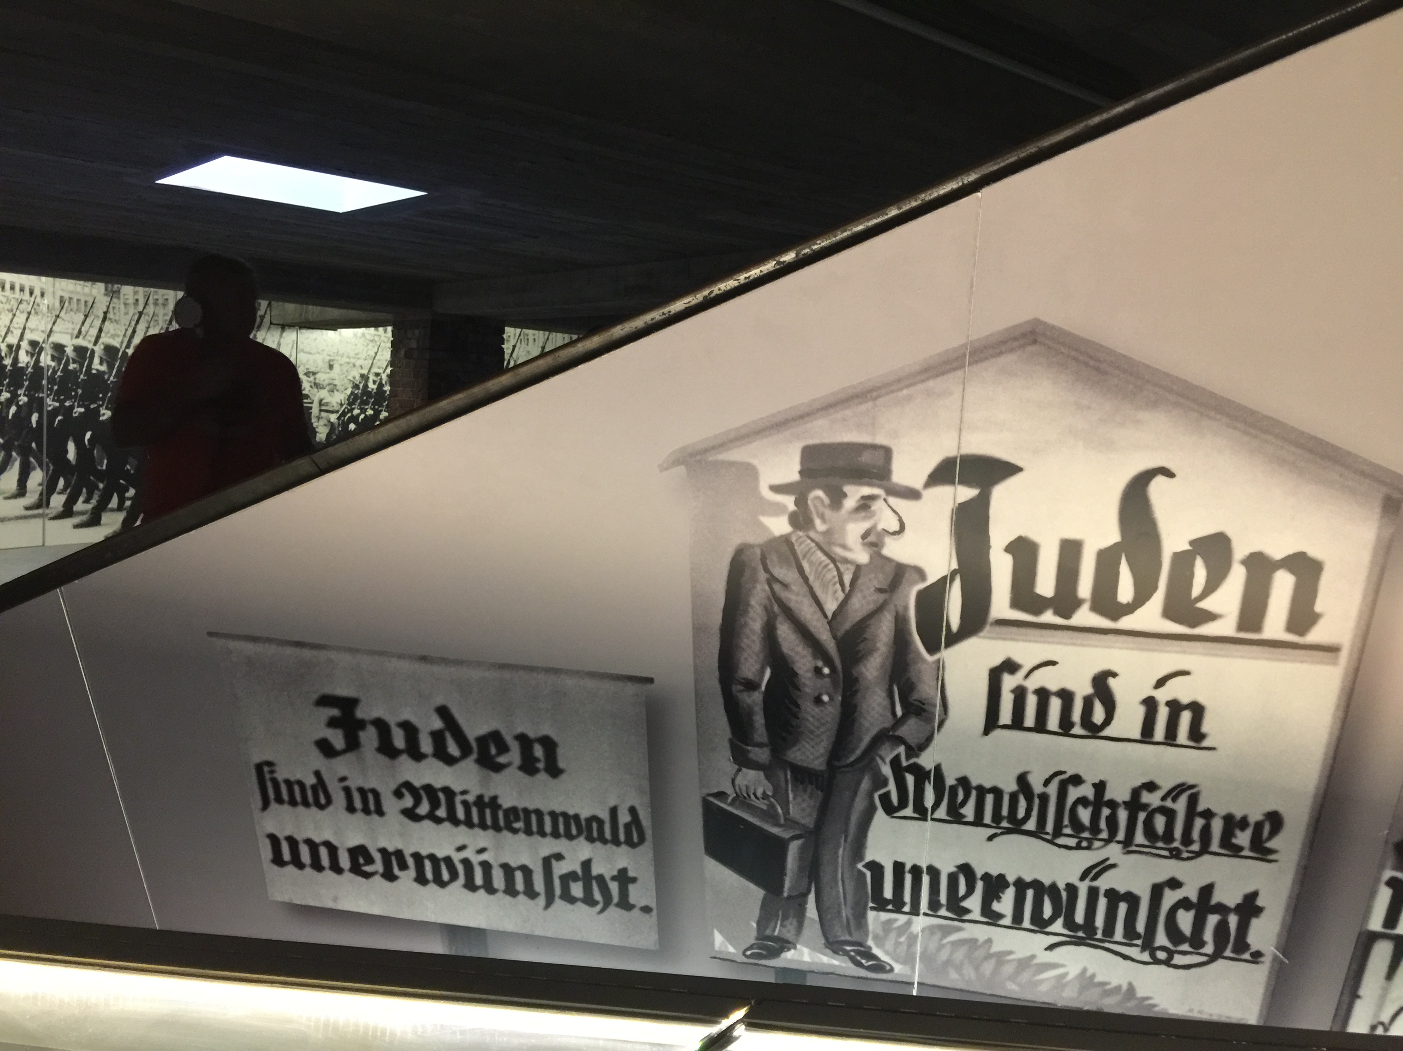
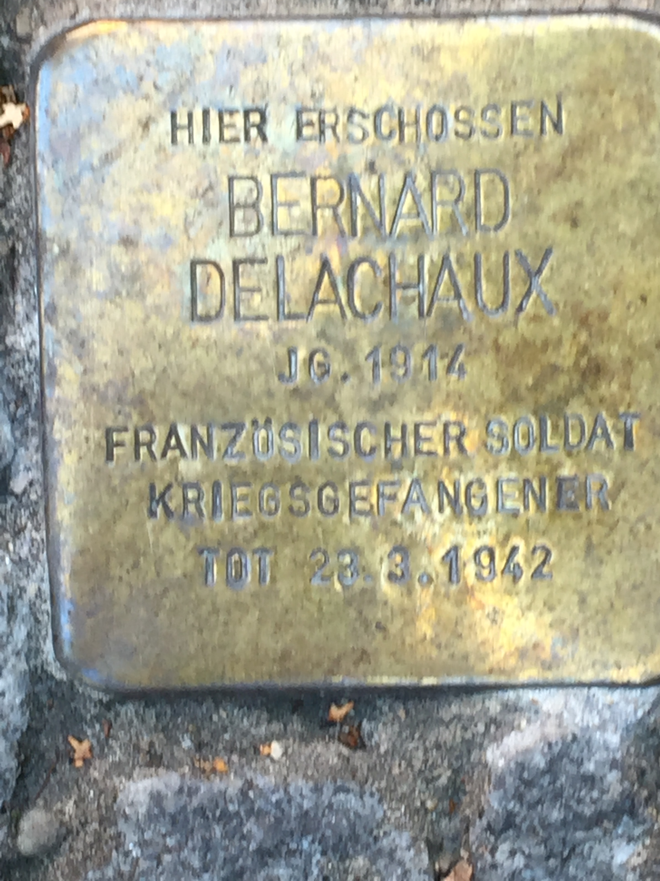
Am yisrael chai!

